Slide 1
McCamant Lab Foundational Papers

Slide 2
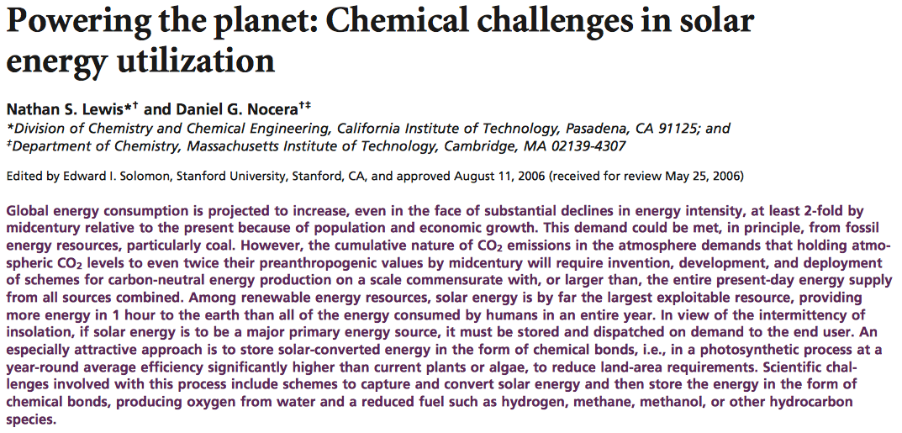
READ
Lewis, N. S. and Nocera, D. G. "Powering the Planet: Chemical Challenges in Solar Energy Utilization" Proc. Natl. Acad. Sci. 2006, 103, 15729-15735
Notes:
Among renewable energy resources, solar energy is by far the largest exploitable resource, providing more energy in 1 hour to the earth than all of the energy consumed by humans in an entire year.

Slide 3
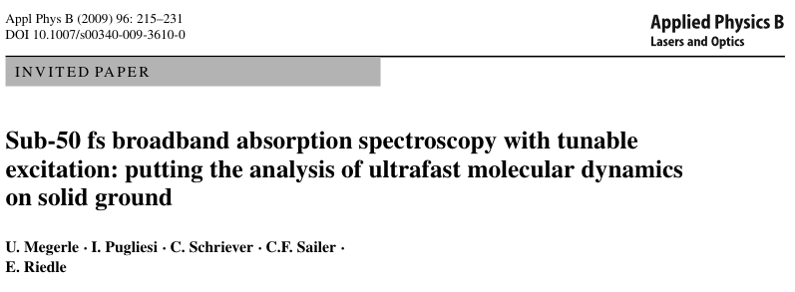
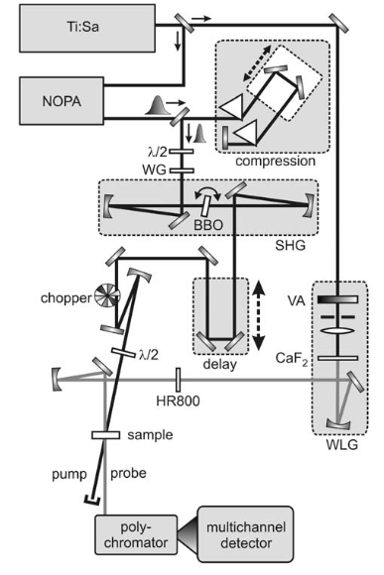
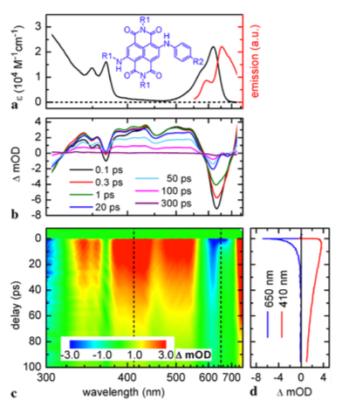
READ

Slide 4
READ
Notes:
It is clear that an optimized sensitizer will need to balance T1 yield and T1 lifetime in order to maximize its ability to inject electrons into TiO2 and minimize photo- damage occurring from the corresponding triplet or radical anion states.

Slide 5
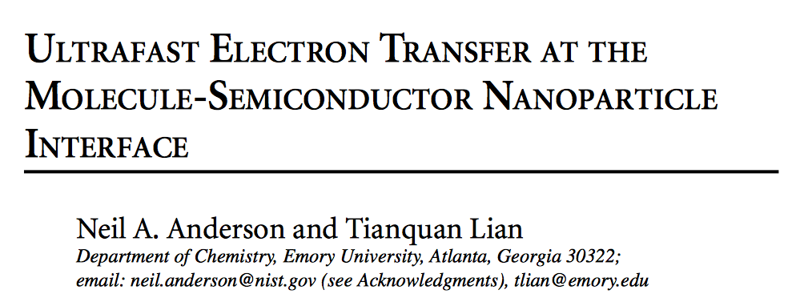
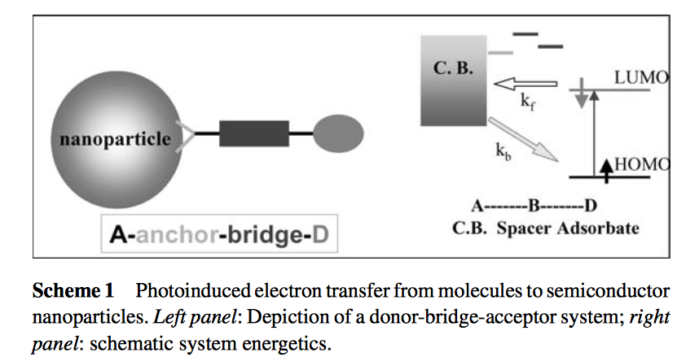
READ
Notes:
This review summarizes recent progress in understanding electron transfer dynamics from molecular adsorbates to semicon- ductor nanoparticles. Photoexcitation of molecular adsorbates to their excited states is followed by electron injection into semiconductor nanoparticles.

Slide 6
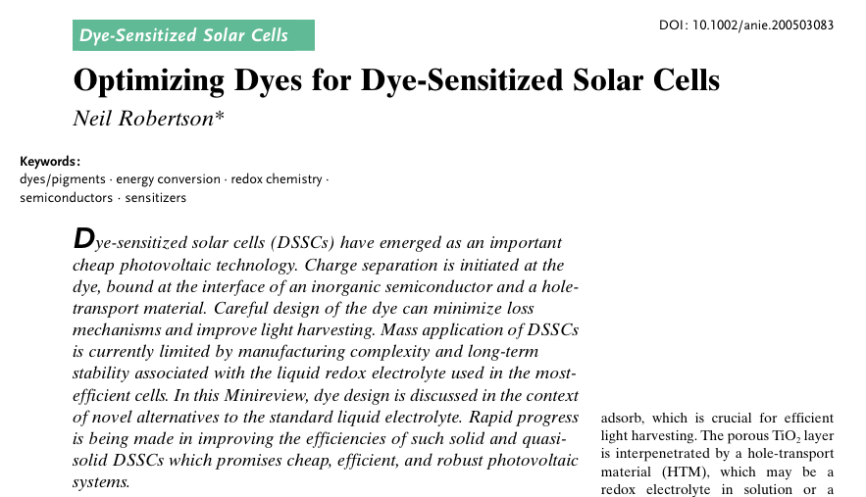
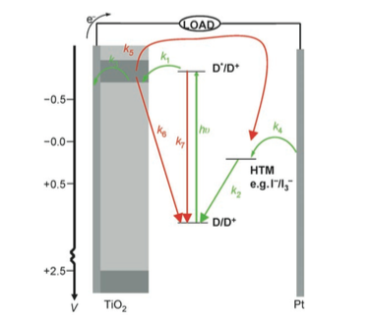
READ
Notes:
Enhanced Charge Separation in the Dye: Minimizing Charge Recombination
Methods to Attach the Dye to TiO2
HydrophobicDyes
Extending the Spectral Coverage of Dyes
Enhancing Molar Extinction Coefficients

Slide 7
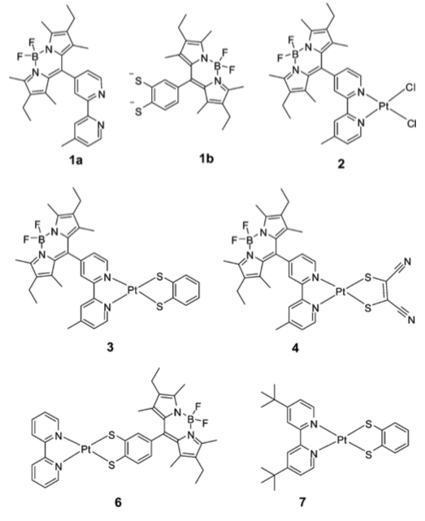
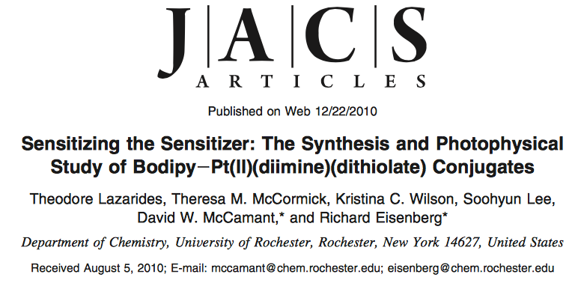
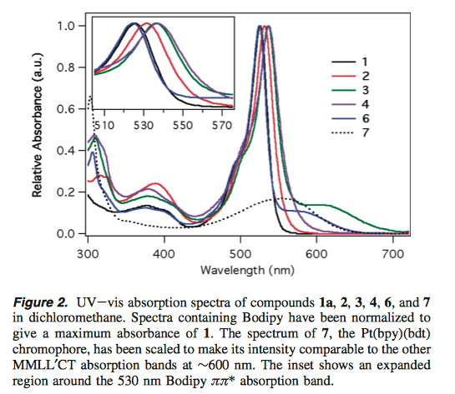
READ
Lazarides, T., McCormick, T. M., Wilson, K. C., Lee, S., McCamant, D. W. and Eisenberg, R. "Sensitizing the Sensitizer: The Synthesis and Photophysical Study of Bodipy−Pt(Ii)(Diimine)(Dithiolate) Conjugates" J. Am. Chem. Soc. 2010, 133, 350-364
Notes:
Sensitizing the charge-transfer state of the Pt(bpy)(bdt)-type chromophore as a method to increase light absorption for use in light-harvesting systems is an attractive proposition.

Slide 8
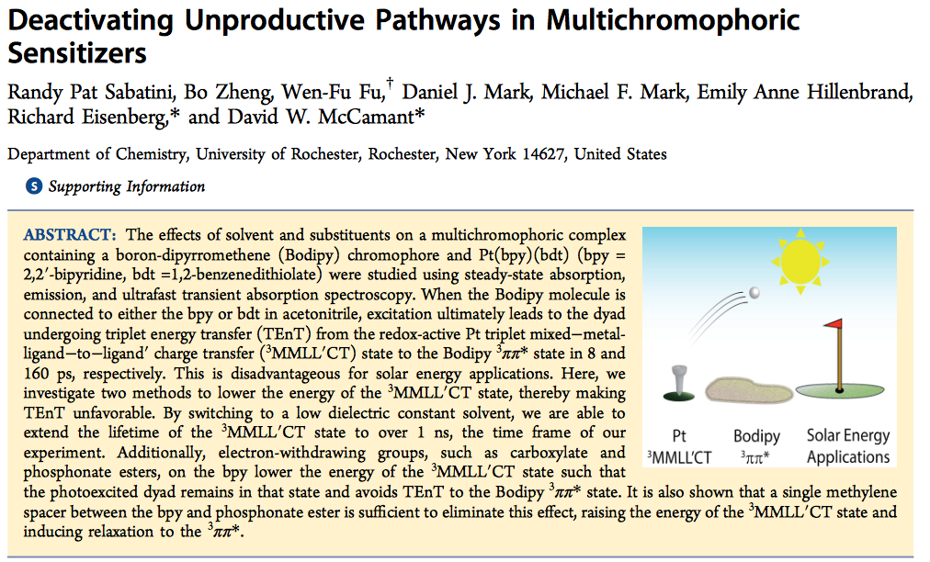
READ
Sabatini, R. P., Zheng, B., Fu, W.-F., Mark, D. J., Mark, M. F., Hillenbrand, E. A., Eisenberg, R. and McCamant, D. W. "Deactivating Unproductive Pathways in Multichromophoric Sensitizers" J. Phys. Chem. A 2014, 118, 10663-10672
Notes:
The effects of solvent environment and electron-withdrawing substituents were studied in two Bodipy−Pt(diimine)- (dithiolate) multichromophoric species. The lowest-energy state of the dyad is usually the 3ππ* state of the Bodipy moiety. When the Bodipy chromophore is attached to either bpy or bdt, excitation ultimately leads to population of this state in under 200 ps. This is disadvantageous in terms of solar energy applications as the Pt moiety’s charge-transfer state can facilitate necessary electron transfer.

Slide 9
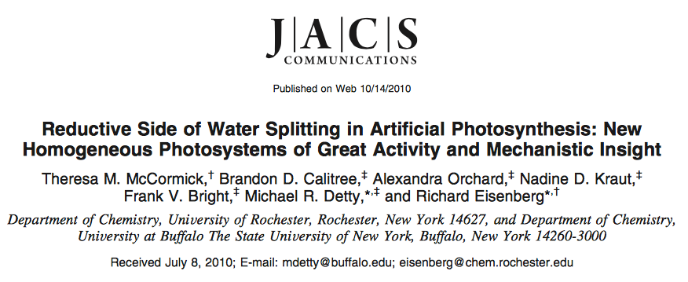
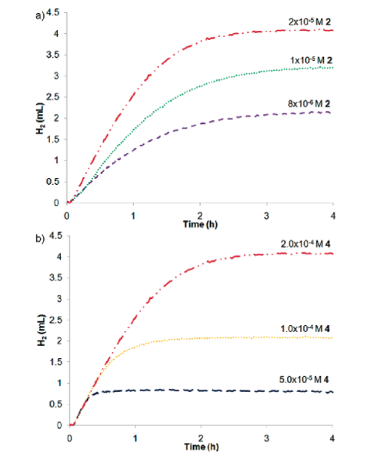
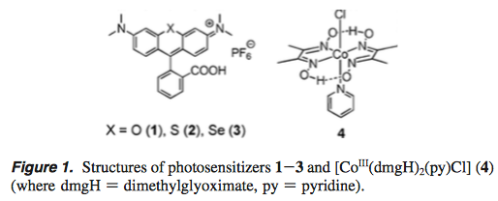
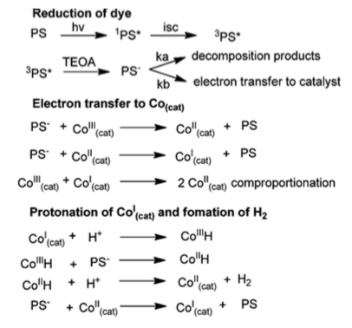
READ

