Slide 1
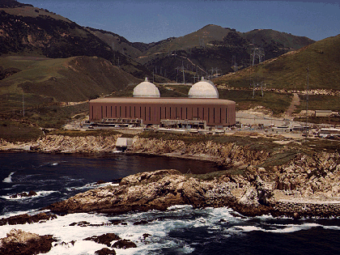
Power from Nuclear Transmutation
(Fission and Fusion)
The Diablo Canyon NPPT produced CO₂-free electricity at 2¢/kwh, half the state’s (CA) average cost.
Notes:
Georgia Power announced this week that the 1,114-megawatt (MW) Unit 4 nuclear power reactor at Plant Vogtle near Waynesboro, Georgia, entered into commercial operation after connecting to the power grid in March 2024. The commercial start of Unit 4 completes the 11-year expansion project at Plant Vogtle. No nuclear reactors are under construction now in the United States.
Vogtle Unit 3 began commercial operation in July 2023. The plant’s first two reactors, with a combined 2,430 MW of nameplate capacity, began operations in 1987 and 1989. The two new reactors bring Plant Vogtle’s total generating capacity to nearly 5 gigawatts (GW), surpassing the 4,210-MW Palo Verde plant in Arizona and making Vogtle’s four units the largest nuclear power plant in the United States.

Slide 2
Agenda
Nuclear stability & particle radiation
Potential biological hazards
Energy Generation from Nuclear Fission
U.S./World trends,
Nuclear fuel resources (U.S.),
  Fission chain reaction and reactor control,
  Reactor types,
  Fuel cycles, radioactive waste & storage.
New Nukes: Advanced Nuclear Energy Technologies
  Small modular plants,
  Advanced (Gen IV) reactors,
  U & Th breeder reactors, subcritical reactors,
  Closed fuel cycle,
  Non-fission applications: Radioisotope Thermoelectric Generators (RTG)
Energy from nuclear fusion reactions
Fusion energetics, critical
Principles of magnetic and inertial confinement
Strategic Issues for Nuclear Power
Sustainability, reliability, scalability, safety, eco-footprint, cost

Slide 3
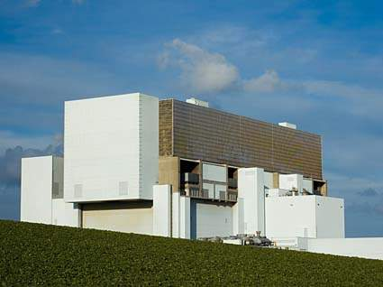
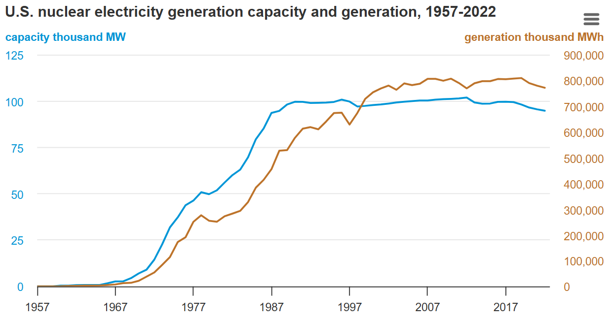

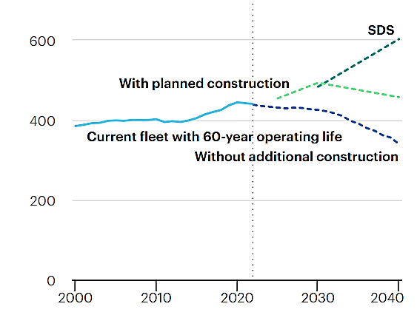
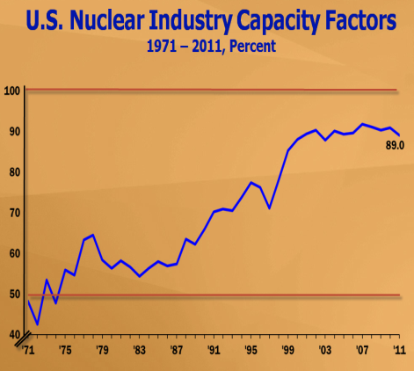
U.S./World Trends in Nuclear Energy Production
Steady increase of nuclear power output over 30y. Efficiency ε ↗
Now: ε ≧ 90% → equivalent: 24 quads of oil. NPP lifetime 40a → > 60a
World 2023 (US): 440 (92) reactors; 400 (100) GW, 2.5 PWh → Modernize !
World Trend
>53 new NPPt
→2050: 600GW ?
US(since 2012):
+3 -6
> 20 planned (?)
license app
US potential:
1.Extend plant lifetime,
2.N new reactors/a
(@ $(3-4)B/GW_{e} → (5-10)¢/kWh)
Several new companies → SMR, Na-cooled
Microreactors
Fusion Demos
GW
GW
Most recent
Notes:
With a total installed capacity of about 97 GW, the largest commercial nuclear generating fleet of any country is located in the United States. The fleet of operating nuclear power reactors accounted for nearly 19% of domestic electricity production in 2023, making nuclear the second-largest source of U.S. electricity generation after natural gas, which accounted for 43% of electricity generation in the United States last year.
***In 2019 globally 5.5 GW of additional nuclear capacity were connected to the grid and 9.4 GW were permanently shut down, bringing global capacity to 443 GW. New projects were launched (about 5.2 GW), and refurbishments are under way in many countries to ensure the long-term operations of the existing fleet. Nevertheless, while the existing nuclear fleet remains the world’s second most important low-carbon source of electricity, new nuclear construction is not on track with the SDS. According to current trends, nuclear capacity in 2040 will amount to 455 GW – well below the SDS level of 601 GW. Additional lifetime extensions and a doubling of the annual rate of capacity additions are therefore required.
Georgia Power Co. announced Monday that Unit 3 at Plant Vogtle, southeast of Augusta, has completed testing and is now in commercial operation, seven years late and $17 billion over budget. First new reactor built from scratch.
At its full output of 1,100 megawatts of electricity, Unit 3 can power 500,000 homes and businesses. A number of other utilities in Georgia, Florida and Alabama are receiving the electricity, in addition to the 2.7 million customers of Southern Co. subsidiary Georgia Power.
South Carolina Electric & Gas Co. and state-owned utility Santee Cooper spent more than $9 billion before abandoning construction on the reactors at the V.C. Summer Nuclear Station near Columbia last year. State and federal authorities are probing the failure, and irate customers and shareholders have filed lawsuits.

Slide 4
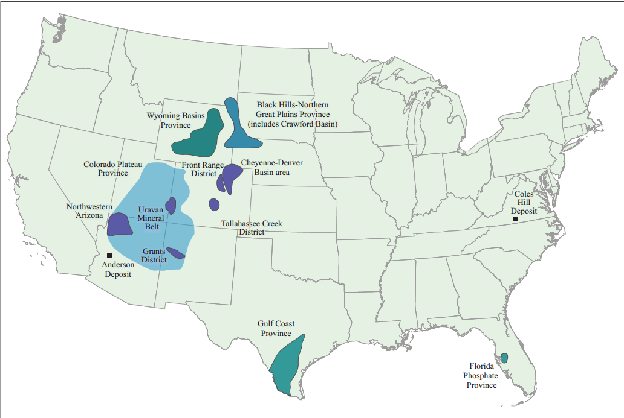
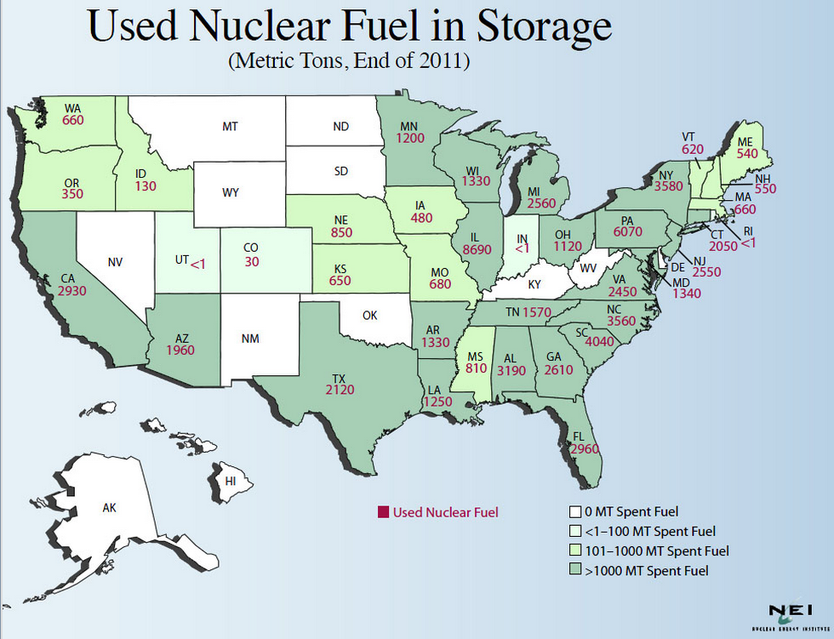
U.S. Uranium Resources/Used Fuel Elements
Used fuel elements in NP stations is U enriched in U-235. Used fuel elements: < 3 % U-235, > 95% U-238= fertile fuel for breeding.
Future small modular ppt,
U, Th breeder reactors,
Nuclear Magnetic Confinement fusion demos.
1GWe nuclear reactor requires yearly core load of (17.5-20) t low-enriched uranium U₃O₈
(3.5 - 5)% U-235, > 95% U-238

Slide 5
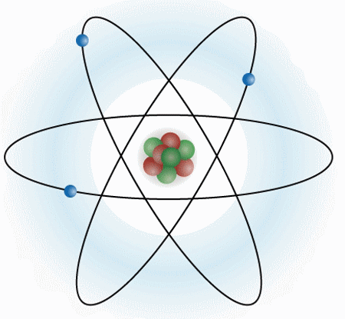
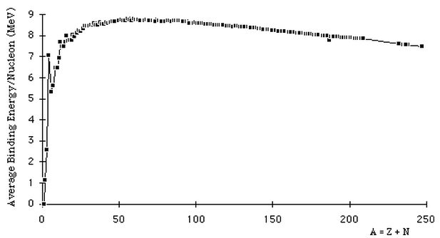
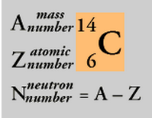
Basic Nuclear Properties
Atom of element Z: Z negatively charged electrons orbit around a Z-times positively charged, small nucleus in center of atom.
Nucleus= (Z protons, N neutrons), mass number A = N+Z
Nuclear radii range from R_{Nucleus} ≈(1-10)·10⁻¹⁵m. (1 fm= 10⁻¹⁵m)
Nuclear radius R_{Nucleus} « R_{Atom} atomic radius ( 1Å=10⁻¹⁰ m)
Nuclear mass m_{A} < N·m_{neutron} + Z·m_{proton} →
Δm·c² = binding energy B >0.
Classical Model of Atom
Mean Specific Nuclear Binding Energy B/A
Isotope Terminology
Fe, Ni
Nuclear mass unit: u := 931.5 MeV/c²
m_{proton} =1.00728 u, m_{neutron}= 1.00866 u
m_{neutron} > m_{proton}
¹²C =stable isotope
>>>¹⁴C or C-14<<<
=radioactive isotope

Slide 6

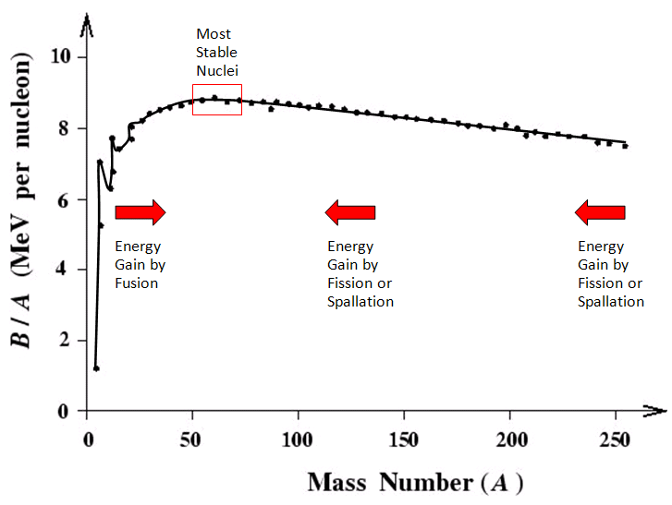
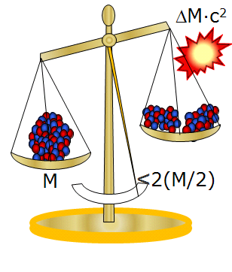
Basic Energetics: Nuclear Rearrangement Energies
Mass M_{(N,Z)} < N·M_{n} + Z·M_{p} → ΔM ∝ B(A=N+Z)
Einstein: equivalence
mass = energy E = M·c²
Energy of fusion: B=ΔM·c² is released
Energy release in fission A→2A/2
²³⁶U
Fe Ni
Fission of ^{235,238}U from g.s. is not spontaneous → Activation energy = Fission Barrier
Pass via n-capture ²³⁵U+n→²³⁶U*

Slide 7

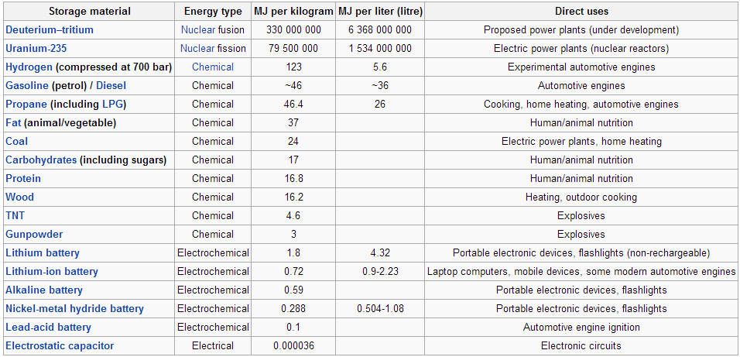
Fuel Energy Density
10⁸
10⁷
Energy Density (MJ/kg)
10⁰
From P. W. Huber & M. P. Mills, “The Bottomless Well,” Basic Books, New York, 2005
From Wikipedia, Nov. 2012
Nuclear fuel has highest known material energy density (~10⁷)
→ potentially lowest environmental impact (“footprint”)
Fission Reactions

Slide 8
Energy Release in n_{th}-Induced Fission
thermal→ E= (3/2)k_{B}T, k_{B}T=25meV
Additional fuels: ²³⁹Pu
Fertile actinides ²²³Th, ²³⁸U can be made into nuclear fuel by neutron irradiation (“breeding”)
Fission fragments have a distribution
fission fragment
n
Converts 0.1% of the mass → energies of fragments+n
Thermal energy/heat
1g ²³⁶U/day = 1MW
>10⁶ x chemical energies
E_{ff} = 168 MeV
E_{n tot} = 5 MeV
E_{γ} = 7 MeV
FF β-decay = _27 MeV
Q_{total} = 207 MeV
²³⁶U*
n
n
highly
unstable
fission fragment

Slide 9
β−Delayed Neutrons
87% of fission energy (≈200 MeV) promptly in fission ≤ 10⁻¹⁴ s
13% emitted in β-decays of fission fragments, range of life times → delayed emission of β⁺, β⁻, ν_{e}, γ, n
0.65% of neutrons from ²³⁶U fission are delayed (occur after fission) → = Essential for sustaining chain rxn + control function
Fission Fragment
Example
⁸⁷Br
β−delayed neutron <Δt> ≈ 80 s
(55.6 s)
β⁻ (2%)
⁸⁶Kr+n
β⁻ (98%)
⁸⁷Kr
Energy
β⁻
k<1 → k_{eff}≈1
Effective neutron
multiplication factor, but not all “survive”
Most have “wrong” energy for ²³⁵U chain rxn
(76 m)
⁸⁷Rb
(5·10¹⁰a)
β⁻
⁸⁷Sr
“Ignition” possible? → self-sustaining chain reaction

Slide 10
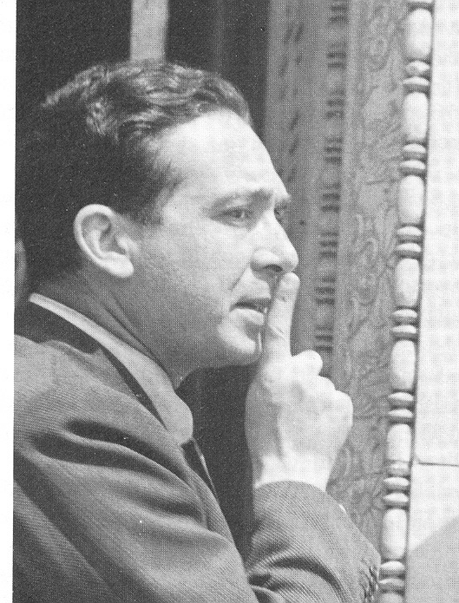
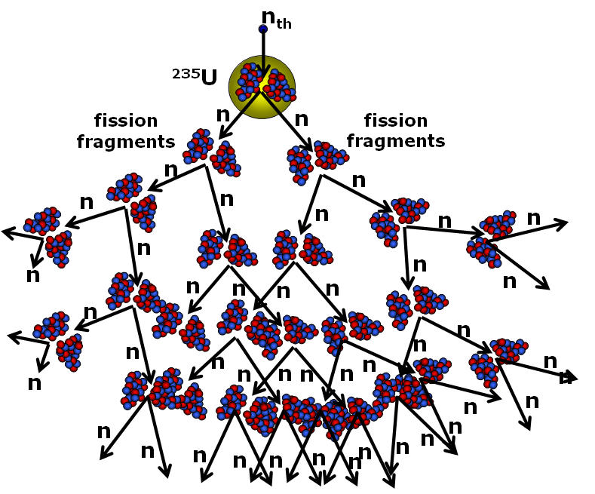
Self-Sustaining Fission Chain Reaction
Neutron multiplication through fission: k=2.4, minus losses (capture, leaking, escape,..) → effective k < 1.
One n used in each fission → effective multiplication k-1
Leo Szilard
1938
Self-Sustaining Chain Reaction
k >1: avalanche of n
τ = time between generations
(τ ~ 40μs in critical reactors
τ ~ ns in explosive devices)
Reactor Control: delayed n’s
Characteristic time period
k_{eff}≈1
e.g.,k_{eff}=1.03
Most fission neutrons are lost or not useful for further fission.
Fission fragments = “reactor poison” → k_{eff} < 1 stops chain reaction!

Slide 11
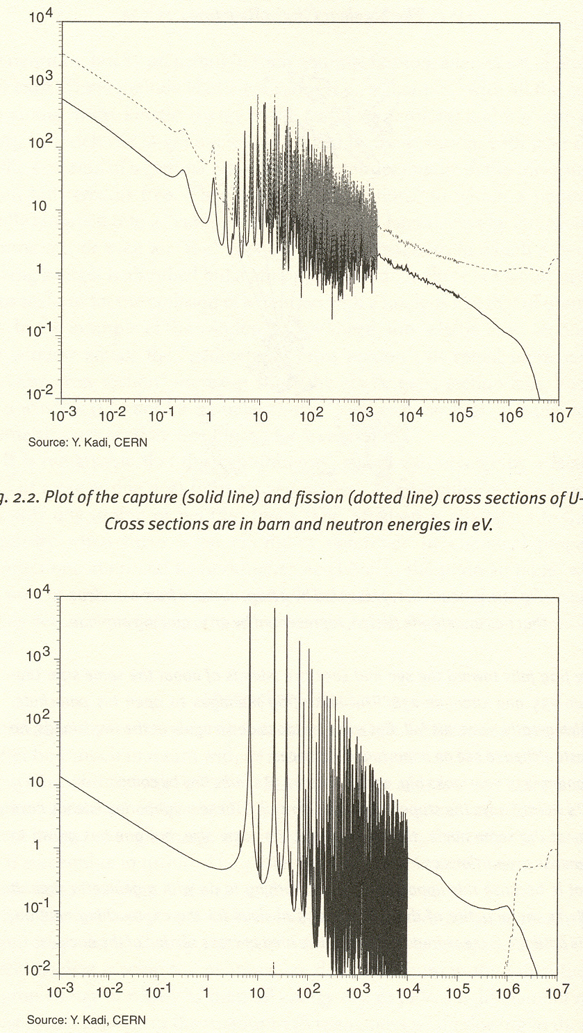
Fission and n-Capture Probabilities (“Cross Sections”)
“cross section” ∝ Probability/Nucleus
Central Problem:
Ignition of a self-sustaining fission reaction.
→ Moderate & recycle fission neutrons!
²³⁵U+n
fission
0.7% nat
n capture
^{nat}U: 99.3% ²³⁸U, 0.7% ²³⁵U
Fission cross sections → typically small,
²³⁸U: σ_{f} ~ 1 b for E_{n} > 1 MeV
≈ 0 b for E_{n} < 1 eV
dominating: scattering (~8 b) + capture
²³⁵U: σ_{f} ~ 1-2 b for E_{n} > 1 MeV
~ 10³ b for E_{n} < 1 eV large!!
dominating: (n, f) fission
Quantum Mech.
²³⁹U “resonance”
Neutron Capture and Fission Cross Sections (b=10⁻²⁴cm²)
²³⁸U+n
99.3% nat
Observed ^{nat}U fission is due to (0.7%) ²³⁵U
isotopically enrich ²³⁵U, > 4% -20% for higher efficiency (∝ output fission energy/input neutron energy)
n capture
Fast-neutron
fission
Slow neutrons → large σ_{f}!
Slowing-down (moderation) of fission n‘s by elastic n scattering on light moderator nuclei (H, C,…)
Neutron Kinetic Energy (eV)

Slide 12
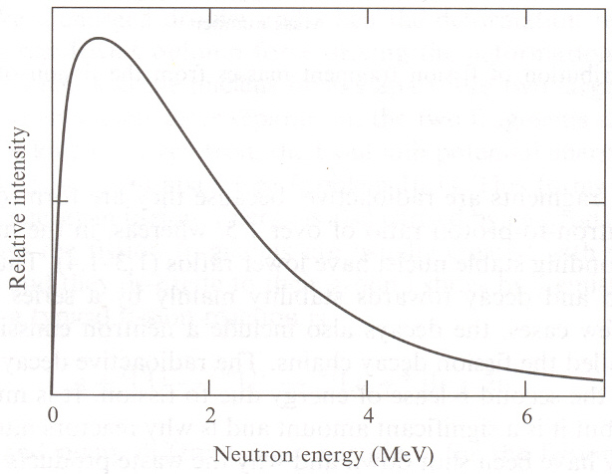
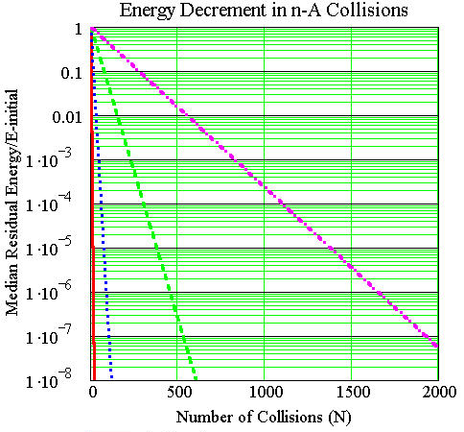

Neutron Energy Moderation
Fast Neutrons from U-236 Fission
Fission neutrons too energetic, → “thermalize” to maximize σ_{n},_{fiss} for ²³⁵U !
→ multiple elastic scattering (“moderation”) moderator: small σ_{capt} !
Slow down for capture !
Need:2 MeV → 0.025 eV/2MeV (= 10⁻⁸)
Must “miss” ²³⁸U capture resonances (2eV < E_{n} <10keV)
H₂O, D₂O, Be, C(graphite), prevent n leakage
Needed: moderator and fuel coolant
Control rods (Cd,..) capture n’s → k_{eff} ≈1
Cd Control rods
A=238
A=65
A=12
A=1
U
moderator
U
U
H₂O moderator
n-reflector
H, D are best moderators
H can capture neutrons (k < 1 !):
H+n_{th} → D+2.2 MeV

Slide 13
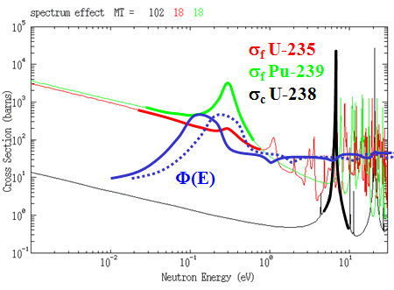
Reactor Control and Safety
“Reactivity dρ/dT “; ρ = (k_{eff} -1)/k_{eff}
Reduce by n absorbers Cd, B (control rods, moderator)
Automatic: fission products= “reactor poisons“
Cd Control Rods
Temperature dependent reactivity coefficient dρ/dT<0 → Negative reactivity desirable (self-regulating).
U
U
U
In BWR/PWR
Doppler Effect: broadening of resonance and n spectrum leads to increased n-capture by ²³⁸U → dρ/dT < 0
Density Effect: hot moderator expands,
lower density → longer mean free path,
less moderating efficiency → dρ/dT < 0
Dilatation Effect: hot moderator
delays slowing down → dρ/dT < 0
dρ/dT = -(0.5-1)x10⁻⁴/⁰C PWR
dρ/dT = - 1x10⁻³/⁰C Breeder, EA

Slide 14
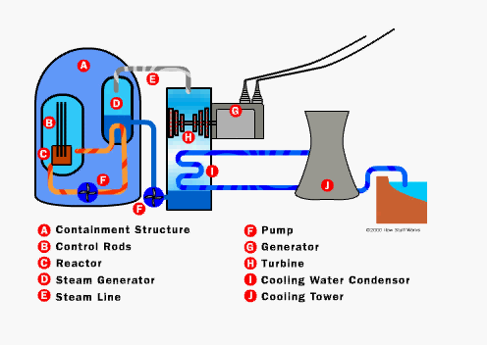
Principle Boiling Water Reactor

Slide 15
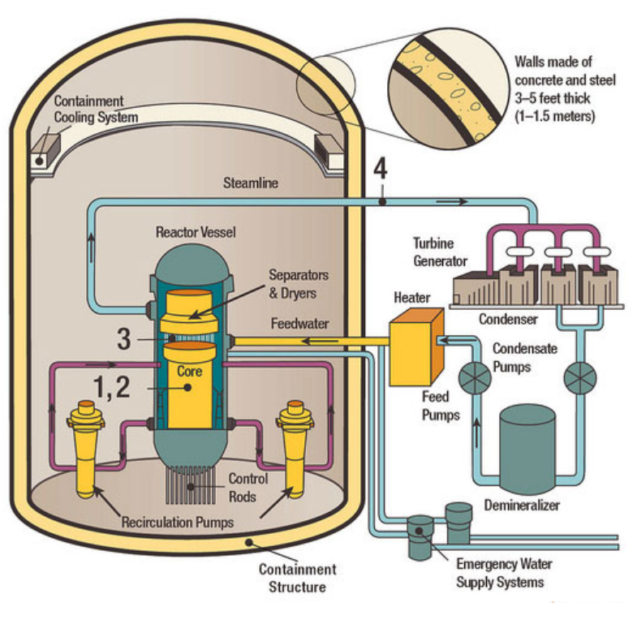
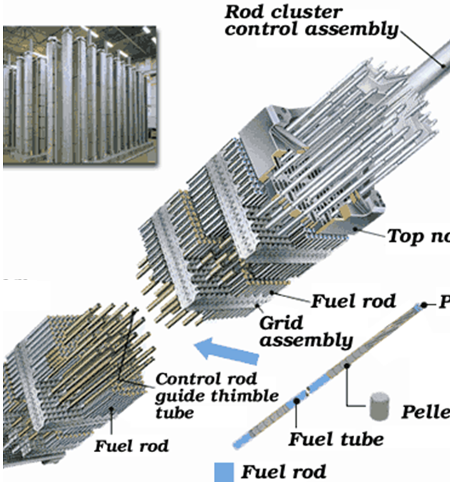
Boiling Water Reactor/Fuel Assembly
Centrifuge Array
Reactor core with fuel.
Water (moderator/coolant) streaming through core.
Separators dry steam-from water droplets, before it enters steam line.
Steam line to main turbine/ generator producing electricity.
Notes:
The unused steam is exhausted to the condenser, where it is condensed into water. The resulting water is pumped out of the condenser with a series of pumps, reheated, and pumped back to the reactor vessel. The reactor's core contains fuel assemblies that are cooled by water circulated using electrically powered pumps. These pumps and other operating systems in the plant receive their power from the electrical grid. If offsite power is lost, emergency cooling water is supplied by other pumps, which can be powered by onsite diesel generators. Other safety systems, such as the containment cooling system, also need electric power. BWRs contain between 370-800 fuel assemblies.

Slide 16
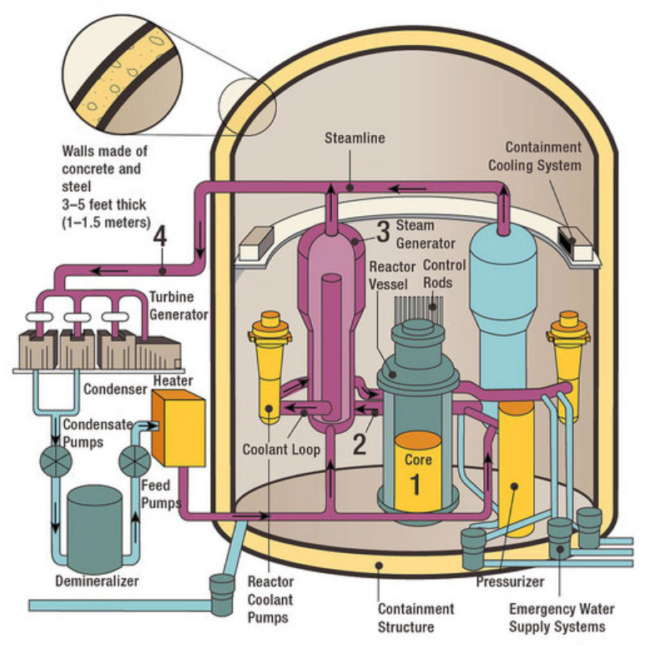
Pressurized-Water Reactor (PWR)
Reactor core, contains fuel creates heat.
Pressurized water primary coolant loop to steam generator.
Steam generator vaporizes water in a secondary loop.
Steam line to the main turbine/ generator producing electricity.
Notes:
The unused steam is exhausted to the condenser, where it is condensed into water. The resulting water is pumped out of the condenser with a series of pumps, reheated, and pumped back to the steam generator. The reactor's core contains fuel assemblies that are cooled by water circulated using electrically powered pumps. These pumps and other operating systems in the plant receive their power from the electrical grid. If offsite power is lost, emergency cooling water is supplied by other pumps, which can be powered by onsite diesel generators. Other safety systems, such as the containment cooling system, also need electric power. PWRs contain between 150-200 fuel assemblies.

Slide 17
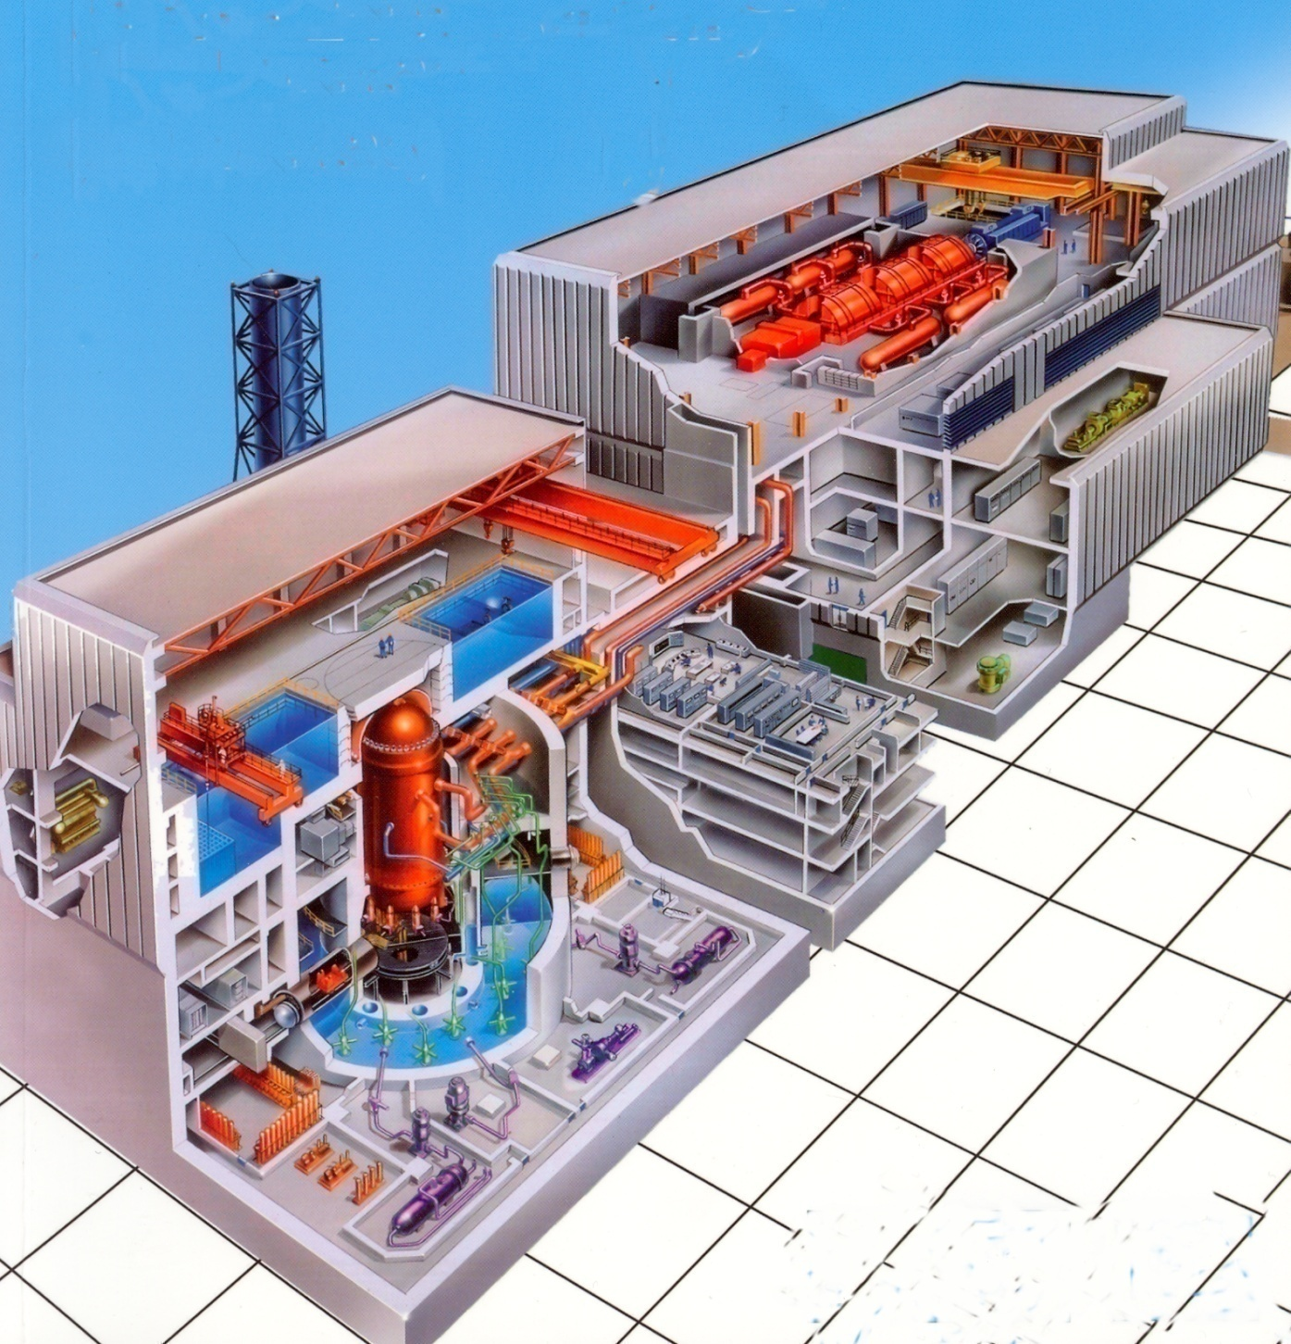
Conventional Gen-II Nuclear BW Power Plant 1-2GW
2-3 B$/1GW_{e} NPP
Fail-safe operation
Negative Reactivity
Negative feedback loops:
Reaction subsides when
coolant gets too hot or
disappears (less dense,
less moderation)
fuel gets too hot
(n capture increases)
control rods are not
moved out
Generator Island
Passive safety:
Pressure reactor vessel ~1’ thick steel, pressure tubes,
Reactor containment building with several 3-5-feet-thick concrete walls, concrete + water shielding on top of reactor vessel, gravitation replaces mechanical pumps.
Nuclear Island
Fuel Elements

Slide 18
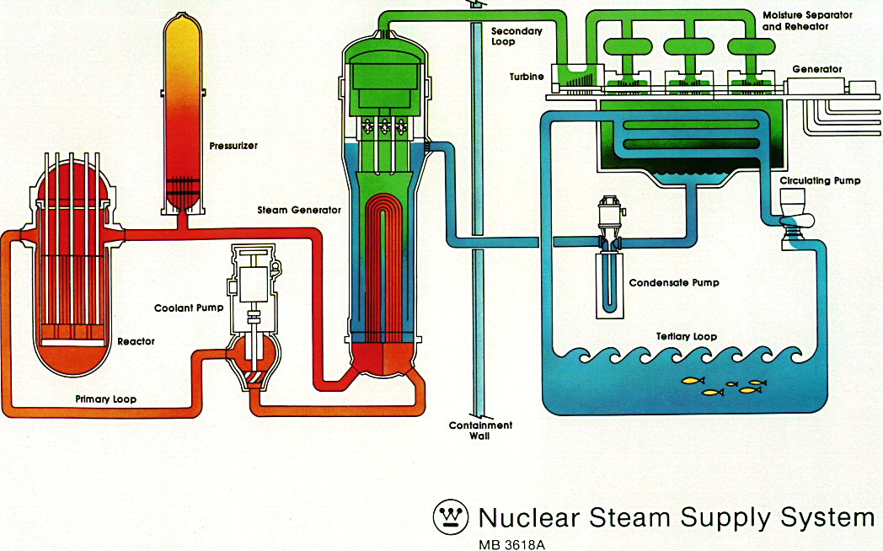
PWR Primary and Secondary Cooling Systems
Nuclear Island
Generator Island
Pressurizer
tower 13.5m
4.4m Ø

Slide 19
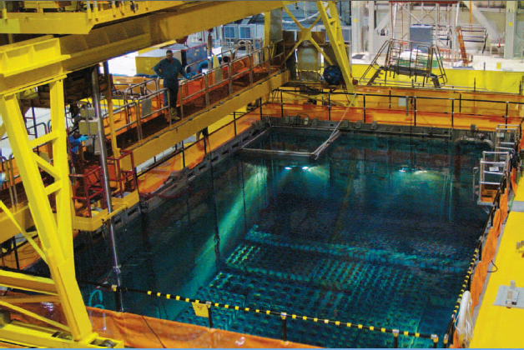
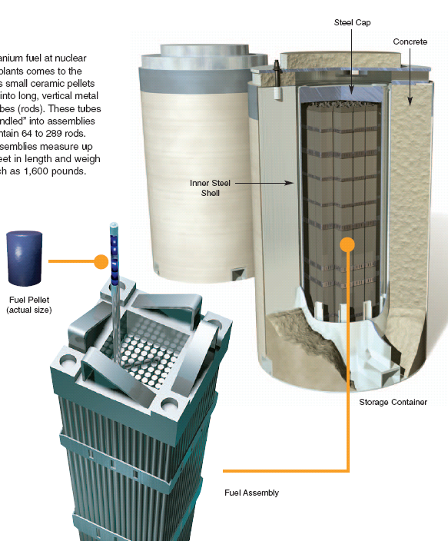
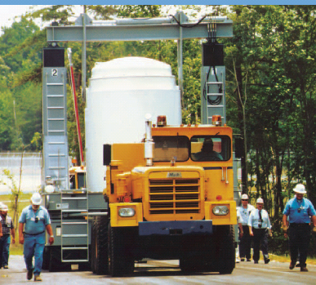
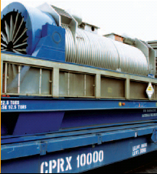
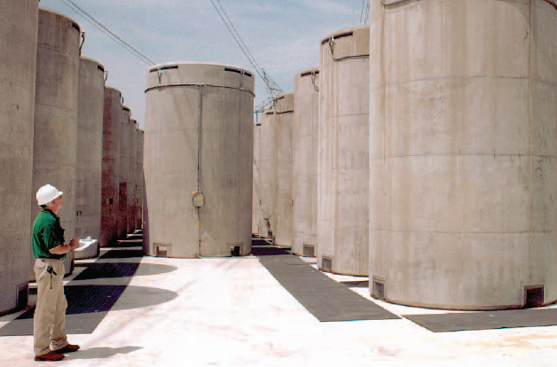
Nuclear Fuel Storage & Transport
Progress Energy

Slide 20
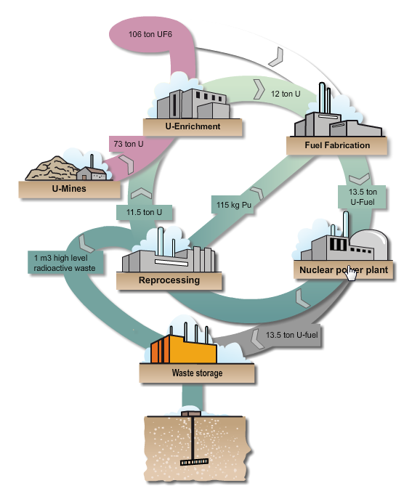
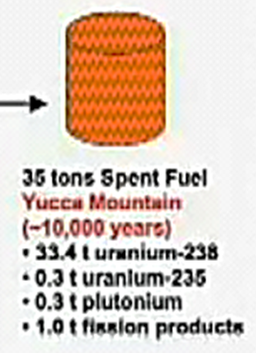
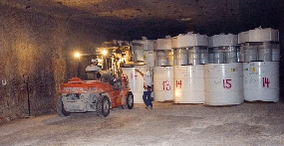
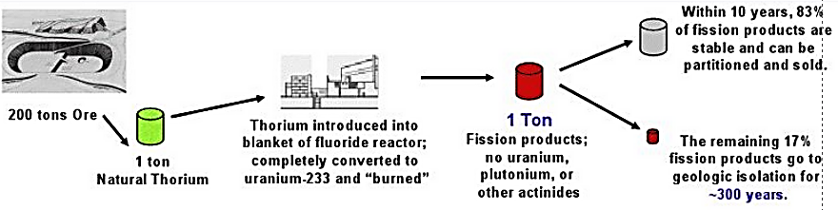
Uranium and Thorium Fuel Cycles
“Spent fuel” still contains 97% of nuclear energy (^{235,238}U, ^{239,240}Pu) + FF & MA
Permanent storage of high-level waste already paid for by consumers
¢0.1/kWh.
Closed fuel cycle with reprocessing
(France, Japan, Russia, India, ...)
Uranium Fuel Conversion
Worldwide:
5 geological depositories in operation (US: 1)
Yucca Mountain
Stopped in 2010, temporarily?
35 tons U fuel
← A, A+1,..
US: Once-through
Geological Depository in Carlsbad/NM
Thorium Fuel Conversion
Notes:
A type of nuclear reactor fuel (often called "MOX") that contains plutonium oxide mixed with either natural or depleted uranium oxide, in ceramic pellet form. (This differs from conventional nuclear fuel, which is made of pure uranium oxide.) Using plutonium reduces the amount of highly enriched uranium needed to produce a controlled reaction in commercial light-water reactors. However, plutonium exists only in trace amounts in nature and, therefore, must be produced by neutron irradiation of uranium-238 or obtained from other manufactured sources. As directed by Congress, the NRC regulates the fabrication of MOX fuel by DOE, a program that is intended to dispose of plutonium from international nuclear disarmament agreements. For further detail, see the Backgrounder on Mixed Oxide Fuel and Frequently Asked Questions About Mixed Oxide Fuel.

Slide 21
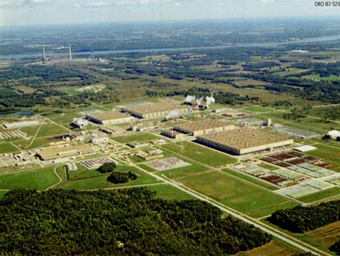
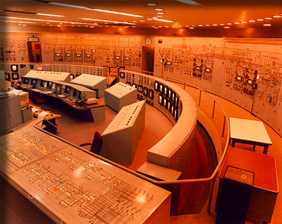
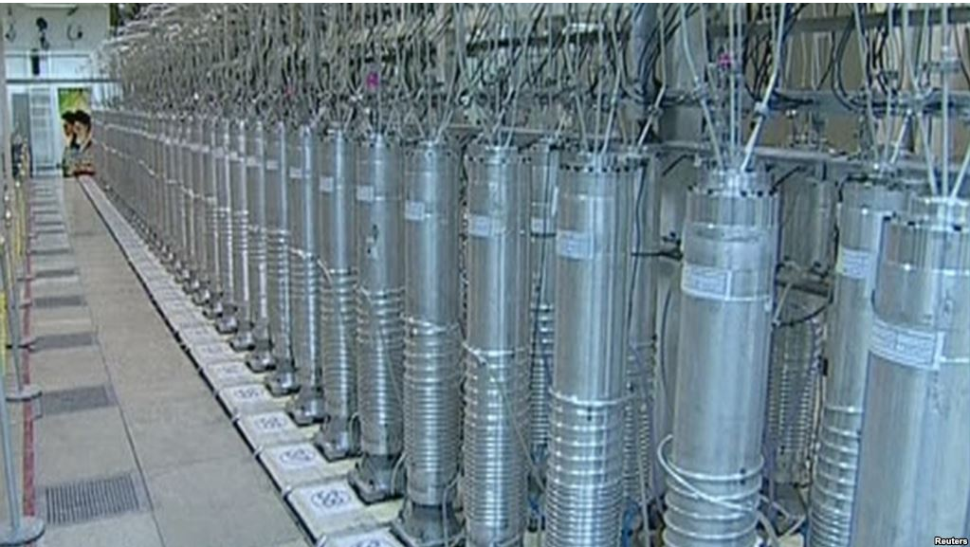
Fuel Cycle: Fuel Enrichment
Paducah/KY Separation Plant
plant control room
Cylinders spin at 1.5km/s surface velocity → centrifugal forces produce different sedimentation rates

Slide 22
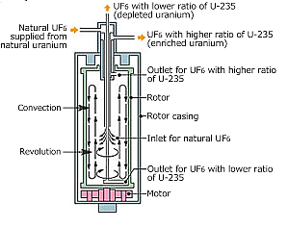
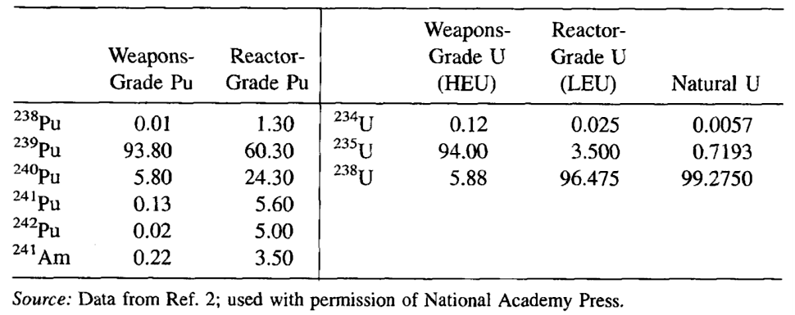
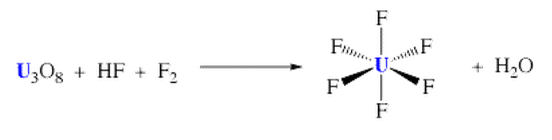
Gas Diffusion Isotope Enrichment
NPP (7TWh/a output) needs
≈ 6 GWh/a for 0.7 → 6% ²³⁵U
1.5% mass difference
Intermediate enrichment ~20% needed for research & radio-pharma reactors
Preferred technology: Gaseous diffusion of UF₆ (¹⁹F mono-isotopic)
Laser ionization possible, economics
US: NPP (7TWh/a output) needs 250 GWh/a for enrichment

Slide 23
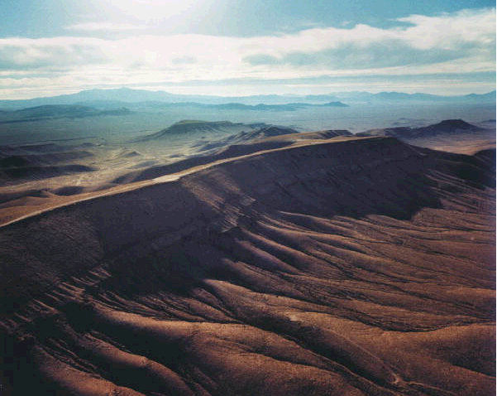
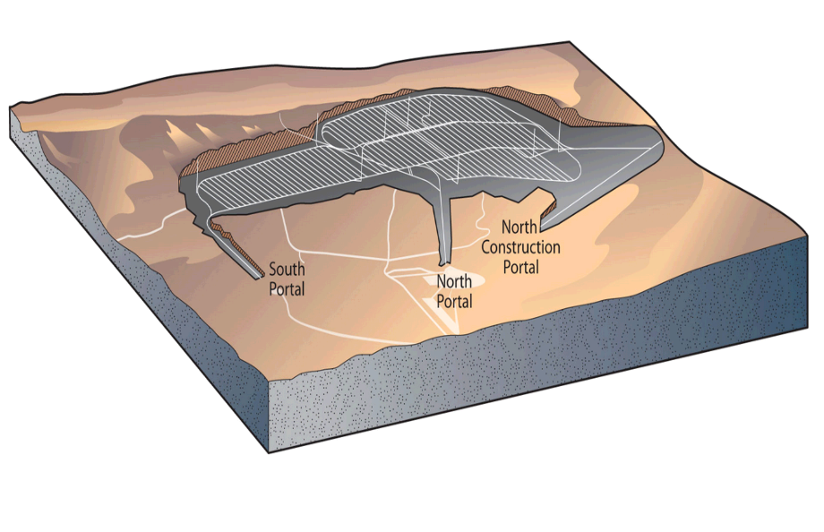
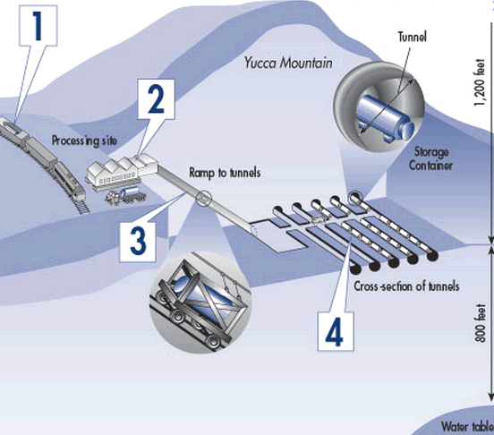
Yucca Mountain (NV) Depository
Spent-fuel canisters, sealed in special casks, are shipped to the site by truck or train.
Shipping casks are removed, inner tube with fuel elements is placed in a steel, multilayered storage container.
Automated system sends and manages storage containers in underground tunnels.
Containers stored on their side along the tunnels.
Retrievable for later use (or not)
16 countries have geological depositories
Notes:
Deep geological disposal is the preferred option for nuclear waste management in most countries, including Argentina, Australia, Belgium, Canada, Czech Republic, Finland, France, Japan, the Netherlands, Republic of Korea, Russia, Spain, Sweden, Switzerland, the UK, and the USA.

Slide 24
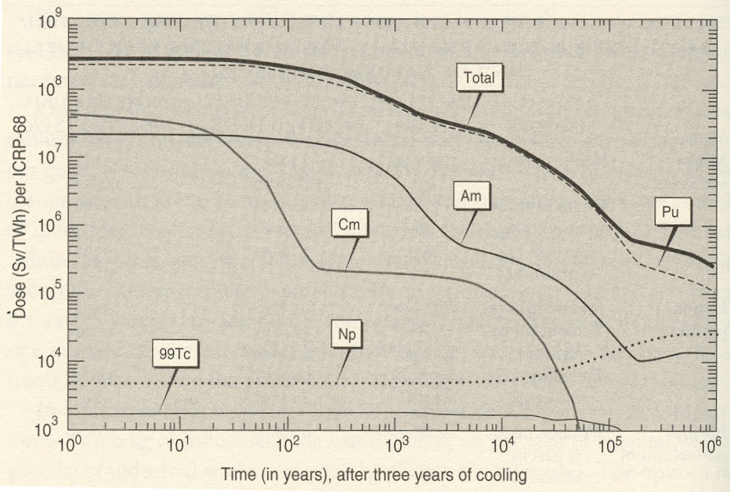
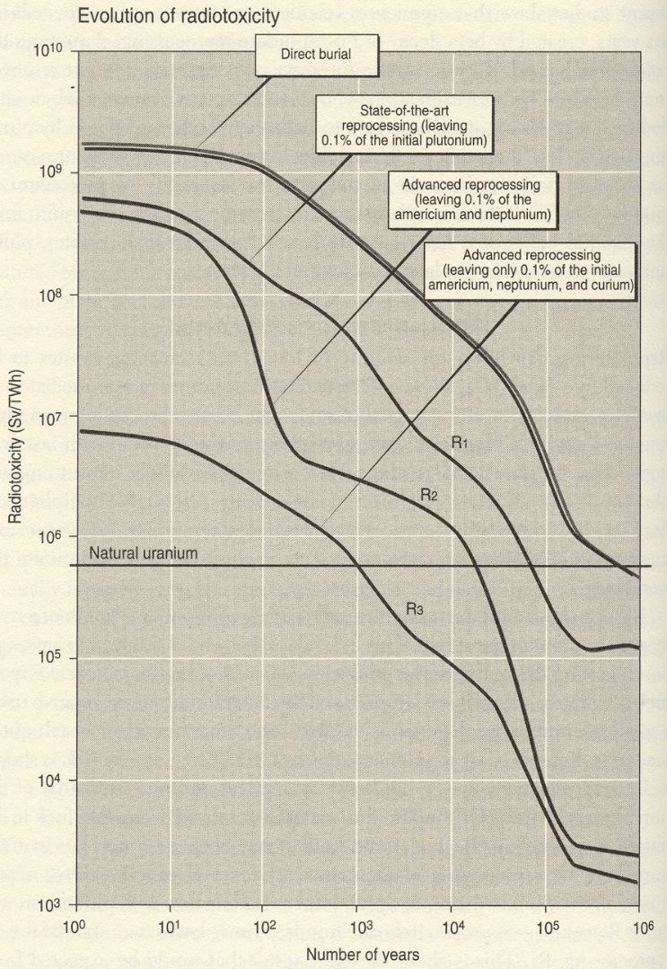
Radioactive Waste: Power Reactors/Weapons Stewardship
High-level waste depository for geological times → Yucca Mtns/NV ?
Radio-chemical reprocessing
FF
Nat Uranium
Ore
Very-long-lived ⁹⁹Tc, ¹²⁹I >could< dissolve in groundwater and move through ecosystem → disposal strategies for isolation.
Better: reprocessing, transmutation/incineration of ⁹⁹Tc, ¹²⁹I, Np
R3
R3: fast-n reactors (“incinerators”) +reprocessing
1 Sv (Sievert) = 100 rem, biolog. equivalent to 1J/kg X-rays
Radiotoxicity: R(Sv)=(Dose in Sv/decay), Activity/kg

Slide 25
Agenda
Nuclear stability & particle radiation
Potential biological hazards
Energy Generation from Nuclear Fission
U.S./World trends,
Nuclear fuel resources (U.S.),
  Fission chain reaction and reactor control,
  Reactor types,
  Fuel cycles, radioactive waste & storage.
New Nukes: Advanced Nuclear Energy Technologies
  Small modular plants,
  Advanced (Gen IV) reactors,
  U & Th breeder reactors, subcritical reactors,
  Closed fuel cycle,
  Non-fission applications: Radioisotope Thermoelectric Generators (RTG)
Energy from nuclear fusion reactions
Fusion energetics, critical
Principles of magnetic and inertial confinement
Strategic Issues for Nuclear Power
Sustainability, reliability, scalability, safety, eco-footprint, cost

Slide 26
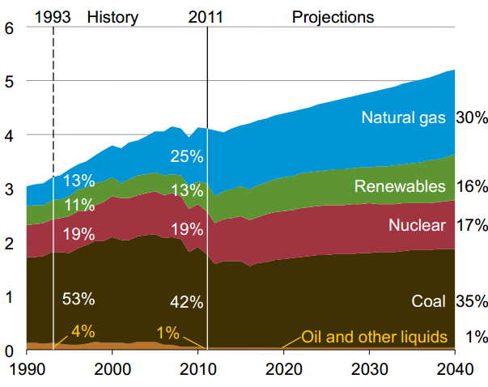
U.S. Electricity Generation
Forecast:
Total electricity demand: 3.8 10¹⁵ Wh/a (2011) →
5.1 10¹⁵ Wh/a (2040),
→ Δ= 1.1 %/a, accounting for eff gains.
PWh
+ Hydro
Retire 7GW Gen II in the next 10 years (?)
Recent rapid decline of natural gas prices → projected mean delivered electricity prices 9.9 c/kWh → 9.2 c/kWh (2015).
Projected scenario BAU is workable but increases GHG output.

Slide 27
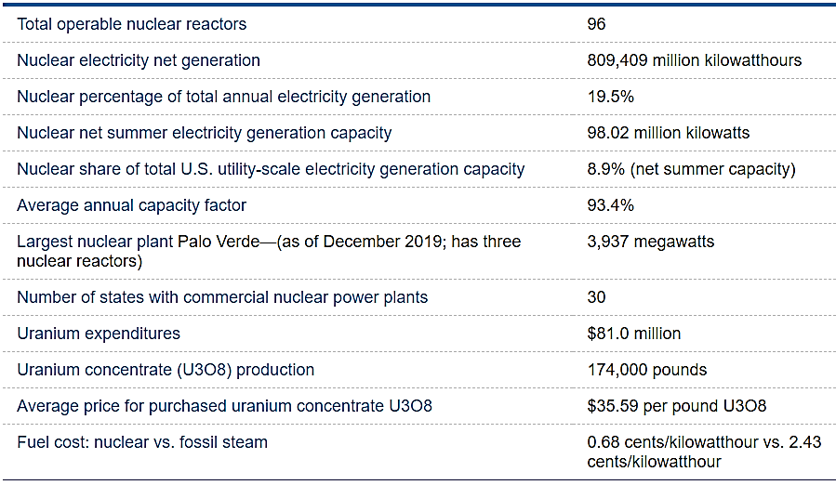
U.S. 2020 Nuclear Statistics (EIA)

Slide 28
Agenda
Energy Generation from Nuclear Fission
  Nuclear binding/rearrangement energies
  Fission chain reaction and reactor control
  Reactor types, nuclear fuels, fuel cycle
Advanced(Gen IV) Nuclear Energy Technologies
  Small modular reactors, MSR-LFTR, Th breeder, ADR
  Closed fuel cycle
  Reactor inventory and trends in nuclear fission power
Strategic Issues for Nuclear Power
  Safety, eco-footprint, cost, scalability
  Proliferation safety
  Biological effects of radiation
Energy Generation from Nuclear Fusion
  Principles of energy conversion
  Tokamak scheme

Slide 29
