Slide 1
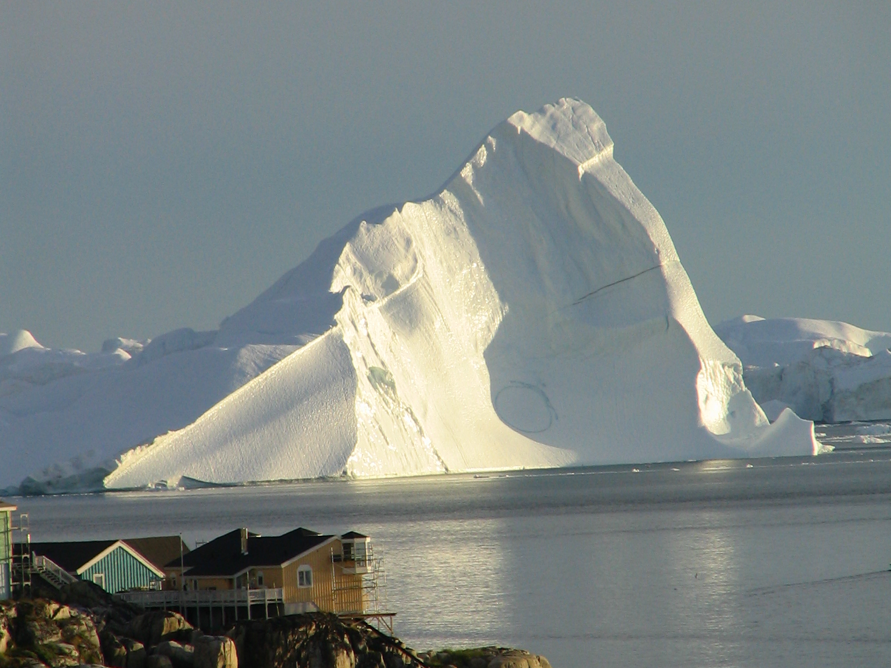
Ice and Climate: Past, Present and Future
Vasilii Petrenko
Associate Professor
Earth and Environmental Sciences
University of Rochester

Slide 2
WHAT WILL THIS TALK BE ABOUT?
Basics of ice on Earth
Lessons from the past: what do we know about how climate and greenhouse gases affect ice sheet size and sea level?
How has Earth’s ice cover been changing recently?
How will Earth’s ice cover change in future and what does it mean for sea level?

Slide 3
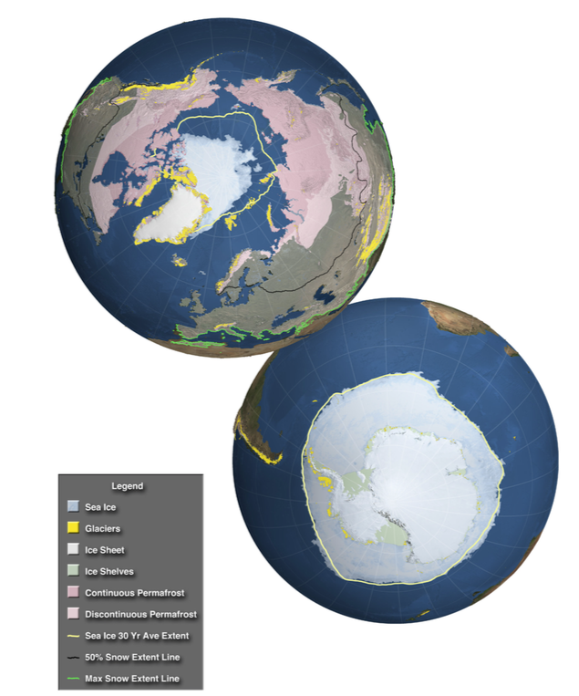
THE EARTH’S CRYOSPHERE
Contains ≈ 2/3 of Earth’s freshwater
If all land ice melts: ≈66 m (217 ft) of sea level rise
Strong interactions with climate
IPCC 2013, WG1, Ch. 4

Slide 4
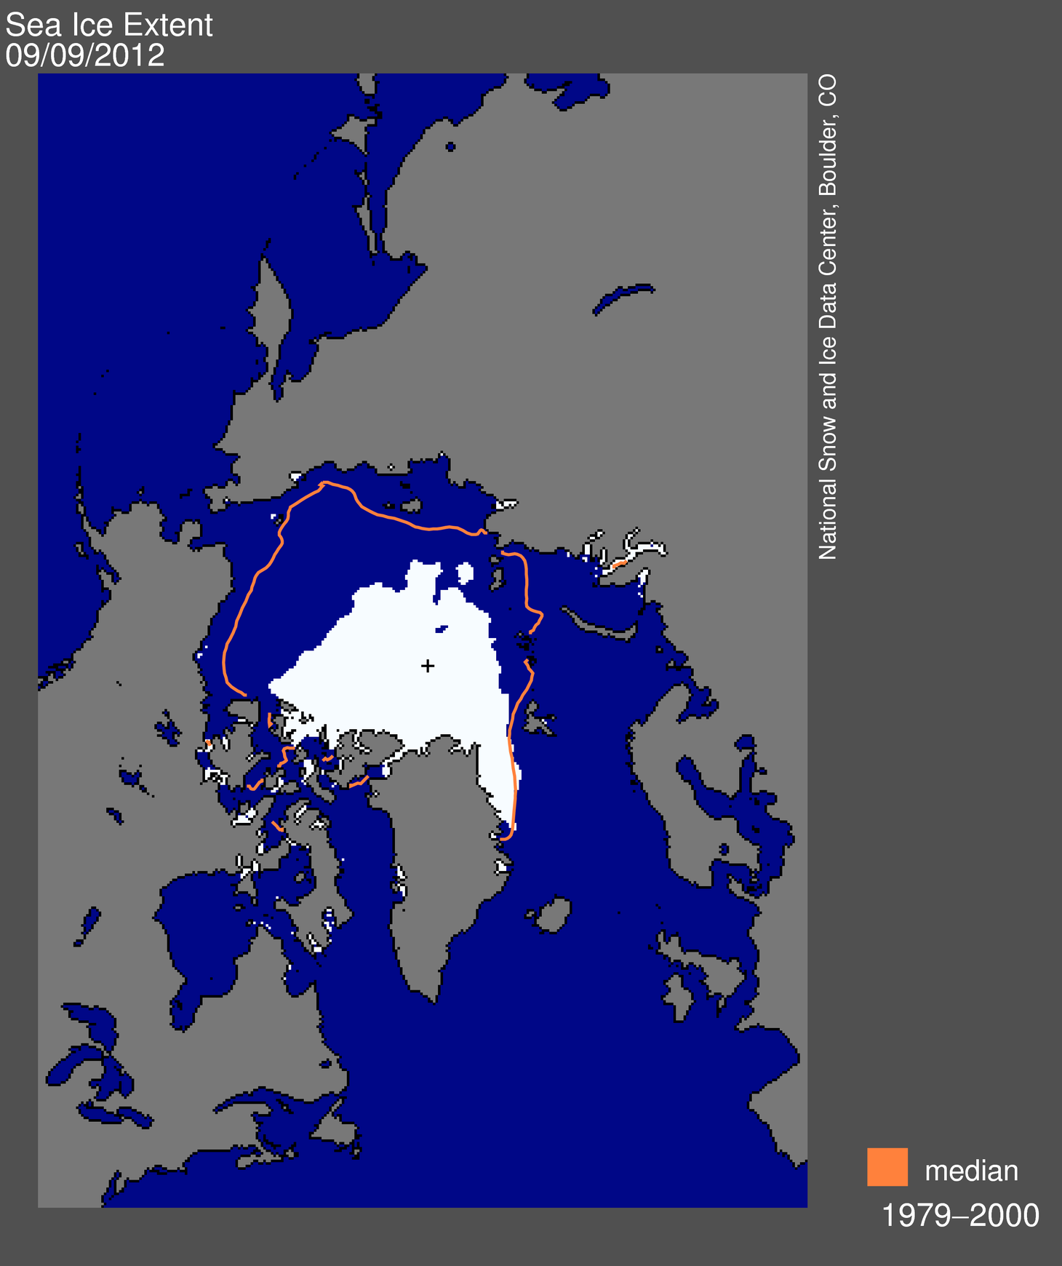
ICE AND SNOW ALBEDO FEEDBACK
Positive feedback
fast for snow and sea ice
slow for ice sheets
Notes:
Map of Arctic ice during a record low year
Ice and snow are very good reflectors of sunlight
Explain albedo
Colder --> More ice --> Less solar radiation absorbed --> Further cooling
Ice-Albedo feedback is very important for large climate changes in the past

Slide 5
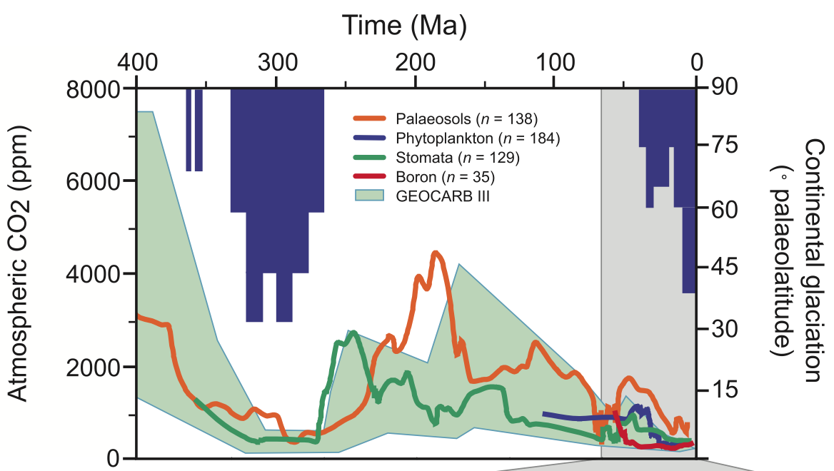
ICE AND ATMOSPHERIC CO₂ IN THE DEEP PAST
IPCC 2007, WG1, Ch. 6
Notes:
What this figure basically shows
Currently continental glaciation doesn’t extend past 60˚ latitude (in Greenland and Antarctica)
Periods of relatively low CO2 coincided with cold climates and large-scale ice sheets

Slide 6
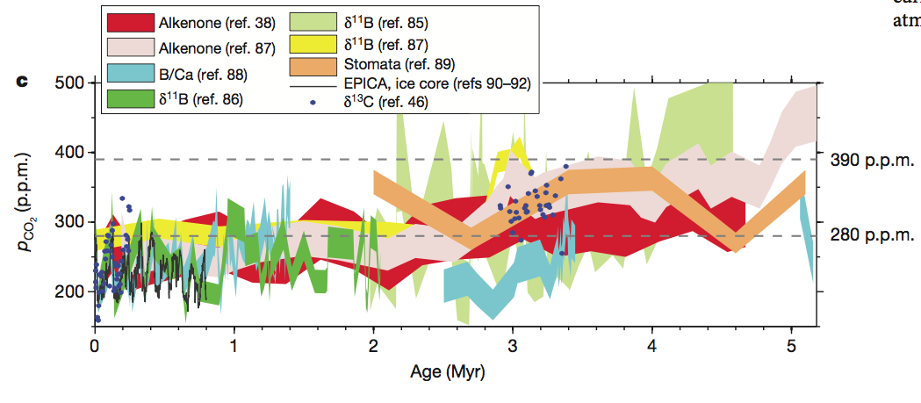
EARLY TO MID PLIOCENE PERIOD, 3 – 5 MYR AGO
Global surface temperatures 3 – 4°C warmer than today
Global average sea level 10 – 30 m higher than today
Fedorov et al., 2013, Nature
Notes:
Figure: Compilation of different estimates for past CO2
Uncertainties are large
CO2 was likely higher than preindustrial but lower than today
So CO2 was higher but not dramatically higher
3 – 4˚C warmer than today is well within the range of projections for the end of the century
Geologic records of past sea level from the Pliocene suggest that a warming of such magnitude
could set off a long-term very large sea levels rise
What would this kind of sea level rise look like?

Slide 7
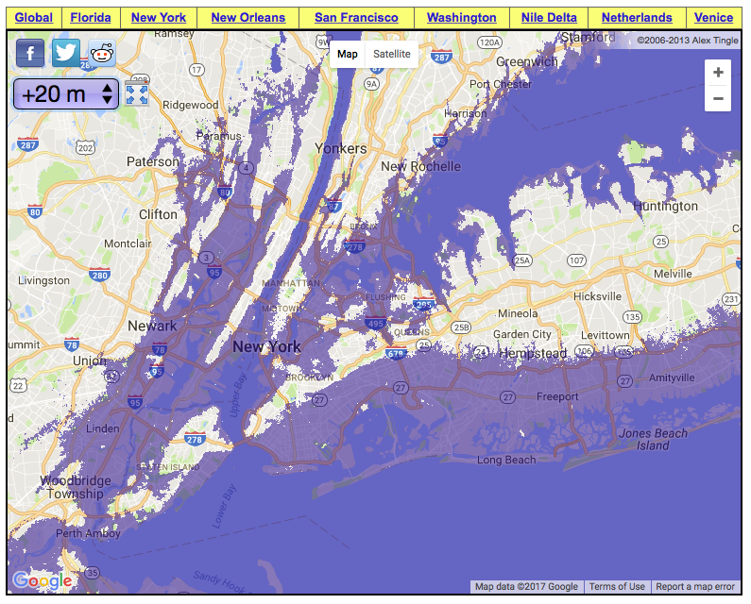
20 M OF SEA LEVELS RISE IN NEW YORK CITY

Slide 8
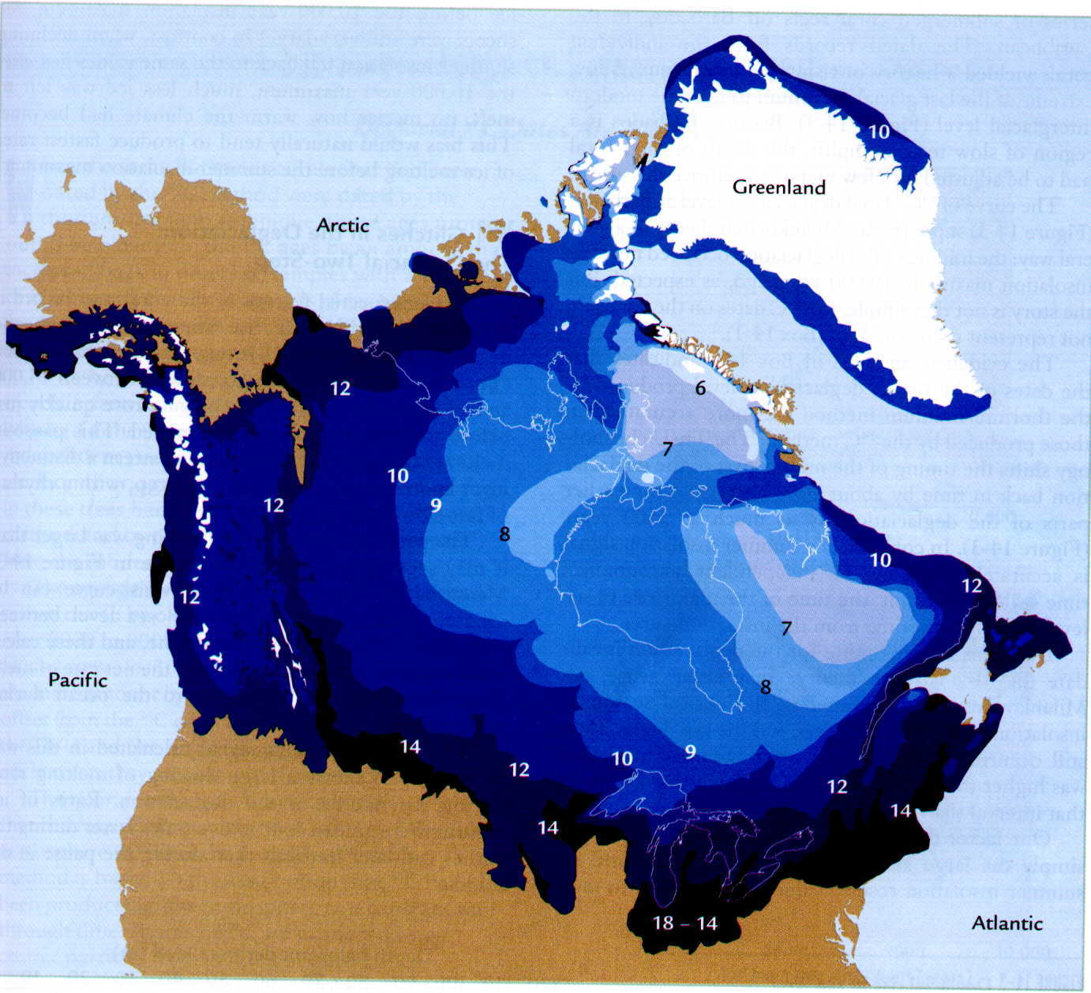
GLACIAL CYCLES
Image:
http://earth.usc.edu/classes/geol150/stott/evolution/pleistocene.html
Notes:
Now will talk about somewhat more recent past, about the last 1,000,000 years
This period was marked by alternating cold and moderate climates with large changes in ice sheets
This is the ice extent in N America during the last glacial maximum
The numbers indicate how many thousands of years ago the ice receded from a given area
Rochester was under about a mile of ice 20,000 yrs ago
Sea level was about 120 m lower than today
Long Island and Cape Cod were formed when the ice sheet dumped a great deal of sediment at its terminus
There is geologic evidence of a past ice sheet all over this area too

Slide 9
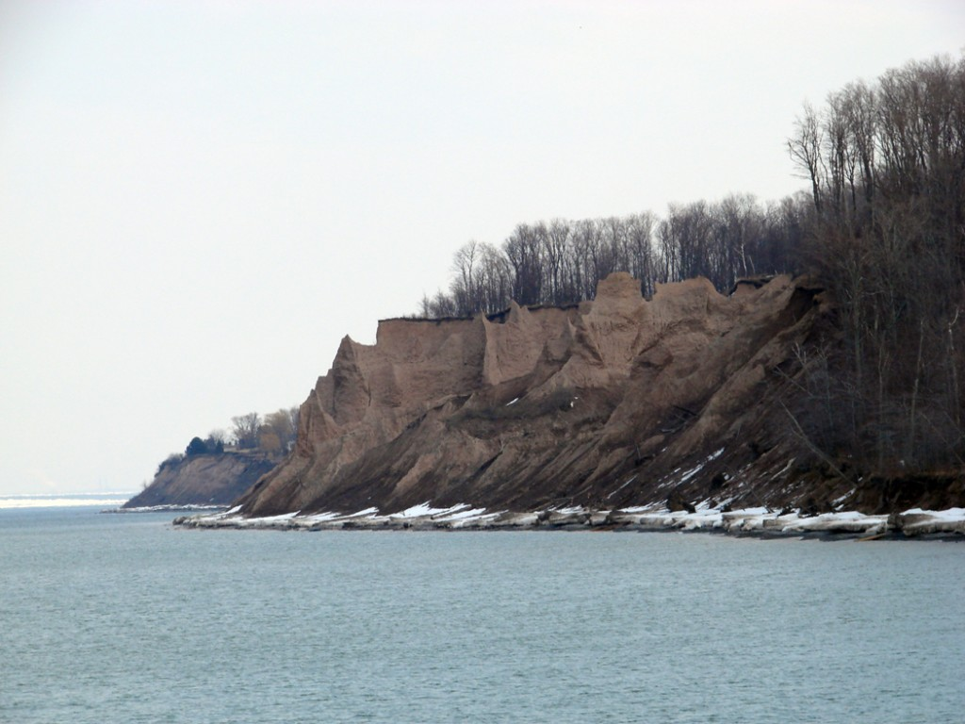
CHIMNEY BLUFFS STATE PARK
Image: http://blogs.agu.org/magmacumlaude/2010/11/23/chimney-bluffs-state-park-drumlin-hunting/
Notes:
Just an hour’s drive East
This is an eroded end of a drumlin (glacially deposited hill of sediment)

Slide 10
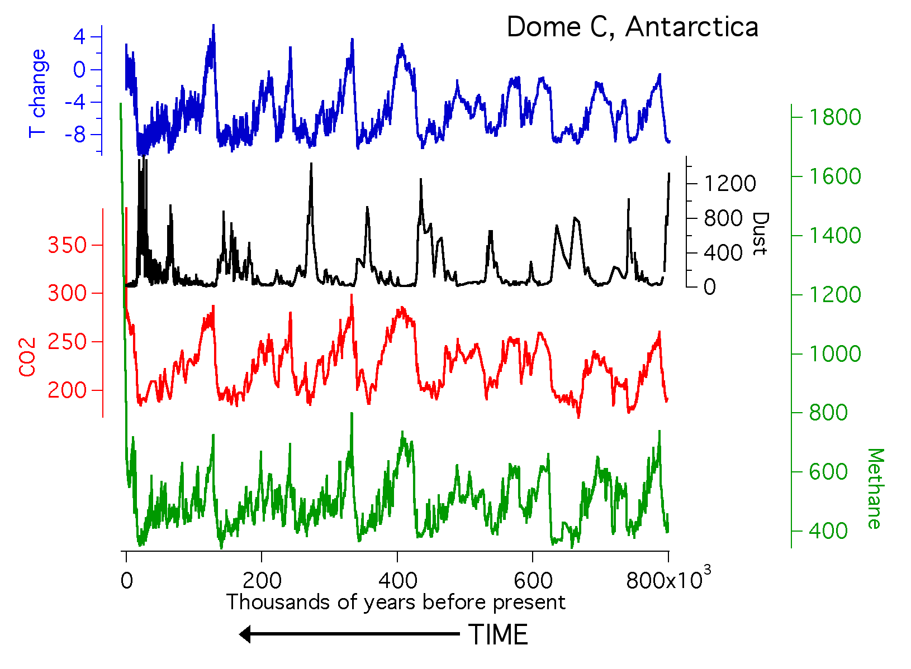
GLACIAL CYCLES FROM ICE CORES
(˚C)
(ppm)
(ppm)
(ppb)
Notes:
The longest ice core record; what’s plotted; time axis
Explain major glacial cycles; we are currently in an interglacial
What do the major T changes represent. Relationships w/other tracers
So we have a record of the major greenh gases for 800K
Warm interglacial’s and high CO2 and methane coincide

Slide 11
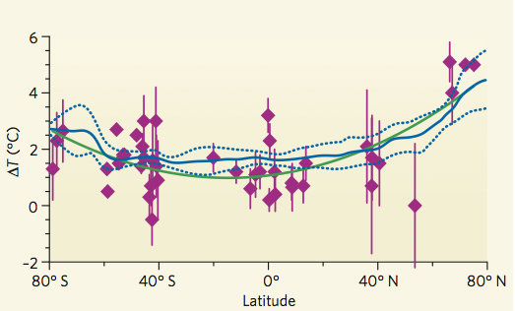
LAST INTERGLACIAL PERIOD (≈125 thousand years ago)
The last time the global climate was warmer than today
Globally about 1 – 2˚C warmer than preindustrial
Warmth amplified in Arctic (3 – 5˚C warmer)
Figure: Clark and Huybers, 2009, Nature
Last Interglacial temperatures are similar to what we expect sometime in the next century under conditions of anthropogenic global warming, including polar amplification of warming
Notes:
Diamonds: proxy surface T data 120 – 130 kyr (last interglacial) for ∆T as compared to pre-industrial
Green line: polynomial curve fit to the data
Blue line: model results for end of 21st century as compared to 1980-99 average under a low emissions scenario
In this case, the warming was not driven by CO2 but by a redistribution of solar energy around different latitudes through small changes in the Earth’s orbit
But it allows us to answer the question of sea level response to warming

Slide 12
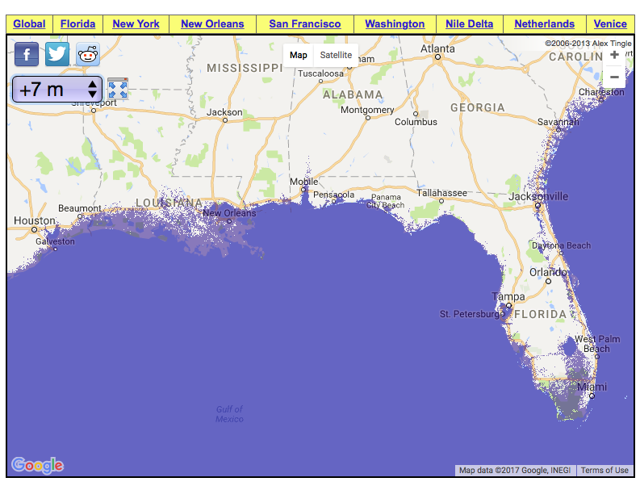
LAST INTERGLACIAL SEA LEVEL WAS 6 – 9 m HIGHER
Take-home:
Even a relatively small warming can produce a large sea level rise
Figure: Geology.com / Google Earth / Google Maps
Notes:
image shows the impact of a 7 m sea levels rise on Florida and the Gulf Coast

Slide 13
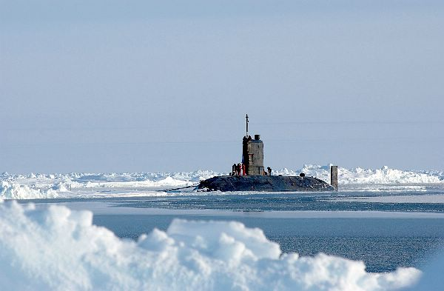
RECENT CHANGES IN THE CRYOSPHERE
Image: US Navy
Notes:
British submarine at N Pole

Slide 14
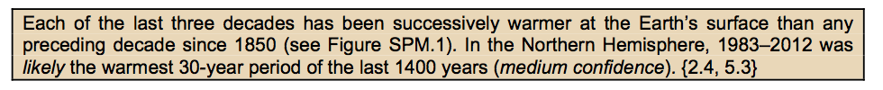
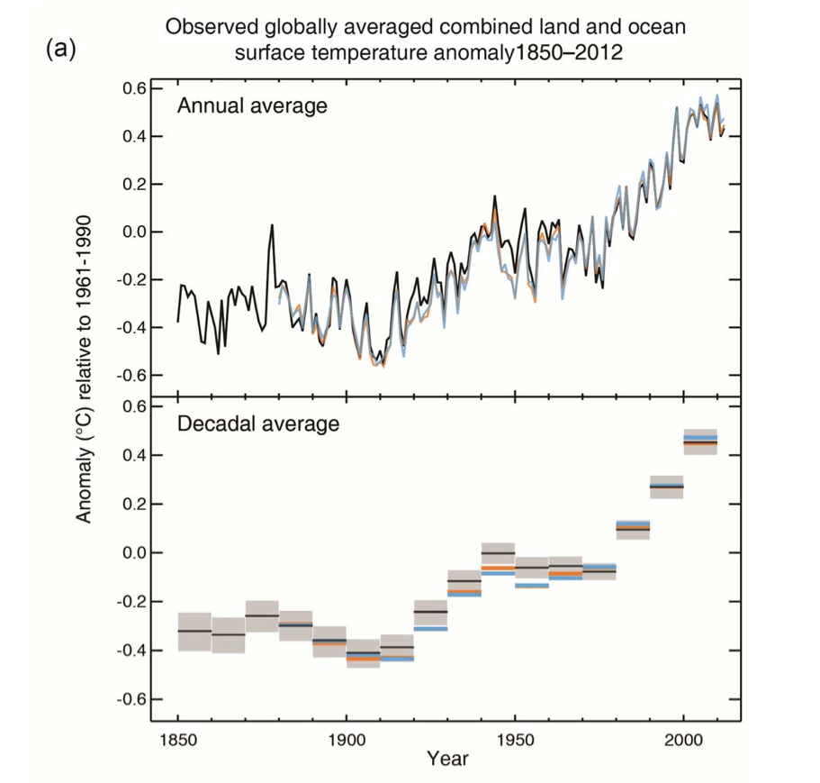
+ 1.0˚C for 1880 – 2016
Substantial interannual and decadal variability
IPCC WG1, 2013
Notes:
Explain the IPCC and what it does
Hundreds of scientists

Slide 15
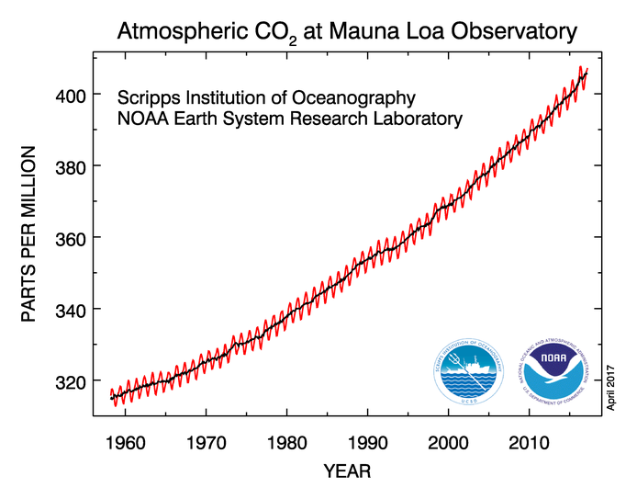
THE MAIN CAUSE OF WARMING: OUR EMISSIONS OF GREENHOUSE GASES
Average rate of CO₂ increase for last few years:
2 ppm / year
Global mean CO₂:
January 2016: 402.4 ppm
January 2017:
405.3 ppm
Notes:
Why CO2 is going up
the rate has been gradually accelerating
C cycle is clearly out of balance
What are the faster oscillations? Seasonal cycle; land biosphere breathing!

Slide 16
RECENT CO₂ INCREASE AS COMPARED TO LAST 800,000 YEARS
(˚C)
(ppm)
(ppm)
(ppb)
Notes:
How does this fit into the perspective of the last 800 kyr?

Slide 17
RECENT CO₂ INCREASE AS COMPARED TO LAST 800,000 YEARS
(˚C)
(ppm)
(ppm)
(ppb)
Notes:
We’re way outside the natural variability for at least the last 800 kyr
It is well-known Physics that more of these gases in the atmosphere would
Cause the Earth to warm

Slide 18
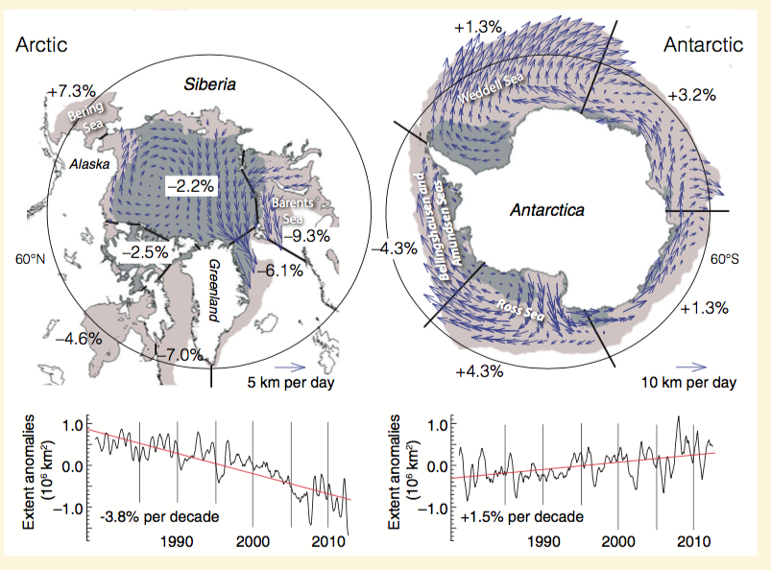
RECENT CHANGES: SEA ICE
IPCC 2013, WG1, Ch. 4
Notes:
Decline in Arctic is larger than increase in Antarctic
Increase in Antarctic may have to do with addition of freshwater from increased ice melting

Slide 19
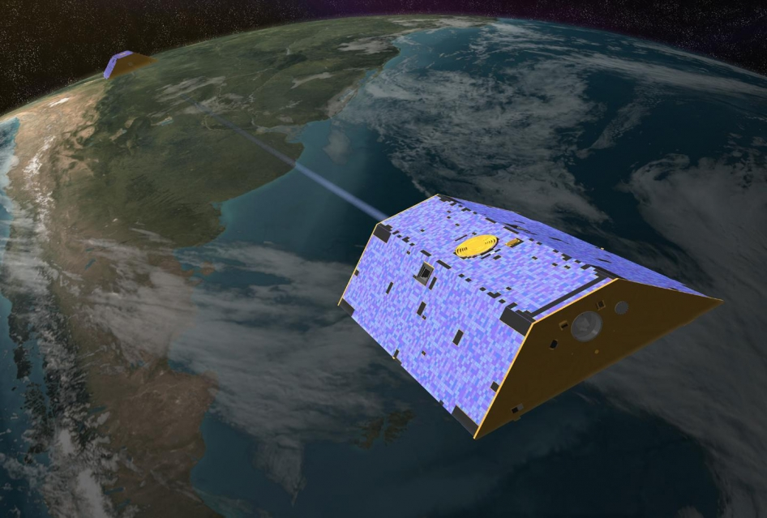
SATELLITE GRAVITY SENSING OF ICE SHEET CHANGES
Image: NASA
Notes:
NASA BRIEF DESCRIPTION OF GRACE:
GRACE consists of two identical spacecraft that fly about 220 kilometers (137 miles) apart in a polar orbit 500 kilometers (310 miles) above Earth.
GRACE maps Earth's gravity field by making accurate measurements of the distance between the two satellites, using GPS and a microwave ranging system.
As the pair circles the Earth, areas of slightly stronger gravity (greater mass concentration) will affect the lead satellite first,
pulling it away from the trailing satellite, then as the satellites continue along their orbital path, the trailing satellite is pulled
toward the lead satellite as it passes over the gravity anomaly. The change in distance would certainly be imperceptible to our eyes,
but an extremely precise microwave ranging system on GRACE is able to detect these miniscule changes in the distance between the satellites.

Slide 20
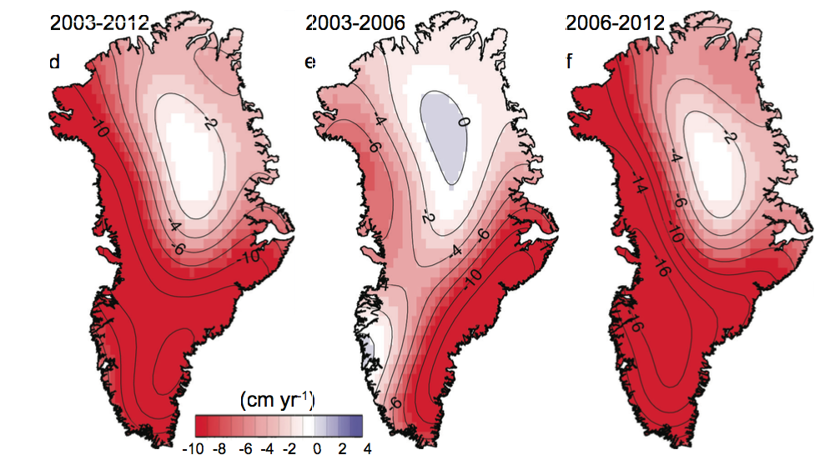
ICE SHEETS: ICE LOSS IN GREENLAND
IPCC 2013, WG1, Ch. 4
Notes:
IPCC FIGURE CAPTION:
Temporal evolution of ice loss determined from GRACE time-variable gravity, shown in centimetres
of water per year for the periods (a) 2003–2012, (b) 2003–2006 and (c) 2006–2012,
colour coded red (loss) to blue (gain) (Velicogna, 2009).

Slide 21
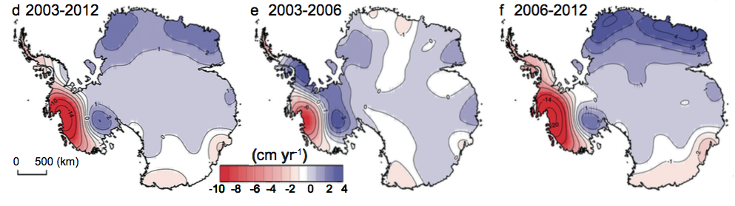
ICE SHEETS: ICE LOSS IN ANTARCTICA
IPCC 2013, WG1, Ch. 4
Notes:
IPCC FIGURE CAPTION:
Temporal evolution of ice loss determined from GRACE time-variable gravity, shown in centimetres of water per year for the periods
(a) 2003–2012, (b) 2003–2006 and (c) 2006–2012, colour coded red (loss) to blue (gain) (Velicogna, 2009).
Note that parts of Antarctica are gaining mass
Amundsen sea sector in West Antarctica is losing mass very rapidly
Overall Antarcica seems to be losing ice mass

Slide 22
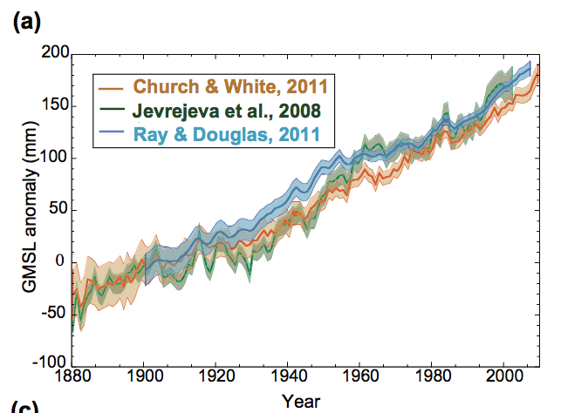
SEA LEVEL RISE
IPCC 2013, WG1, Ch. 3
Notes:
THIS IS GLOBAL MEAN SEA LEVEL
Sea level is rising at a rate of about 3 mm / year
Currently the single largest contribution is thermal expansion of seawater, not melting ice on land

Slide 23
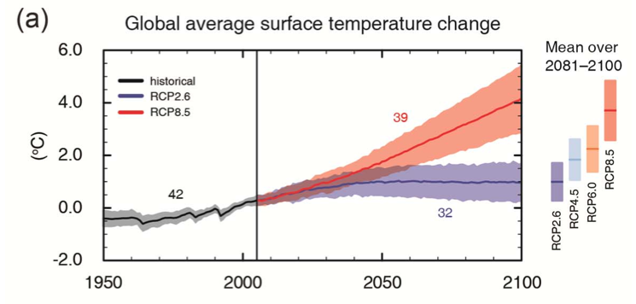
ICE AND CLIMATE IN THE FUTURE
Image: IPCC, 2013
Our emissions are the single largest uncertainty in determining future climate
Notes:
Mention climate models
RCP 8.5 is the most aggressive emissions scenario
RCP 2.6 is a climate mitigation scenario; keeps T rise below 2˚C “danger” threshold

Slide 24
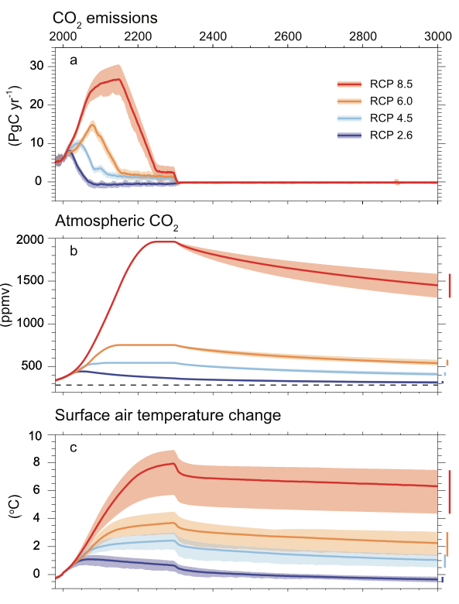
HIGH CO2 AND TEMPERATURE PERSIST FOR A LONG TIME EVEN AFTER OUR EMISSIONS STOP
IPCC, 2013
Notes:
this is a longer-term perspective
Atmospheric CO2 keeps rising as long as emissions are relatively high
High CO2 persists for quite a while after emissions stop. The dashed line on (b) indicates the pre-industrial CO2 concentration
High temperatures persist for a long time along with high CO2

Slide 25
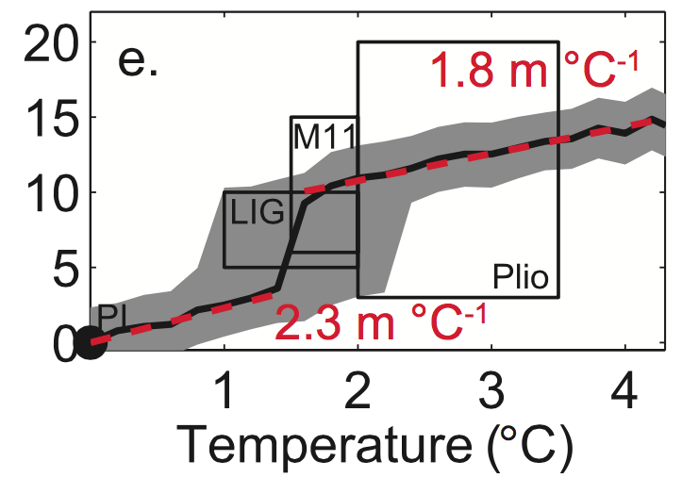
MULTI-MILLENIAL (NEW EQUILIBRIUM) SEA LEVEL
Sea level rise (m)
IPCC, 2013
Notes:
Melting the large ice sheets is a slow process, likely requiring several millenia
Y-axis is in m sea level
Model average prediction and uncertainty envelope are in black / gray
Compared to information from paleoclimate archives
LIG – Last Interglacial
M11 – Marin Isotope Stage 11 (strong interglacial ≈400,000 years ago)
Plio – Pliocene period, 5.3 to 2.6 Myr ago
What is the steep jump in the curve at 1.5˚C?
indicates Greenland response in the models: this is the threshold it melts at
But, it’s possible that the ice sheet sensitivity to warming is higher
Where we are already

Slide 26
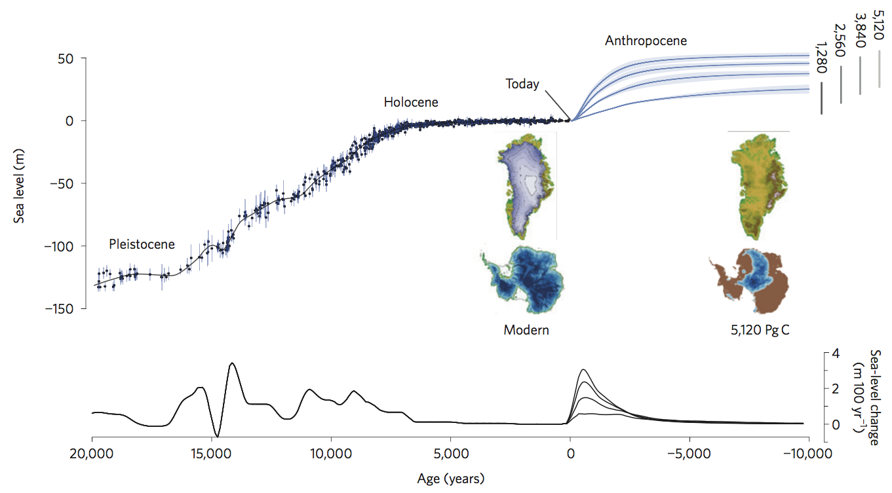
LONG-TERM PERSPECTIVE, CONTINUED
We have already emitted
580 ± 70 Gt C
Clark et al., 2016, Nature Climate Change
Notes:
Historical sea level since the last glacial maximum
And projections into future for 10kyr
Numbers in upper right are cumulative amount of carbon (in Gt C) emitted
Vertical grey bars in upper right are uncertainty ranges
5,120 is similar to the RCP8.5 scenario (>50 m sea level rise)
1,280 is similar to the RCP 4.5 scenario (≈25 m)
Under RCP 8.5 scenario, all of Greenland melts, and more than half of Antarctica does as well
The point is, we are committing the world to a VERY LARGE sea level rise, of which we ourselves
Will only see a tiny fraction

Slide 27
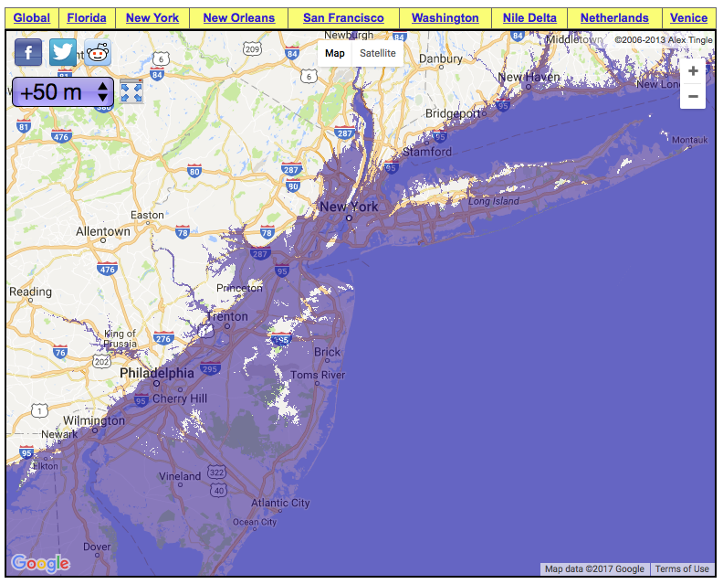

Slide 28
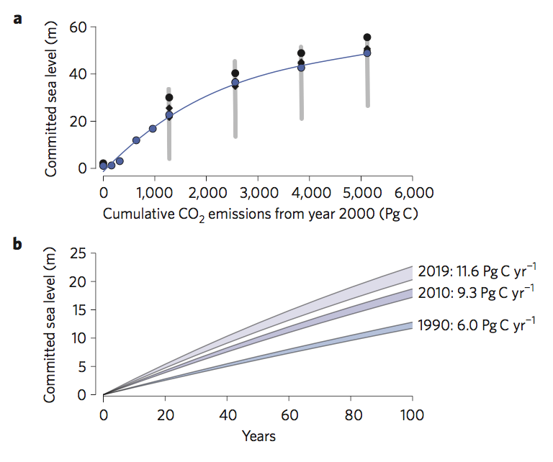
THE HIGHER THE EMISSIONS, THE HIGHER THE FINAL SEA LEVEL
At the current rates of emission, we are committing to approximately 20 cm (8”) of long-term sea level rise EVERY YEAR
Clark et al., 2016, Nature Climate Change
Notes:
Lower panel: committed sea level rise vs years of emission, at emission rates similar to recent / current
At the current rates of emission, we are committing to approximately 20 cm (8”) of long-term sea level rise every year

Slide 29
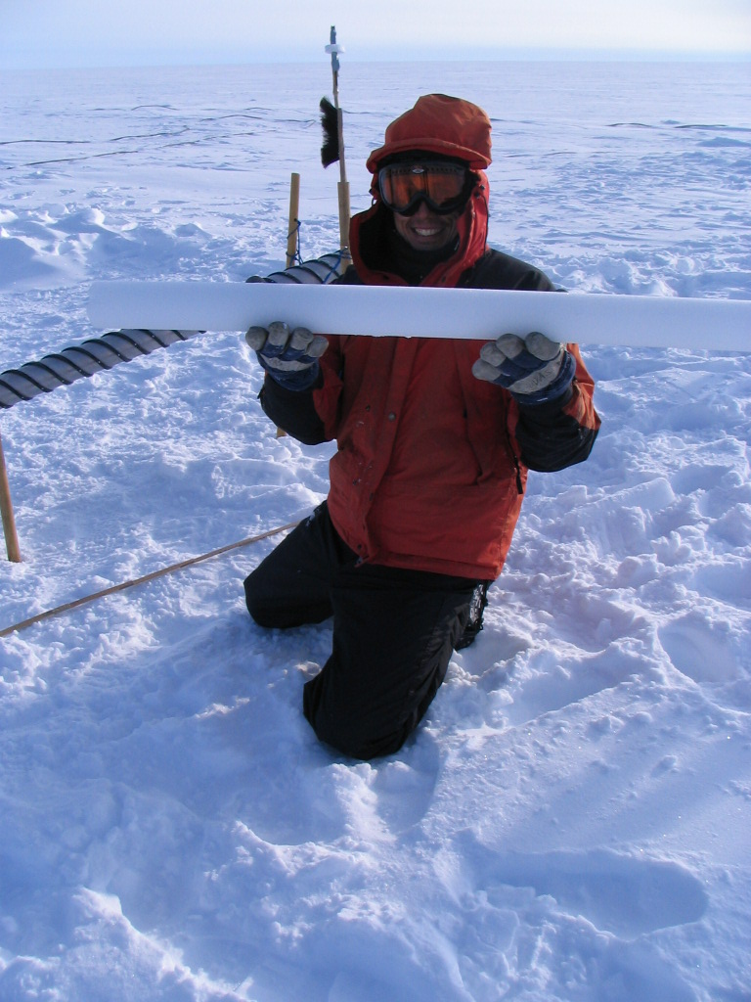
MY RESEARCH: ANCIENT ATMOSPHERIC COMPOSITION FROM ICE CORES
What ice cores have to offer:
High Time Resolution
Excellent record preservation
Temperature
Past atmosphere
Wind, aerosols
Notes:
Will only talk about ice cores in general terms

Slide 30
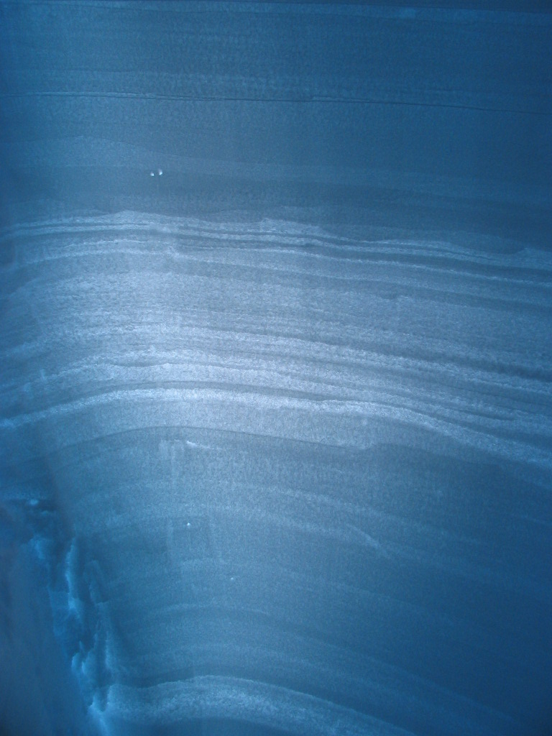
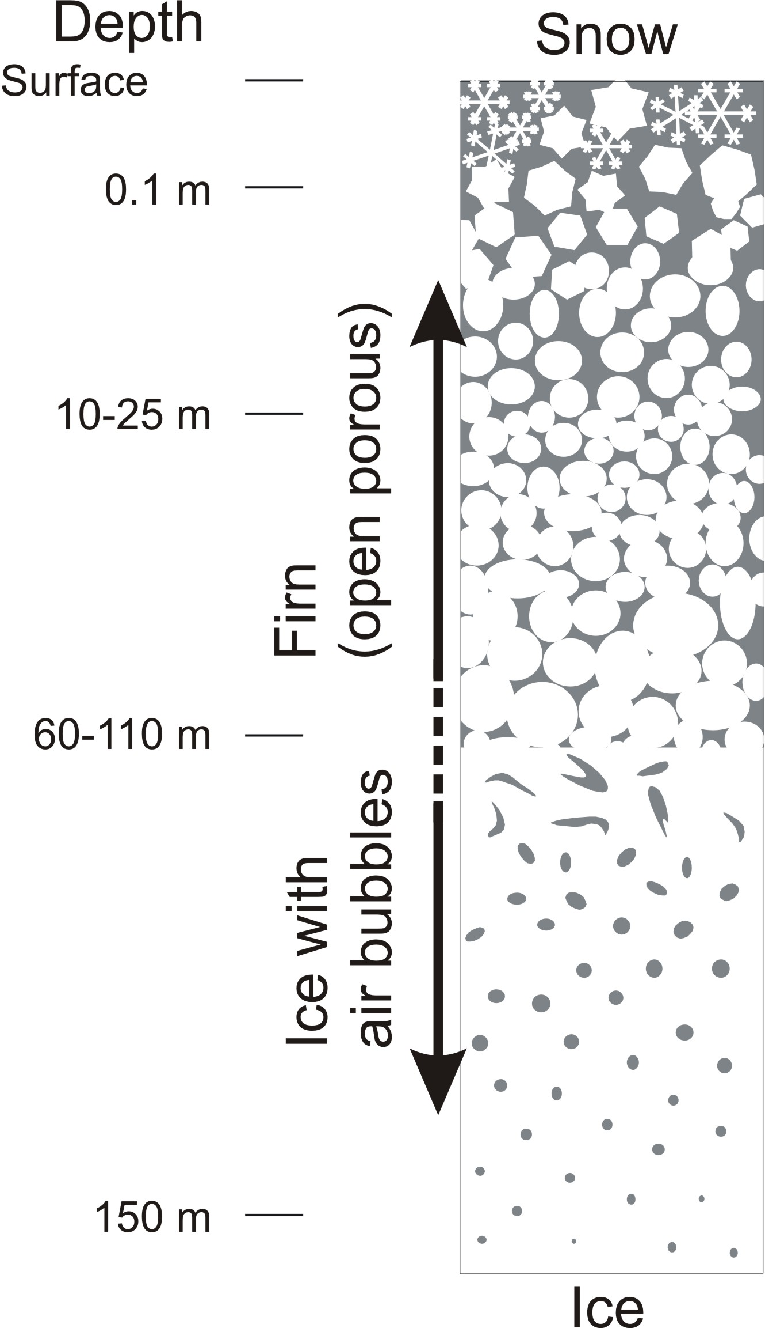
HOW DO ICE CORES WORK?
Center for Ice and Climate, U Copenhagen
Notes:
How glacial ice forms
Layering
Each layer preserves information
Gases: explain firn

Slide 31
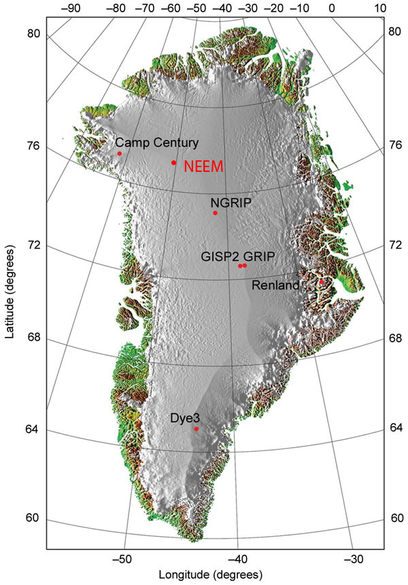
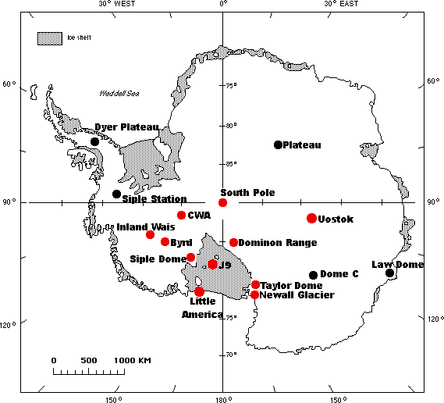
WHERE ARE ICE CORES DRILLED?
Center for Ice and Climate
NICL
Greenland:
- up to 2 miles thick
- 130,000 + yrs old
Antarctica:
- up to 2.5 miles thick
- 800,000 + yrs old
Notes:
Major ice core sites
Shorter ice cores have been drilled on mountain glaciers: even Kilimanjaro!
Why Antarctic ice is older

Slide 32
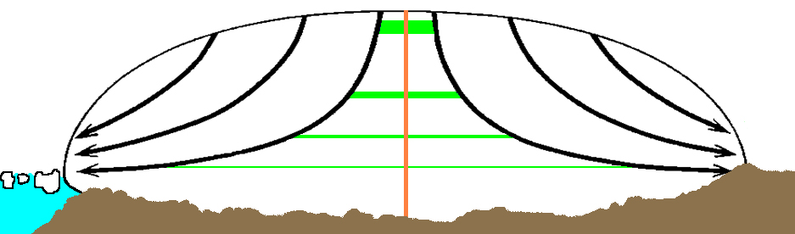
ICE LAYER THINNING
Center for Ice and Climate, U Copenhagen
Notes:
Ice flows
Because of this layers are thinner at depth
Lose resolution, but gain time
Important to choose an ice coring site near a flow divide
So what does a typical ice core site look like?

Slide 33
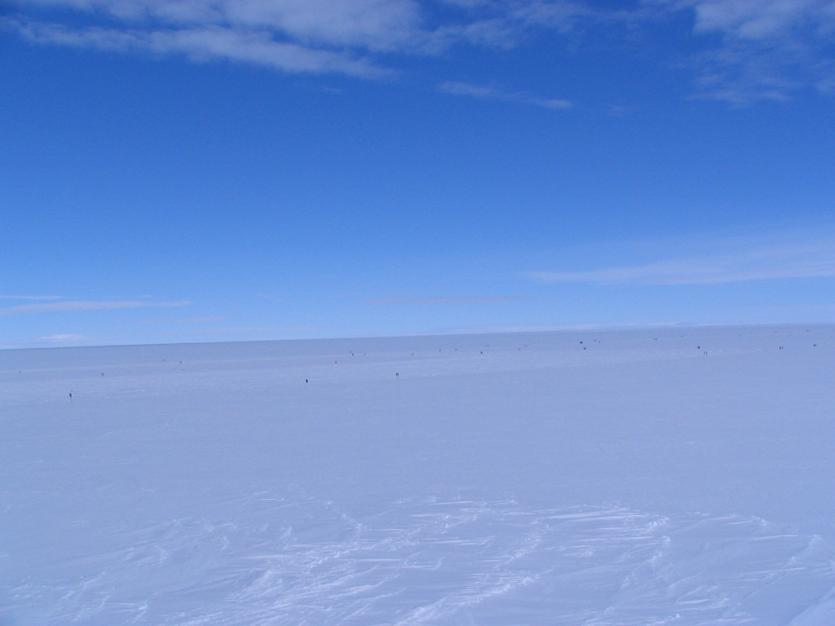
Notes:
What does it look like once we start drilling?

Slide 34
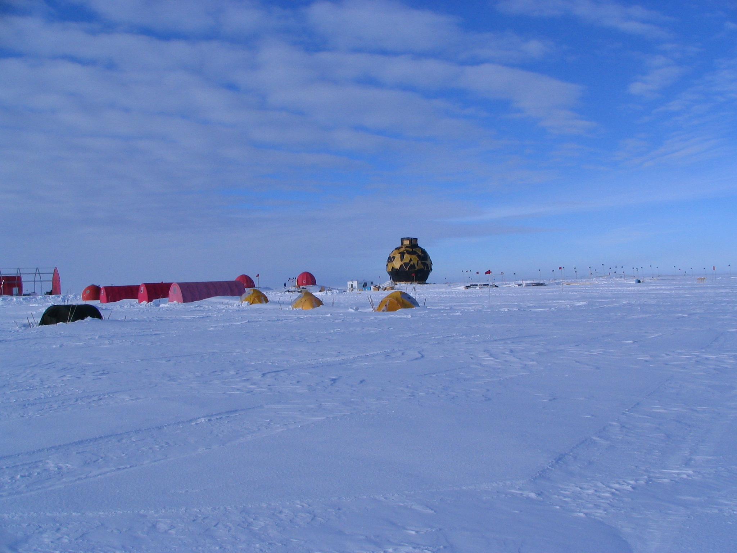
Notes:
Show Movie of WAIS drilling and pass around ice samples

Slide 35

Notes:
PASS AROUND ICE SAMPLES!
WAIS video by Todd Rampendahl
Drill re-appears at 1:35
Deep ice coring projects are massive – lots of people, resources and $$

