Slide 1
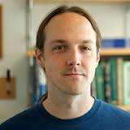
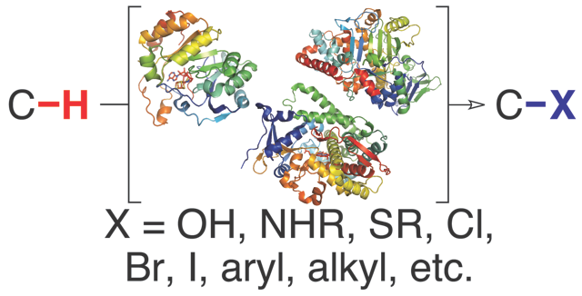
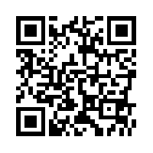
Guest Speaker:
PROFESSOR JARED LEWIS
UNVERSITY OF CHICAGO
SEARLE CHEMISTRY LAB
ORGANIC SEMINAR
Friday, October 7th 2016
9:00 a.m.
Hutchison Hall 473
University of Rochester
Department of Chemistry
“Engineering Proteins for Selective Catalysis ”
Abstract: Proteins have great potential as scaffolds to control the selectivity of catalysts and reactive intermediates contained within their structures. Techniques to improve the substrate scope and alter the selectivity of natural enzymes are now well established, and examples in which enzymes are used to catalyze synthetically useful, non-native reactions are appearing with increasing frequency. This trend of using proteins to control chemical reactivity has been further extended through the development of artificial metalloenzymes, hybrid catalysts comprised of synthetic cofactors linked to protein scaffolds. I will discuss efforts by my group aimed at engineering natural enzymes and artificial metalloenzymes for selective C-H bond functionalization and other challenging transformations. The examples presented will highlight the potential for molecular recognition and evolution to enable new methods and strategies for organic synthesis.
Host: Professor Rudi Fasan, email: rfasan@ur.rochester.edu

