Slide 1
Agenda: Complex Processes in Nature and Laboratory
Order and Chaos, determinism and unpredictability
Non-linear dynamics in nature and their modeling
Examples (climate, planetary motion),
mathematical model (logistic map)
Stability criteria, stationary states
Complex kinetics in coupled chemical reactions
Self-organization in coupled chemical reactions
Application: Self-replication in autocatalytic reactions
Cellular automata and fractal structures
Thermodynamic states and their transformations
Collective and chaotic multi-particle systems
Equilibration of transferred energy
Flow of heat and radiation
Laws of thermodynamics, ensembles
Reading Assignments
Weeks 3 &4
LN II.6, III.1:
Kondepudi Ch. 9.6
Additional Material
McQuarrie & Simon
Ch. 3.1 -3.4
Math Chapters
MC B, C, D,

Slide 2
Multi-Dimensional/Particle Systems
Complex kinetics (kinematics) behavior of complex, multi-particle systems:
time evolution is extremely sensitive to initial conditions.
Seemingly: Particles in a multi-particle systems move predominantly in random directions and with quasi-random velocities.
Why?
→ result of multiple scattering.
Example of molecular scattering off an ordered crystal lattice.
Therefore, one can use statistical-probabilistic arguments in discussing average properties of such systems.
Notes:
At these troubled times in the live of the nation, and all around the globe, people often hear the phrase “statistics” or “statistical” in the contexts of the pandemics, the economy, the climate change, partitions of the body politic, etc.
More often than usual, one can detect an attitude of suspicion or disbelief best described by a aphorism attributed to Disraeli., “There are 3 kinds of lies, lies, damn lies, and statistics.”

Slide 3
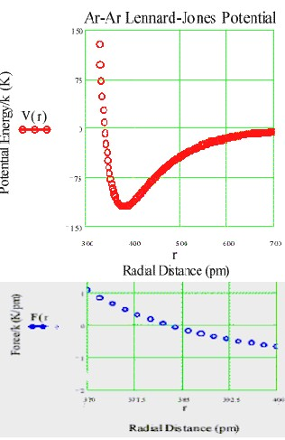
Potential Interacting Energies
Lennard-Jones Potential
Multi-Particle Systems (3D): N≫1
Lennard-Jones potential: Attractive (< 0) at intermediate & large distances, repulsive at small distances
depth range
Potential
Force

Slide 4
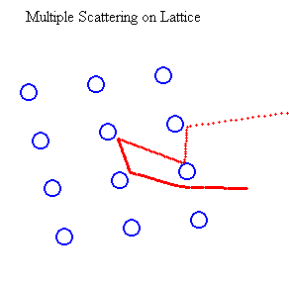
Randomization through Multiple Interactions
A number “projectile” particles enter the system at various positions from the right with identical momenta (e.g., kicked by racket).
A lattice of very heavy (M) bound atoms or ions is hit by fast projectiles (m « M).
Depending on how and where the first lattice particle is hit, the next few collisions and their momentum and energy transfers change.
Projectiles
The result is a random pattern of projectile deflections, momenta and energies. The particles hit by the projectiles are also accelerated and deflected to various extents. They themselves become projectiles and collide with other gas particles. In this fashion, the energy of the projectile is dissipated over all particles in the system.
Collisions with unbound gas particles are “much more” random than collisions with a periodic solid-sate lattice structure.

Slide 5
Random Velocity Distribution
Impact parameter
before
b=0
Head on
after
Particle velocities change differently through different collisions
→ random speeds, random 3D directions
→ for all possible
Impact parameter
before
b>0
Glancing
after

Slide 6
Random Velocity Distribution
Impact parameter
before
b=0
Head on
after
Particle velocities change differently through different collisions
→ random speeds, random 3D directions
→ for all possible
Impact parameter
before
b>0
Glancing
after

Slide 7
Maxwell-Boltzmann Velocity Distribution
Impact parameter
before
b=0
Head on
after
Particle velocities change differently through different collisions
→ random speeds, random 3D directions
→ for all possible
Impact parameter
before
b>0
Glancing
after
We call
Boltzmann Factor

Slide 8
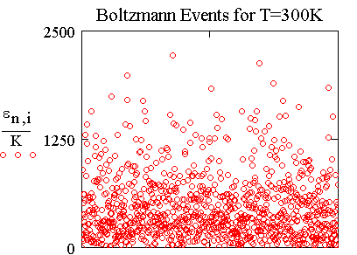
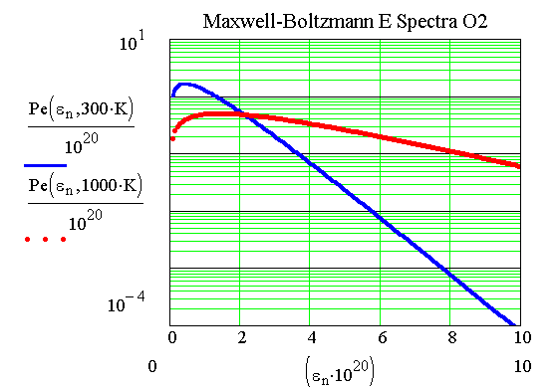
The Final State: Randomized Thermal Energy
Particles in gas volume collide continuously. Transfer of momentum and energy occur depending centrality of collisions (head on,……., grazing) like ≙ hard spheres.
→ randomly fluctuating (“thermal”) “Maxwell-Boltzmann” kinetic-energy spectrum.
(Ideal gas: internal U= ε (kinetic energy), no potential energy ≙ no interactions)

Slide 9
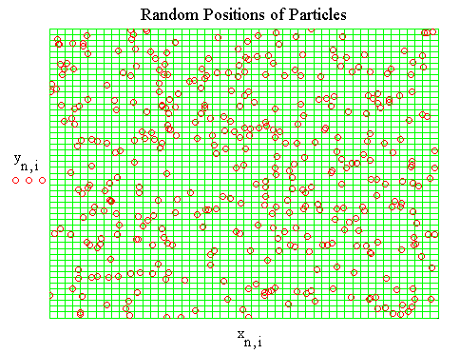
Random (Thermal) Motion in Space
Example: Motion in two dimensions of 300 non-interacting (ideal-gas) particles.
All particles move in random directions because of multiple collisions, which actually do occur but are not explicitly treated here.
Every particle visits every one of the energetically equivalent cells.
Contrast: Collective motion.
Particles in a gas move in different directions and at different speeds, colliding with one another often. Eventually, their positions at any given time are random.
All available (accessible) space is visited by all particles (in due time).
→ Ergodic Theorem

Slide 10
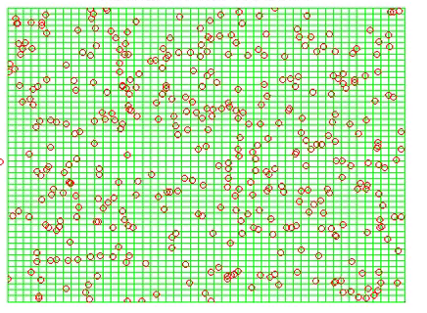
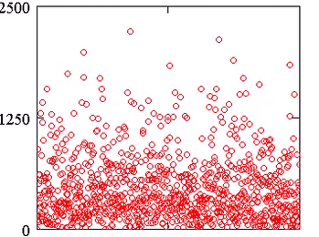
Microscopic Particle Phase Space
Energy transfer to gas of independent particles in containment.
By scattering or by incoherent (short wavelength) radiation → chaotic motion of particles in space → transferred energy is dissipated → not totally reversible
Snapshot (time) = microscopic state of multi-particle system
Particle Position y_{i} (a.u.)
Particle Kinetic Energy_{i} (a.u.)
Particle Position x_{i} (a.u.)
Particle Number i
Chaotic motion in configuration space. Characteristic velocity and energy spectrum (Maxwell-Boltzmann).
Massive (m_{i}) particles:
Notes:
At these troubled times in the live of the nation, and all around the globe, people often hear the phrase “statistics” or “statistical” in the contexts of the pandemics, the economy, the climate change, partitions of the body politic, etc.
More often than usual, one can detect an attitude of suspicion or disbelief best described by a aphorism attributed to Disraeli., “There are 3 kinds of lies, lies, damn lies, and statistics.”

Slide 11

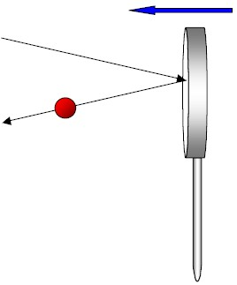
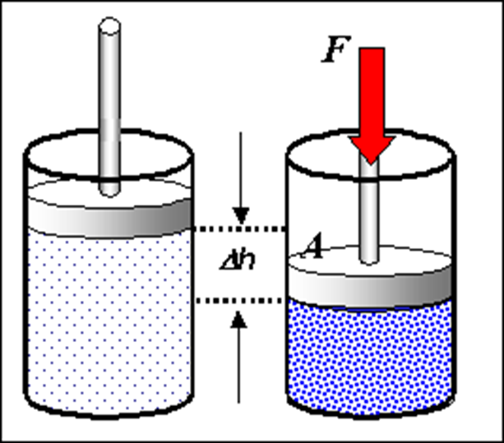
Compression Work as Energy Transfer
Thrust
velocity
Energy and momentum are transferred to gas particles hit by a (collectively) moving piston, depending on the relative velocity of piston and gas particle.
gas particle
|Δp| >0
-
The effect is similar to that driving a tennis ball with a racket.
Thermally insolated system (cylinder with gas)
Compressed gas has more energy in random motion than before. Transfer collective → random motion = dissipation of collective energy into heat.
V
h

Slide 12

Physical Changes: Compression of (Ideal) Gases
Compression of a gas volume V
(= “System”)
with a constant force F (e.g., weight) on a constant area A:
→ Pressure p = Force F/Area A,
at p = p_{ext} =const
(external, not internal)
-
V
h
Sign Convention work: Compressional work on a gas volume (=system) increases the internal energy E of the gas .
Therefore, work w > 0 is counted as positive (done on gas).

Slide 13
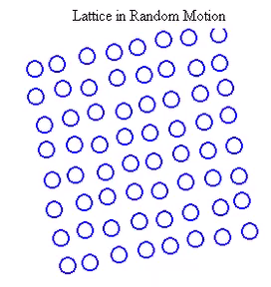
Thermal Motion in Solids
The individual constituents (atoms or ions) of an excited lattice have on average the same thermal energy. If one increases this average energy by introducing energy from the surroundings, the displacements of the particles increase.
At higher excitations, the structure begins to disappear, the lattice is “melting”, becomes a liquid and, eventually, a gas..
The average kinetic energy of each particle
is known as “temperature” (units of k_{B})

Slide 14
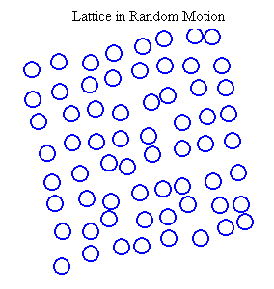
Thermal Motion in Solids (2)
The individual constituents (atoms or ions) of an excited lattice have on average the same thermal energy. If one increases this average energy by introducing energy from the surroundings, the displacements of the particles increase.
At higher excitations, the structure begins to disappear, the lattice is “melting”, becomes a liquid and, eventually, a gas..
The average kinetic energy of each particle
is known as “temperature” (units of k_{B})

Slide 15
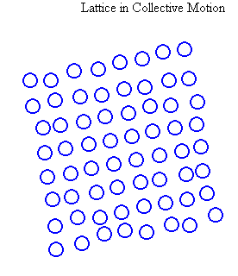
Collective (Synchronized) Motion of Solids
Every system has collective modes of motion: Translation,
rotation, shearing,…, which move the individual constituents in phase with each other, i.e., move the system as a whole.
Collective stretching and compression mode of a lattice.
Collective motion is often damped,
its energy dissipated → radiation

Slide 16
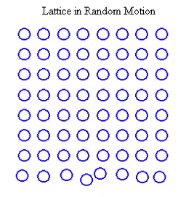
Conduction of Thermal Energy in Solids
T_{c}
Like in a gas, so in every system, energy and density distortions caused by incoming projectiles or photons propagate through the system.
In a solid, where the constituents are bound at lattice sites, collision-like interactions (vibrational redistribution) lead to the dissipation of the deposited energy, i.e., its “even” distribution throughout the system.
Systems at any temperature emit thermal radiation (IR photons), which are absorbed (possibly re-emitted) by objects in the environment.
L
T_{h}
A
Hotplate
Energy flow: hot → cold

Slide 17
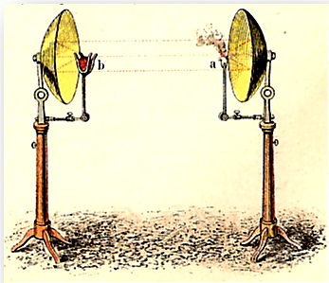
Heat Radiation
Heat can be transferred by electromagnetic radiation → incoherent "light"

Slide 18
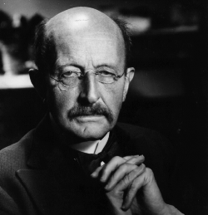
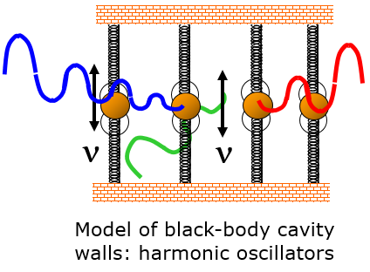
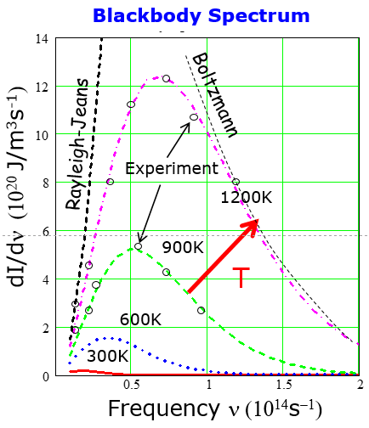
Planck’s Thermal (Blackbody) Radiation
Experimental electromagnetic energy spectrum emitted by a mass (“black” body) @ T. Radiation (photon) energy
→ Elm energy is quantized
Max Planck
(1900)
Power density: universal shape
Stefan-Boltzmann Law: Total thermal power

Slide 19
Transfer of Randomized Energy: Heat Flow
Thermometers
Heat conduction, flux=current density through area A
T_{h}
T_{l}
https://www.schoolmykids.com/learn/interactive-periodic-table/thermal-conductivity-of-all-the-elements
Heat convection: Heat transfer via particles (mass flow)
A
Heat radiation: Heat transfer via elm. photons

Slide 20
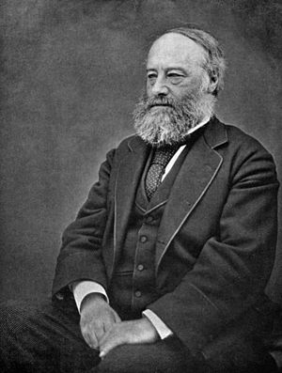
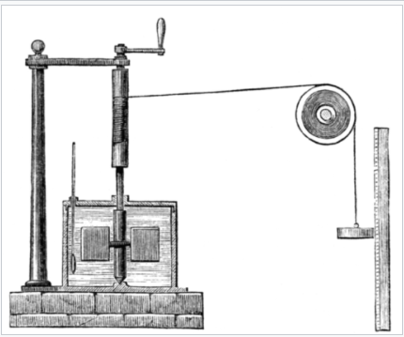

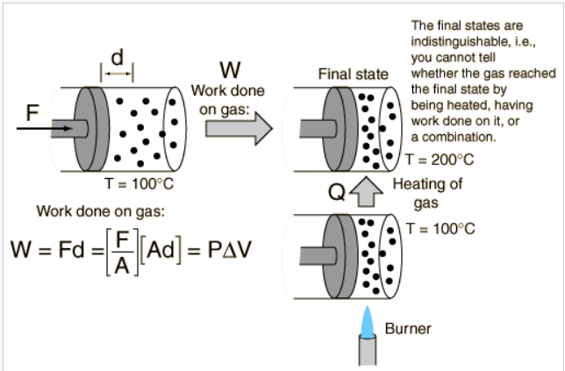

Mechanical Equivalent of Heat
"An Experimental Enquiry Concerning the Source of the Heat which is Excited by Friction", (1798), Philosophical Transactions of the Royal Society p. 102
Joule's experiment
Crank
Thermometer
Ruler
Work Heat
Calorimeter
James Prescott Joule
1818-1889
Paddle wheel
Weight
P-V Work
Specific heat Energy(T) = C·T
Heat energy required for heating
1g material by ΔT=1⁰C
“Heat Bath”
of H₂O: C_{V}(…) ≈ (4.17- 4.22) J/(g·°C)
After Wikipedia

Slide 21
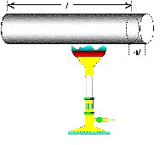
Conversion of Heat to Potential Energy
Can heat energy be converted to mechanical work?
Solid state material, many ions arranged in a lattice enforced by interaction potential V(distance), Lennard-Jones potential is an example.
When the internal energy of the lattice (ion kinetic+pot energies ) is increased, atoms must move up the potential and therefore further apart.
→ A metal bar expands when heat energy is supplied.
L
ΔL
Q: Can this expansion work on the environment? Examples?
Q: Is the expansion reversable, contracting on cooling down, oscillating?
Q: Know examples where compression produces heat?

Slide 22
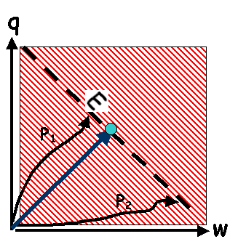
Equivalence of Work and Heat Energy
absorbed by system
Performing (any kind of) work on a complex system or transferring heat to it has eventually the same effect.
→ A given energy state U can be reached along different pathways transferring energy
All that counts is the total internal energy U= w+q, which in equilibrium (long times) is distributed evenly over all degrees of freedom.
For structure-less particles, U is entirely = kinetic energy.
U
E = const.
done on system
The opposite is also true, e.g., when the system does work or emits heat:
The energy loss suffered is equal to the sum of work done and heat emitted by the system.
Convert heat energy to mechanical work

Slide 23
Energy Transfer between System & Surroundings
Energy transferred to N-particle system (e.g., a gas volume) by mechanical (or other) work is randomized by multiple interactions of system constituents (particles in a gas or solid lattice).
This energy dissipation process takes some time.
After “relaxation time,” all N system particles move
randomly & share total energy on average equally:
Stationary random macroscopic state = “Thermal Equilibrium.”
In this stationary macro-state, microscopic configurations fluctuate over entire range → all memory of history is lost. Mode of previous energy transfer (work or heat ?) cannot be answered.
→ Neither applied work nor transferred heat are state functions.
(Total) Energy U(N) is an extensive state variable (“state function”), characteristic of the (macroscopic) state of the system, scales with size.

Slide 24
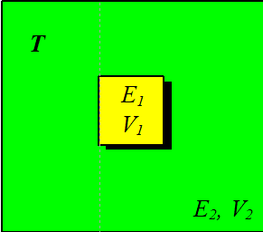
Classification: Random Statistical Ensembles
E: total energy, V : containment volume, N : constituent number
Ensemble: many identically prepared systems
Micro-canonical ensemble
Isolated systems: Total energy E, linear and angular momentum are well defined and conserved. Particle number N and system volume V are well defined and conserved. Macro-state characterized by E, N,V
E, N,
V
Heat Bath
Canonical ensemble
Closed systems: Particle number N and system volume V are well defined and conserved.
Exchange of energy (and other kinematic quantities) with surrounding “Heat Bath”→ fluctuate
Stationary macro-state characterized by T,N,V. → Combined, system and reservoirs = isolated system
N
V,T
Notes:
At these troubled times in the live of the nation, and all around the globe, people often hear the phrase “statistics” or “statistical” in the contexts of the pandemics, the economy, the climate change, partitions of the body politic, etc.
More often than usual, one can detect an attitude of suspicion or disbelief best described by a aphorism attributed to Disraeli., “There are 3 kinds of lies, lies, damn lies, and statistics.”

Slide 25
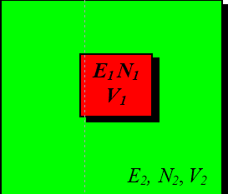
T μ
Classification: Random Statistical Ensembles
E: total energy, V : containment volume, N : constituent number
Ensemble: many identically prepared systems
Grand-canonical ensemble
Open systems: Exchange of energy and particles occur with surrounding particle reservoir and ”Heat Bath.”
Stationary macro-state is characterized by T, μ.
μ : chemical potential energy per particle.
→ Combined, system and reservoirs = isolated system
Homogenous subparts of a heterogenous system are its phases (solid, liquid, gas), separating surfaces are phase boundaries.
Extensive (additive) state variables scale in proportion to system mass (number of particles). Examples: volume and total energy.
Intensive state variables do not scale with the size of the system. Examples are pressure, temperature, refractive index
Notes:
At these troubled times in the live of the nation, and all around the globe, people often hear the phrase “statistics” or “statistical” in the contexts of the pandemics, the economy, the climate change, partitions of the body politic, etc.
More often than usual, one can detect an attitude of suspicion or disbelief best described by a aphorism attributed to Disraeli., “There are 3 kinds of lies, lies, damn lies, and statistics.”

Slide 26
Laws of Statistical Thermodynamics
0) For two systems in contact, mean kinetic energies equalize (“equilibrate”). Equal temperatures for canonical and grand canonical ensembles.
1) Energy (of system plus surroundings) is conserved.
2) Spontaneous processes increase complexity (Entropy).
Corollary: Processes between equivalent complex states are reversible.
3) There exists an absolute “zero point” at which energy and complexity are at a minimum for any system.
Notes:
At these troubled times in the live of the nation, and all around the globe, people often hear the phrase “statistics” or “statistical” in the contexts of the pandemics, the economy, the climate change, partitions of the body politic, etc.
More often than usual, one can detect an attitude of suspicion or disbelief best described by a aphorism attributed to Disraeli., “There are 3 kinds of lies, lies, damn lies, and statistics.”

Slide 27
End
Complex N-Particle Systems

