Slide 1
Agenda: Complex Processes in Nature and Laboratory
Order and Chaos, determinism and unpredictability
Non-linear dynamics in nature and their modeling
Examples (climate, planetary motion),
mathematical model (logistic map)
Stability criteria, stationary states
Complex kinetics in coupled chemical reactions
Self-organization in coupled chemical reactions
Application: Self-replication in autocatalytic reactions
Cellular automata and fractal structures
Thermodynamic states and their transformations
Collective and chaotic multi-particle systems
Equilibration of transferred energy
Flow of heat and radiation
Laws of thermodynamics, ensembles
Reading Assignments
Weeks 3 &4
LN II.6, III.1:
Kondepudi Ch. 9.6
Additional Material
McQuarrie & Simon
Ch. 3.1 -3.4
Math Chapters
MC B, C, D,

Slide 2
Multi-Dimensional/Particle Systems
Complex kinetics (kinematics) behavior of complex, multi-particle systems:
time evolution is extremely sensitive to initial conditions.
Seemingly: Particles in a multi-particle systems move predominantly in random directions and with quasi-random velocities.
Why?
→ result of multiple scattering.
Example of molecular scattering off an ordered crystal lattice.
Therefore, one can use statistical-probabilistic arguments in discussing average properties of such systems.
Notes:
At these troubled times in the live of the nation, and all around the globe, people often hear the phrase “statistics” or “statistical” in the contexts of the pandemics, the economy, the climate change, partitions of the body politic, etc.
More often than usual, one can detect an attitude of suspicion or disbelief best described by a aphorism attributed to Disraeli., “There are 3 kinds of lies, lies, damn lies, and statistics.”

Slide 3
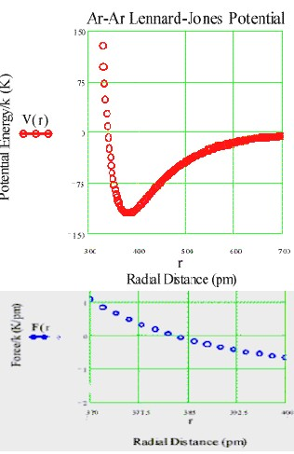
Potential Interacting Energies
Lennard-Jones Potential
Multi-Particle Systems (3D): N≫1
Lennard-Jones potential: Attractive (< 0) at intermediate & large distances, repulsive at small distances
depth range
Potential
Force

Slide 4
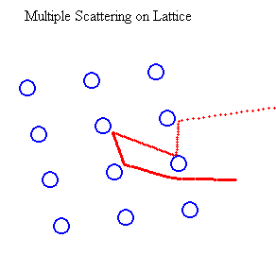
Randomization through Multiple Interactions
A number “projectile” particles enter the system at various positions from the right with identical momenta (e.g., kicked by racket).
A lattice of very heavy (M) bound atoms or ions is hit by fast projectiles (m « M).
Depending on how and where the first lattice particle is hit, the next few collisions and their momentum and energy transfers change.
Projectiles
The result is a random pattern of projectile deflections, momenta and energies. The particles hit by the projectiles are also accelerated and deflected to various extents. They themselves become projectiles and collide with other gas particles. In this fashion, the energy of the projectile is dissipated over all particles in the system.
Collisions with unbound gas particles are “much more” random than collisions with a periodic solid-sate lattice structure.

Slide 5
Random Velocity Distribution
Impact parameter
before
b=0
Head on
after
Particle velocities change differently through different collisions
→ random speeds, random 3D directions
→ for all possible
Impact parameter
before
b>0
Glancing
after

Slide 6
Random Velocity Distribution
Impact parameter
before
b=0
Head on
after
Particle velocities change differently through different collisions
→ random speeds, random 3D directions
→ for all possible
Impact parameter
before
b>0
Glancing
after

Slide 7
Maxwell-Boltzmann Velocity Distribution
Impact parameter
before
b=0
Head on
after
Particle velocities change differently through different collisions
→ random speeds, random 3D directions
→ for all possible
Impact parameter
before
b>0
Glancing
after
We call
Boltzmann Factor

Slide 8
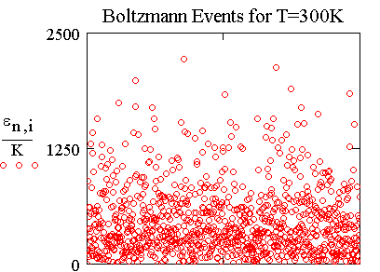
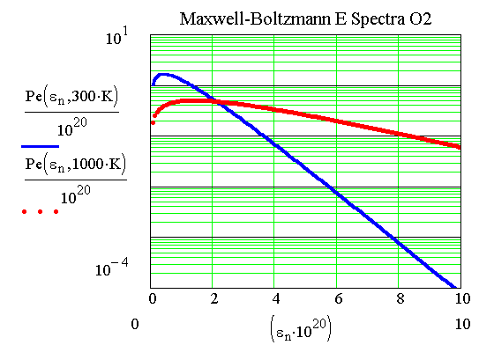
The Final State: Randomized Thermal Energy
Particles in gas volume collide continuously. Transfer of momentum and energy occur depending centrality of collisions (head on,……., grazing) like ≙ hard spheres.
→ randomly fluctuating (“thermal”) “Maxwell-Boltzmann” kinetic-energy spectrum.
(Ideal gas: internal U= ε (kinetic energy), no potential energy ≙ no interactions)

Slide 9
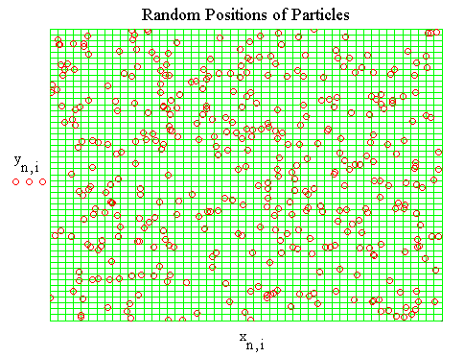
Random (Thermal) Motion in Space
Example: Motion in two dimensions of 300 non-interacting (ideal-gas) particles.
All particles move in random directions because of multiple collisions, which actually do occur but are not explicitly treated here.
Every particle visits every one of the energetically equivalent cells.
Contrast: Collective motion.
Particles in a gas move in different directions and at different speeds, colliding with one another often. Eventually, their positions at any given time are random.
All available (accessible) space is visited by all particles (in due time).
→ Ergodic Theorem

Slide 10
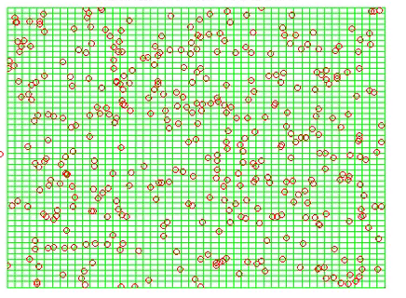
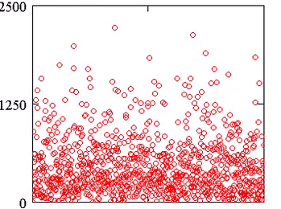
Microscopic Particle Phase Space
Energy transfer to gas of independent particles in containment.
By scattering or by incoherent (short wavelength) radiation → chaotic motion of particles in space → transferred energy is dissipated → not totally reversible
Snapshot (time) = microscopic state of multi-particle system
Particle Position y_{i} (a.u.)
Particle Kinetic Energy_{i} (a.u.)
Particle Position x_{i} (a.u.)
Particle Number i
Chaotic motion in configuration space. Characteristic velocity and energy spectrum (Maxwell-Boltzmann).
Massive (m_{i}) particles:
Notes:
At these troubled times in the live of the nation, and all around the globe, people often hear the phrase “statistics” or “statistical” in the contexts of the pandemics, the economy, the climate change, partitions of the body politic, etc.
More often than usual, one can detect an attitude of suspicion or disbelief best described by a aphorism attributed to Disraeli., “There are 3 kinds of lies, lies, damn lies, and statistics.”

Slide 11
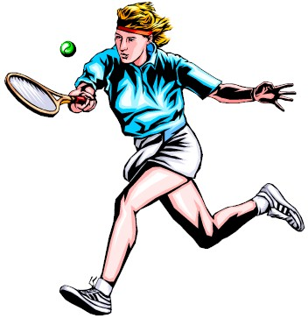
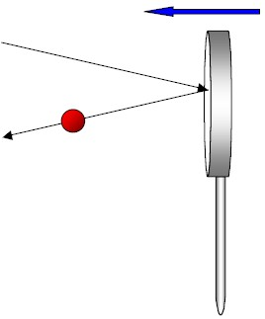
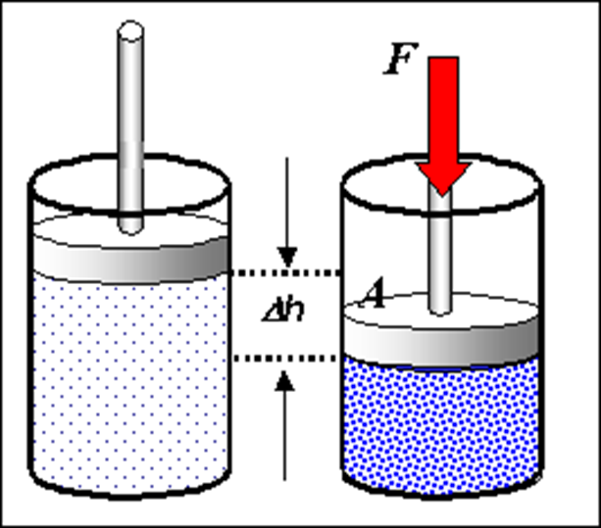
Compression Work as Energy Transfer
Thrust
velocity
Energy and momentum are transferred to gas particles hit by a (collectively) moving piston, depending on the relative velocity of piston and gas particle.
gas particle
|Δp| >0
-
The effect is similar to that driving a tennis ball with a racket.
Thermally insolated system (cylinder with gas)
Compressed gas has more energy in random motion than before. Transfer collective → random motion = dissipation of collective energy into heat.
V
h

Slide 12

Physical Changes: Compression of (Ideal) Gases
Compression of a gas volume V
(= “System”)
with a constant force F (e.g., weight) on a constant area A:
→ Pressure p = Force F/Area A,
at p = p_{ext} =const
(external, not internal)
-
V
h
Sign Convention work: Compressional work on a gas volume (=system) increases the internal energy E of the gas .
Therefore, work w > 0 is counted as positive (done on gas).

Slide 13
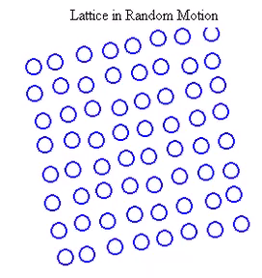
Thermal Motion in Solids
The individual constituents (atoms or ions) of an excited lattice have on average the same thermal energy. If one increases this average energy by introducing energy from the surroundings, the displacements of the particles increase.
At higher excitations, the structure begins to disappear, the lattice is “melting”, becomes a liquid and, eventually, a gas..
The average kinetic energy of each particle
is known as “temperature” (units of k_{B})

Slide 14
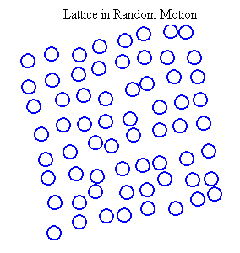
Thermal Motion in Solids (2)
The individual constituents (atoms or ions) of an excited lattice have on average the same thermal energy. If one increases this average energy by introducing energy from the surroundings, the displacements of the particles increase.
At higher excitations, the structure begins to disappear, the lattice is “melting”, becomes a liquid and, eventually, a gas..
The average kinetic energy of each particle
is known as “temperature” (units of k_{B})

Slide 15
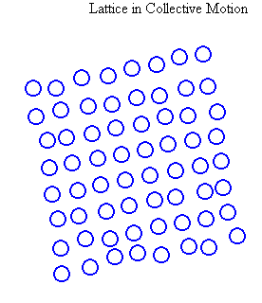
Collective (Synchronized) Motion of Solids
Every system has collective modes of motion: Translation,
rotation, shearing,…, which move the individual constituents in phase with each other, i.e., move the system as a whole.
Collective stretching and compression mode of a lattice.
Collective motion is often damped,
its energy dissipated → radiation

Slide 16
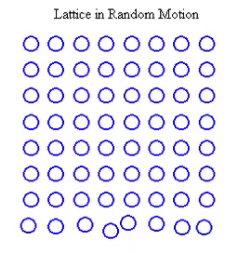
Conduction of Thermal Energy in Solids
T_{c}
Like in a gas, so in every system, energy and density distortions caused by incoming projectiles or photons propagate through the system.
In a solid, where the constituents are bound at lattice sites, collision-like interactions (vibrational redistribution) lead to the dissipation of the deposited energy, i.e., its “even” distribution throughout the system.
Systems at any temperature emit thermal radiation (IR photons), which are absorbed (possibly re-emitted) by objects in the environment.
L
T_{h}
A
Hotplate
Energy flow: hot → cold

Slide 17
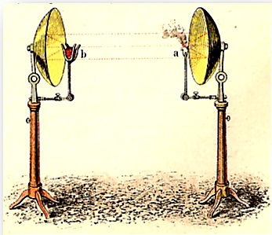
Heat Radiation
Heat can be transferred by electromagnetic radiation → incoherent "light"

Slide 18
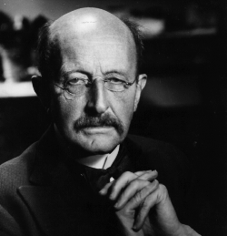
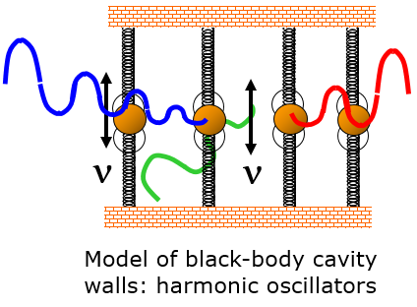
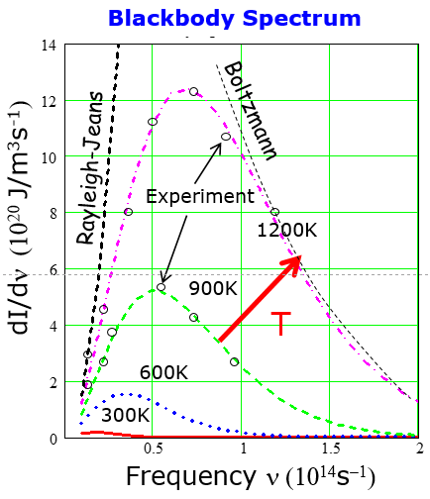
Planck’s Thermal (Blackbody) Radiation
Experimental electromagnetic energy spectrum emitted by a mass (“black” body) @ T. Radiation (photon) energy
→ Elm energy is quantized
Max Planck
(1900)
Power density: universal shape
Stefan-Boltzmann Law: Total thermal power

Slide 19
Transfer of Randomized Energy: Heat Flow
Thermometers
Heat conduction, flux=current density through area A
T_{h}
T_{l}
https://www.schoolmykids.com/learn/interactive-periodic-table/thermal-conductivity-of-all-the-elements
Heat convection: Heat transfer via particles (mass flow)
A
Heat radiation: Heat transfer via elm. photons

Slide 20
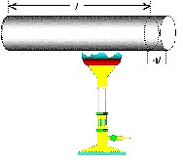
Conversion of Heat to Potential Energy
Q: Does the shape of the Lennard-Jones potential make sense? Consider what happens when a metal bar is heated (energy is transferred to a solid crystal lattice).
A: When the internal energy of the lattice is increased, atoms have to move up the potential and therefore further apart. The metal bar expands when energy is supplied (heat).
L
ΔL
Q: Other constraints requiring specific shape of potential?
Q: Is the expansion reversable, contracting on cooling down, oscillating?

Slide 21
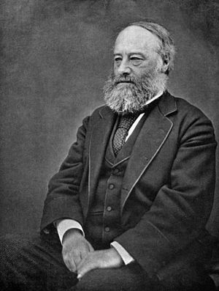
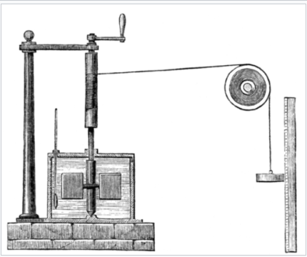

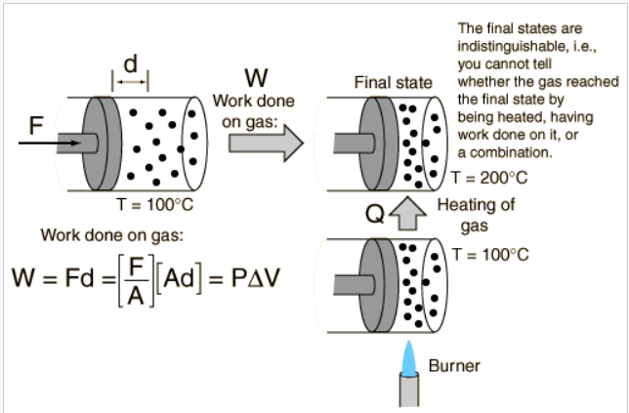

Mechanical Equivalent of Heat
"An Experimental Enquiry Concerning the Source of the Heat which is Excited by Friction", (1798), Philosophical Transactions of the Royal Society p. 102
Joule's experiment
Crank
Thermometer
Ruler
Work Heat
Calorimeter
James Prescott Joule
1818-1889
Paddle wheel
Weight
P-V Work
Specific heat Energy(T) = C·T
Heat energy required for heating
1g material by ΔT=1⁰C
“Heat Bath”
of H₂O: C_{V}(…) ≈ (4.17- 4.22) J/(g·°C)
After Wikipedia

Slide 22
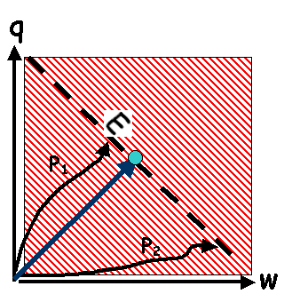
Equivalence of Work and Heat Energy
absorbed by system
Performing (any kind of) work on a complex system or transferring heat to it has eventually the same effect.
→ A given energy state U can be reached along different pathways transferring energy
All that counts is the total internal energy U= w+q, which in equilibrium (long times) is distributed evenly over all degrees of freedom.
For structure-less particles, U is entirely = kinetic energy.
U
E = const.
done on system
The opposite is also true, e.g., when the system does work or emits heat:
The energy loss suffered is equal to the sum of work done and heat emitted by the system.
Convert heat energy to mechanical work

Slide 23
Energy Transfer between System & Surroundings
Energy transferred to N-particle system (e.g., a gas volume) by mechanical (or other) work is randomized by multiple interactions of system constituents (particles in a gas or solid lattice).
This energy dissipation process takes some time.
After “relaxation time,” all N system particles move
randomly & share total energy on average equally:
Stationary random macroscopic state = “Thermal Equilibrium.”
In this stationary macro-state, microscopic configurations fluctuate over entire range → all memory of history is lost. Mode of previous energy transfer (work or heat ?) cannot be answered.
Neither applied work nor transferred heat are state functions.
(Total) Energy U(N) is an extensive state variable (“state function”), characteristic of the (macroscopic) state of the system.

Slide 24
Laws of Statistical Thermodynamics
0) For two systems in contact, mean kinetic energies (temperatures) equilibrate (equalize). Canonical and grand canonical ensembles.
1) Energy (of system plus surroundings) is conserved.
2) Spontaneous processes increase complexity (Entropy).
Corollary: Processes between equivalent complex states are reversible.
3) There exists an absolute “zero point” at which energy and complexity are at a minimum for any system.
Notes:
At these troubled times in the live of the nation, and all around the globe, people often hear the phrase “statistics” or “statistical” in the contexts of the pandemics, the economy, the climate change, partitions of the body politic, etc.
More often than usual, one can detect an attitude of suspicion or disbelief best described by a aphorism attributed to Disraeli., “There are 3 kinds of lies, lies, damn lies, and statistics.”

Slide 25
The First Law of Thermodynamics
In Thermal Equilibrium, the total internal energy (U) is a state variable (state function) characteristic of the state of the system, describing the sum of all kinetic and potential energies of the constituents of the system.
This (internal) energy can be changed by the transfer of heat radiation (q) or by the application of mechanical (electrodynamical, etc…) work (w), such that, in a transition initial → final, the energy changes by
ΔU_{initial→final} = U_{final} - U_{initial} = q + w ∝ ΔT
This is one form of the First Law of TD, the conservation of the total energy. Rigorously, the rest mass energy (E = mc², Einstein et al.) has to be included in the balance. Empirical law: Robert Meyer.

Slide 26
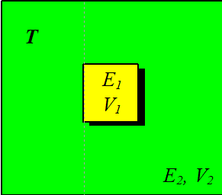
Random Statistical Ensembles
E: total energy, V : containment volume, N : constituent number
Ensemble: many identically prepared systems
Micro-canonical ensemble
Isolated systems: Total energy E, linear and angular momentum are well defined and conserved. Particle number N and system volume V are well defined and conserved. Macro-state characterized by E, N,V
E, N,
V
Heat Bath
Canonical ensemble
Closed systems: Particle number N and system volume V are well defined and conserved.
Exchange of energy (and other kinematic quantities) with surrounding “Heat Bath”→ fluctuate
Stationary macro-state characterized by T,N,V. → Combined, system and reservoirs = isolated system
Notes:
At these troubled times in the live of the nation, and all around the globe, people often hear the phrase “statistics” or “statistical” in the contexts of the pandemics, the economy, the climate change, partitions of the body politic, etc.
More often than usual, one can detect an attitude of suspicion or disbelief best described by a aphorism attributed to Disraeli., “There are 3 kinds of lies, lies, damn lies, and statistics.”

Slide 27
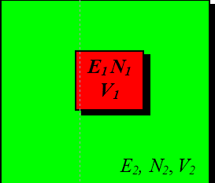
Random Statistical Ensembles
E: total energy, V : containment volume, N : constituent number
Ensemble: many identically prepared systems
Grand-canonical ensemble
Open systems: Exchange of energy and particles occur with surrounding particle reservoir and ”Heat Bath.”
Stationary macro-state is characterized by T, m.
μ : chemical potential energy per particle.
→ Combined, system and reservoirs = isolated system
Homogenous subparts of a heterogenous system are its phases (solid, liquid, gas), separating surfaces are phase boundaries.
Extensive (additive) state variables scale in proportion to system mass (number of particles). Examples: volume and total energy.
Intensive state variables do not scale with the size of the system. Examples are pressure, temperature, refractive index
Notes:
At these troubled times in the live of the nation, and all around the globe, people often hear the phrase “statistics” or “statistical” in the contexts of the pandemics, the economy, the climate change, partitions of the body politic, etc.
More often than usual, one can detect an attitude of suspicion or disbelief best described by a aphorism attributed to Disraeli., “There are 3 kinds of lies, lies, damn lies, and statistics.”

Slide 28
End
Complex N-Particle Systems

Slide 29
Statistics
Reputation of statistics, statistical,…
Benjamin Disraeli (1804-1881) Prime Minister of Great Britain (1874 -1880)
“There are three types of lies: lies, damn lies and statistics"
is often attributed to, because Mark Twain ascribed it to him in a 1907 article in the North American Review: "Figures often beguile me...particularly when I have the arranging of them myself; in which case the remark attributed to Disraeli would often apply with justice and force: 'There are three kinds of lies: lies, damned lies, and statistics.'
Notes:
At these troubled times in the live of the nation, and all around the globe, people often hear the phrase “statistics” or “statistical” in the contexts of the pandemics, the economy, the climate change, partitions of the body politic, etc.
More often than usual, one can detect an attitude of suspicion or disbelief best described by a aphorism attributed to Disraeli., “There are 3 kinds of lies, lies, damn lies, and statistics.”

Slide 30
Agenda: Complex Processes in Nature and Laboratory
Order and Chaos, determinism and unpredictability
Non-linear dynamics in nature and their modeling
Examples (climate, planetary motion),
mathematical model (logistic map)
Stability criteria, stationary states
Complex kinetics in coupled chemical reactions
Self-organization in coupled chemical reactions
Self replication in autocatalytic reactions
Cellular automata and fractal structures
Thermodynamic states and their transformations
Collective and chaotic multi-dimensional systems
Energy equilibration, flow of heat and radiation (Illustrations)
Reading Assignments
Weeks 3 &4
LN III:
Kondepudi Ch. 20
Additional Material
McQuarrie & Simon
Ch. 3 & 4
Math Chapters
MC B, C, D,

Slide 31

Chaotic Multi-Scattering
Chaotic behavior of complex systems:
time evolution is extremely sensitive to initial conditions.
Example:
Multiple scattering of particles (or photons) on a highly ordered crystal lattice.
Impact Parameter
Projectile particles
Crystal
Particles scattered in random directions → molecular chaos
Notes:
At these troubled times in the live of the nation, and all around the globe, people often hear the phrase “statistics” or “statistical” in the contexts of the pandemics, the economy, the climate change, partitions of the body politic, etc.
More often than usual, one can detect an attitude of suspicion or disbelief best described by a aphorism attributed to Disraeli., “There are 3 kinds of lies, lies, damn lies, and statistics.”

Slide 32
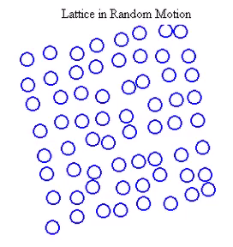
Energy Dissipation
Energy transfer to crystal lattice in elastic particle-particle scattering leads to temporal changes in structure → random motion of ions about equilibrium points in holding potential (quantum mechanics multi-body problem)
Impact Parameter
Projectile particles
Scattering in random directions → random energy transfer (dissipation)
Notes:
At these troubled times in the live of the nation, and all around the globe, people often hear the phrase “statistics” or “statistical” in the contexts of the pandemics, the economy, the climate change, partitions of the body politic, etc.
More often than usual, one can detect an attitude of suspicion or disbelief best described by a aphorism attributed to Disraeli., “There are 3 kinds of lies, lies, damn lies, and statistics.”

Slide 33
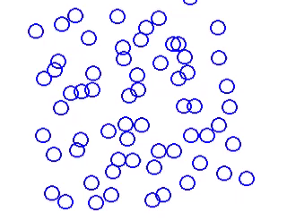
More Energy Dissipation
Energy transfer to crystal lattice in elastic particle-particle scattering leads to temporal changes in structure → random motion of ions about equilibrium points in holding potential (quantum mechanics multi-body problem)
Impact Parameter
Projectile particles
More dissipation → more energy per lattice particle
Notes:
At these troubled times in the live of the nation, and all around the globe, people often hear the phrase “statistics” or “statistical” in the contexts of the pandemics, the economy, the climate change, partitions of the body politic, etc.
More often than usual, one can detect an attitude of suspicion or disbelief best described by a aphorism attributed to Disraeli., “There are 3 kinds of lies, lies, damn lies, and statistics.”

Slide 34
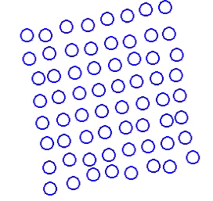
Collective Exitation
Energy transfer to crystal lattice in coherent (long wavelength)→ collective motion of ions in normal vibrational modes ( quantized energy→quantum mechanics problem)
Energy absorbed in discrete packages (quanta) → is not dissipated,
flows back and forth between potential and kinetic energy → can in principle be recovered (re-emitted), except from ground state.
Notes:
At these troubled times in the live of the nation, and all around the globe, people often hear the phrase “statistics” or “statistical” in the contexts of the pandemics, the economy, the climate change, partitions of the body politic, etc.
More often than usual, one can detect an attitude of suspicion or disbelief best described by a aphorism attributed to Disraeli., “There are 3 kinds of lies, lies, damn lies, and statistics.”

Slide 35
Agenda: Information, Probability, Statistical Entropy
Chance and probability
Combinatorics
Information and probability
Partition of probability
Phase space evolution (Eta Theorem)
Partition functions
Gibbs equilibrium, stability
Reading Assignments
Weeks 3 &4
LN III:
Kondepudi Ch. 20
Additional Material
McQuarrie & Simon
Ch. 3 & 4
Math Chapters
MC B, C, D,

Slide 36
Statistics
Reputation of statistics, statistical,…
Notes:
At these troubled times in the live of the nation, and all around the globe, people often hear the phrase “statistics” or “statistical” in the contexts of the pandemics, the economy, the climate change, partitions of the body politic, etc.
More often than usual, one can detect an attitude of suspicion or disbelief best described by a aphorism attributed to Disraeli., “There are 3 kinds of lies, lies, damn lies, and statistics.”

Slide 39
Chance and Necessity
Chance and Necessity
The Reign of Entropy

Slide 40
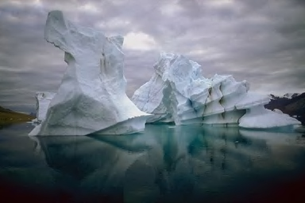
The Ultimate Fate(?): Thermal Equilibrium
Examples of systems in equilibrium:
Ice (floating) and water at 0ºC
Mercury in thermometer and environment (air, liquid)
Common property:
Systems 1,2… in equilibrium have thermal contact and acquire same T= T₁= T₂=…
Stationary state, no change

Slide 41
Canonical Ensemble
E = E₁ +E₂ = const. , T=const.
E₁ « E₂ ≈ E System 1 very small
_{CS} (E, E₁) = Ω₁(E₁) · Ω₂ (E - E₂)
P_{CS} (E, E₁) = P₁(E₁)
∝ Ω₁(E₁) · Ω₂ (E - E₁)
k ln Ω₂ (E - E₁) = S₂(E₂)
≈ S₂ (E) - E₁ (∂S₂/∂E₂)
≈ S₂ (E) - E₁/T

Slide 42
Grand Canonical Ensemble
E = E₁ +E₂ = const., N = N₁ +N₂ = const., T=const., System 1 very small. E₁« E, N₁« N
P₁ (E,N; E₁,N₁) =P₁(E₁,N₁) ∝ ∝ Ω₁(E₁,N₁)·Ω₂ (E-E₁, N-N₁)
k ln Ω₂ (E-E₁, N-N₁) = S₂ (E-E₁, N-N₁)

Slide 43
Statistics and Probability
Particles in a multi-particle systems move often in random directions and with quasi-random velocities, a result of multiple scattering, see example of molecular scattering off a crystal lattice.
Therefore, one can use statistical-probabilistic arguments in discussing the properties of such systems.
Assumption of molecular chaos: All microscopic states that are energetically available to a system are occupied by the system with equal probability (Ergodic System) → same macro-state.

Slide 44
Simple Probabilistic Considerations
Additive, cumulative, multiplicative, conditional probabilities.
Random variables.
Monte Carlo simulations of physical processes
Nature throws dice all the time. Determines progress and outcome of many processes: diffusion, dissipation, convection,…..

Slide 45
Microstate Probability
A=6
Each A-particle microstate has the same total energy, only different spatial and energy configurations. The number of states depends on the number of particles and the total energy of the system, Ω = Ω_{Α}(E).
energy
ε =25
position
System fluctuates back and forth between all, equally likely, microstates. Probability for each microstate:
P(E) = 1/ Ω_{Α}(E) = const.

Slide 46
Microscopic Picture of Equilibrium
Every (bound) system has a set of possible states (energy, position x, position y,…) for any single particle. A particles are accommodated by distributing particles over A different s.p. states → different equivalent configurations (“micro-states”).
Ω_{Α} states in total. Ω_{Α} = number or density of equiv. A-states
A=6
A=6
energy
energy
zero reference energy
ε =25
ε =25
position
position
2 different equivalent microstates

Slide 47
Equilibration and Dissipation
Principal Assumptions
All states are equivalent, equally accessible by the system (Ergodicity).
Transitions occur between states, in random directions.
Principle of Equal a priori Probability

Slide 48
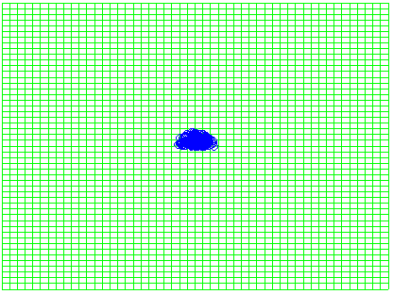
Cluster Decay and Diffusion
Random diffusion process:
spread increasing in time t
y →
cluster
x →
Random diffusion process should return to initial state. → Poincaré time.

Slide 49
“Evaporative” Decay of a Cluster
100-particle cluster configurations (100 ! intrinsic states): square of side length a = 10 bin widths in a volume of A²=2500 s.p. states.
How many collective cluster states?
ª
A
99-particle cluster/1 single particle configurations:
How many possible configurations?
There are many more cluster-1/1p states than full-cluster states.

Slide 50
Disintegration of Clusters
100 times more states if any particle can be emitted from the cluster:
In general, for n emitted particles,

Slide 51
Lost in Space
A cluster dissolves, particles diffuse into available states
From the simple to the complex. All transitions are individually reversible. However, it is unlikely that all particles move back exactly the same way they came. Probability for reversal is very small (but non-zero!), Poincare Recurrence Time:
t_{rec} ~ Ω (◊ ≡)
Ω increases

Slide 52

The Final Stage
Dissipation (of mass and energy) → proceeding through different types of configurations (cluster/p) states →Equilibration
Equilibrium: Always the same type of configuration (micro-state), an N-particle state with independent particles in random positions and (Boltzmann) velocities.
Dissipation process leads to a region of the largest state density (degeneracy), from where the system cannot escape. In time, the system passes through all possible microstates. There is no contra-diction to Newtonian deterministic.

Slide 53

Different Systems in Thermal Contact
Disequilibrium: Two systems, 1 and 2, with fixed individual particle numbers and energies, A₁+A₂=A, E₁+E₂=E, and numbers of states Ω₁(E₁) and Ω₂(E₂).
Let the combined system CS=1+2 be isolated, the total energy be fixed, E₁+E₂=E, but the partition E₁/E₂ variable through heat exchange between 1 and 2 (no particle exchange).
1
2
energy
position
How likely is any E₁/E₂, how does it evolve in time?
If all configurations are equally likely →
P(E,E₁)  Ω_{CS}(E₁,E₂)= Ω₁(E₁) · Ω₂(E₂) = Ω₁(E₁) · Ω₂(E−E₁)

Slide 54
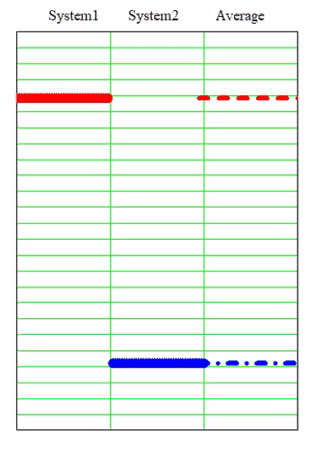
Energy Equilibration
Microscopic Populations
Discrete energy states of two interacting systems in contact.
Initial conditions
<E₁> ≈ E <E₂> ≈ 0
Random heat exchange allowed
Average energy
ε_{i} = E_{i}/A_{i}
thermalization ε_{i} → T_{i}=T
Sys1 Sys2
Thermal Contact

Slide 55
Probability Flow between Systems in Contact
1
2
1
2
time
energy
energy
Δq
position
position
Change in probability of E₁/E₂ by heat flow Δq?
ΔP(E,E₁)  Δ[Ω₁(E₁) · Ω₂(E₂)] = [ΔΩ₁(E₁)] · Ω₂(E₂)+ +Ω₁(E₁)· [ΔΩ₂(E₂)]
Let the total energy be fixed, E₁+E₂=E, but the partition E₁/E₂ variable through heat exchange between 1 and 2 (no particle exchange).

Slide 56
Thermal (Statistical) Equilibrium
Governing Principle
The system tends to become increasingly more complex. It searches out and occupies the region (configuration) with a maximum number of possibilities (microstates).
Probability P ~ Ω Number of states

Slide 57
Equilibration by Heat Exchange
Sys1 Sys2
For each heat exchange
Δq = -ΔE₁ = ΔE₂, there is a change
in overall probability:
ΔP(E,E₁)  ΔΩ_{CS} = Δ[Ω₁(E₁)·Ω₂(E₂)]
[ΔΩ₁(E₁)]·Ω₂(E₂)+Ω₁(E₁)·[ΔΩ₂(E₂)]
heat flow
E₁ E₂
Thermal Contact

Slide 58
Maximizing Opportunities (# of states)
P(E₁)
ΔP/ΔE₁=0
E₁

Slide 59
Maximum Probability
Expt: k=k_{B}

Slide 60
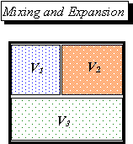
Entropy of Mixing
Gas type in V_{i} ; i = 1,2,3; all at same p, T.
V=V₁+ V₂+ V₃

Slide 61
Entropy of Mixing: Example
Q: One mole each of two gases, A and B, are in the respective halves of a separated container. When the partition is removed, the gases will mix. Calculate the entropy gain or loss in the mixing of the two gases.

Slide 62
Entropy of Mixing: Example
Q: One mole each of two gases, A and B, are in the respective halves of a separated container. When the partition is removed, the gases will mix. Calculate the entropy gain or loss in the mixing of the two gases.
A: There are n = 2 moles in total.
The mole fractions are n_{A} = n_{B} = 0.5.
Similarly, the probabilities are P_{A} = P_{B} = 0.5
The entropy of mixing is given by

Slide 63
Entropy of Mixing: Example
Q: One mole each of two gases, A and B, are in the respective halves of a separated container. When the partition is removed, the gases will mix. Calculate the entropy gain or loss in the mixing of the two gases.
A: There are n = 2 moles in total.
The mole fractions are n_{A}/n = n_{B} /n = 0.5.
Similarly, the probabilities are P_{A} = P_{B} = 0.5
The entropy of mixing is given by
Since entropy is gained, mixing occurs spontaneously.

Slide 64
Statistical Definition of Entropy

Slide 65

A Good Question
Q: The mixing of three gases considered in the previous example at p = 1 atm and T=298K yielded an entropy gain of ΔS_{mix} = 11.5kJ/K. How much heat will be generated?

Slide 66
A Good Question
Q: The mixing of three gases considered in the previous example at p = 1 atm and T=298K yielded an entropy gain of ΔS_{mix} = 11.5kJ/K. How much heat will be generated?
A: None. Because the mixing is irreversible, an entropy gain of ΔS_{mix} = 11.5kJ/K at T =298K here only means that q_{irrev}< TΔS_{mix}. Absence of heat, q_{irrev} =0, is compatible with the Second Law TD.

Slide 67
Ergodicity
Dynamical Equilibrium
Time average
1
2
3
4
1
2
3
4
5
6
7
8
q
j
9
17
Ensemble average (Average over all visited states)
Microstate Coordinate q_{i}
Number microstates successively

Slide 68
Canonical Ensemble
E = E₁ +E₂ = const. , T=const.
E₁ « E₂ ≈ E System 1 very small
_{CS} (E, E₁) = Ω₁(E₁) · Ω₂ (E - E₂)
P_{CS} (E, E₁) = P₁(E₁)
∝ Ω₁(E₁) · Ω₂ (E - E₁)
k ln Ω₂ (E - E₁) = S₂(E₂)
≈ S₂ (E) - E₁ (∂S₂/∂E₂)
≈ S₂ (E) - E₁/T

Slide 69
Grand Canonical Ensemble
E = E₁ +E₂ = const., N = N₁ +N₂ = const., T=const., System 1 very small. E₁« E, N₁« N
P₁ (E,N; E₁,N₁) =P₁(E₁,N₁) ∝ ∝ Ω₁(E₁,N₁)·Ω₂ (E-E₁, N-N₁)
k ln Ω₂ (E-E₁, N-N₁) = S₂ (E-E₁, N-N₁)

Slide 70
Statistics
Reputation o
Notes:
At these troubled times in the live of the nation, and all around the globe, people often hear the phrase “statistics” or “statistical” in the contexts of the pandemics, the economy, the climate change, partitions of the body politic, etc.
More often than usual, one can detect an attitude of suspicion or disbelief best described by a aphorism attributed to Disraeli., “There are 3 kinds of lies, lies, damn lies, and statistics.”

Slide 71
The Path to Equilibrium
Energy dissipation by transfer of heat, dissipation, convection,…
cold T₂ <T₁
Δq
hot plate T₁
Heat exchange as long as -ΔS₁ = -Δq₁/T₁ < ΔS₂ = Δq₂/T₂

Slide 72
Thermal Equilibrium
Energy dissipated evenly over entire system heat exchange back and forth, no net transfer, Δq = ΔU. sign (Δq) = sign (ΔU)
warm T₂ = T
Δq
warm plate: T₁ =T
For any system in equilibrium with others at temperature T:
ΔS/ΔU = 1/T regardless of substance and construction!

Slide 74
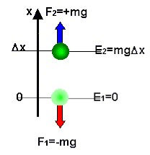
Mechanical Work & Energy: Weightlifting
Lifting a body of mass m against the gravitational force F₁ requires an equal force F₂ in the opposite direction.
Applying F₂ over an altitude change Δx increases the energy of the body (= system) by
If the work is done during time Δt, the mean power applied is
Measureable are only differences ΔE in energy E → energy-zero, E=0, is arbitrary.
The body gains, as internal energy, the difference in gravitational potential energies at different heights x. Body can do work w=mgΔx.

Slide 75
Numerical Example
Q: What is the potential energy (SI units) gained by a body of mass
m = 1 kg lifted vertically up from a table by a distance h = 1m ?
A: The force resisting the motion of the body is the gravitational force (downwards is the negative h direction)
To lift the body requires a force F upwards of the magnitude 9.81 N.
This force F = - F_{g} =+9.81 N, applied over the distance of 1m does
the work
Q: If this work is done within 1 second, what is the power P exerted?
A:
Q: If the body is then dropped from its 1-m height, what is its velocity hitting the table?

Slide 76
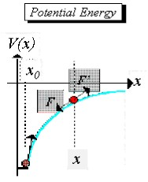
Work Against a Variable Force
Variable force F’(x), differential work:
Sum over (infinitely) many differentials
dw = F’(x)•dx = - F(x)•dx > 0
Total work and potential energy:
0
Negative gradient:

Slide 77
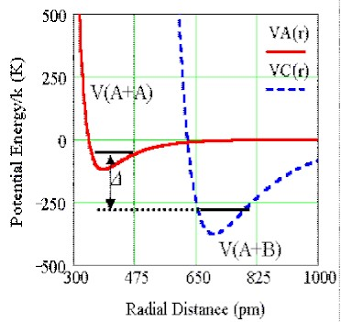
Work in Chemical/Nuclear Changes
Example: Covalent bonding
(Lennard-Jones potential)
Consider schematic reaction between one bound molecule A₂ and 2 unbound atoms B forming 2 bound molecules AB:
A₂+2B → 2AB + ΔH
Enthalpy ΔH < 0: energy released from the molecular system (2AB)
Since B are individual atoms and not bound together, V(B)=V_{B+B}=0.
Reaction takes place if
2V_{A+B} < V_{A+A} +2V_{B} = V_{A2}
Reaction is exo-thermic (final system is more strongly bound).
2 V(B)
H
2
2
=0
Rearrangement of individual constituents of ensemble of atoms and molecules is associated with changes in potential (bonding) energy.

Slide 78
Example: Bond Energetics in Combustion
0 kJ
H
O
O
O
O
Constituents in unbound (free) states
C
-75 kJ
CH₄
O
O
O
O
Useful energy function for isobaric gas phase reactions: Enthalpy H = U+p·V
-324kJ
CH₄
O₂
O
O
-573kJ
CH₄
O₂
O₂
Combustion Initial State Bond Energy
ΔH = q<0 Energy Release
-890kJ
H₂O
H₂O
CO₂
Combustion Final State Bond Energy

Slide 80
Potential Interacting Energies
Lennard-Jones Potential
Multi-Particle Systems (3D): N≫1
Lennard-Jones potential: Attractive (< 0) at intermediate & large distances, repulsive at small distances
depth range
Potential
Force

Slide 81
Collision Dynamics/Kinematics
Gas volume V filled homogeneously with A and B: ρ_{A}, ρ_{B}
d_{A}
d_{B}
Projectile, A
Target, B

Slide 82
Collision Dynamics/Kinematics
Gas volume V filled homogeneously with A and B: ρ_{A}, ρ_{B}
d_{A}
d_{B}
Projectile, A
Target, B

Slide 83
Collision Dynamics/Kinematics
Gas volume V filled homogeneously with A and B: ρ_{A}, ρ_{B}
d_{A}
d_{B}
Projectile, A
Target, B

Slide 84
Collision Dynamics/Kinematics
Gas volume V filled homogeneously with A and B: ρ_{A}, ρ_{B}
d_{A}
d_{B}
Projectile, A
Target, B

Slide 85
Random Maxwell-Boltzmann Velocity Distribution
Impact parameter
b=0
Head on
Particle velocities change differently through different collisions
→ random speeds, random directions
→ for all possible
Impact parameter
b>0
Glansing

Slide 86
Maxwell-Boltzmann Velocity Distribution
Impact parameter
before
b=0
Head on
after
Particle velocities change differently through different collisions
→ random speeds, random 3D directions
→ for all possible
Impact parameter
before
b>0
Glancing
after
We call
Boltzmann Factor

Slide 87
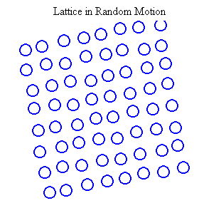
Thermal Motion in Solids (1)
Every system has thermal modes of motion, which move the individual constituents out of phase with each other, i.e., in an uncorrelated fashion, while the system as a whole may be at rest.
Thermal vibrations of the atoms in a lattice about their equilibrium positions.

