Slide 1
Agenda: Complex Processes in Nature and Laboratory
Order and Chaos, determinism and unpredictability
Non-linear dynamics in nature and their modeling
Examples (climate, planetary motion),
mathematical model (logistic map)
Stability criteria, stationary states
Complex kinetics in coupled chemical reactions Self-organization in coupled chemical reactions Application: Self-replication in autocatalytic reactions
Cellular automata and fractal structures
Thermodynamic states and their transformations
Collective and chaotic multi-dimensional systems
Energy types equilibration,
flow of heat and radiation

Slide 2
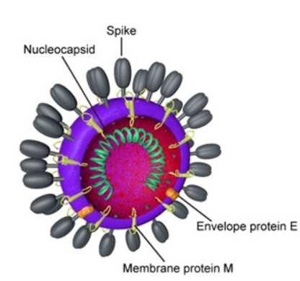
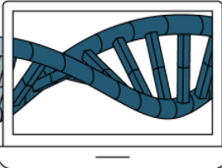
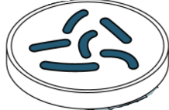
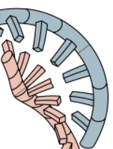
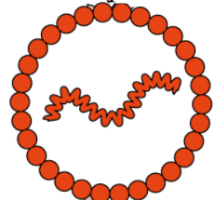
Application Vaccine Design
Computer DNA design
Spike
Genetic sequencing Covi-19 virus and mutants, identify specific sub-sequence
Synthetic DNA design for building instructions for Sars-CoV-2 spike protein = one part of virus shell, not a pathogen, but generates antibodies
Belouzard et al., 2012)
Insert synthetic DNA as a “template” into bacteria, mass breed bacteria → produce large mass of spike DNA by replication, harvest from bacteria
Insert into lipid nanoparticle, safe transfer into body
Separate DNA strands → use enzyme RNA polymerase to make mRNA

Slide 3
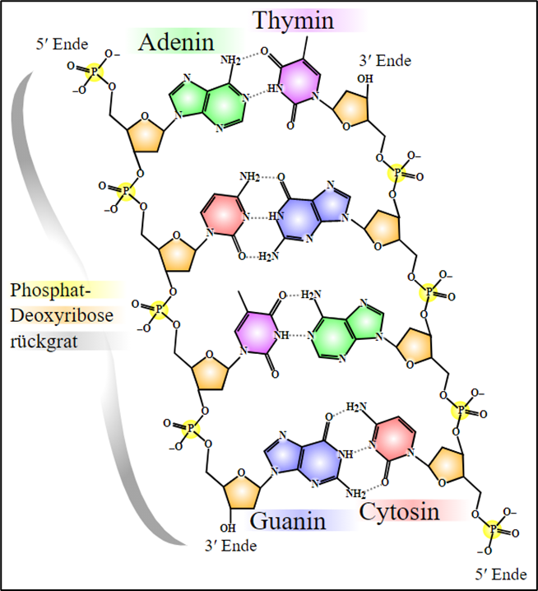
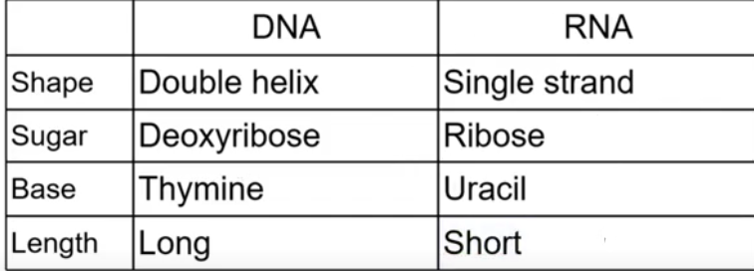
DNA/RNA Building Blocks
James Watson and Francis Crick (1951) structure of DNA: Genetic code = encrypted functionality and structure of biologic tissue matter.
DNA Structure
Excerpt genetic sequence
Main DNA components = Bases: adenine (A), cytosine (C), guanine (G), and thymine (T)
Bases can form pairs and link together → DNA double helix
Backbone

Slide 4
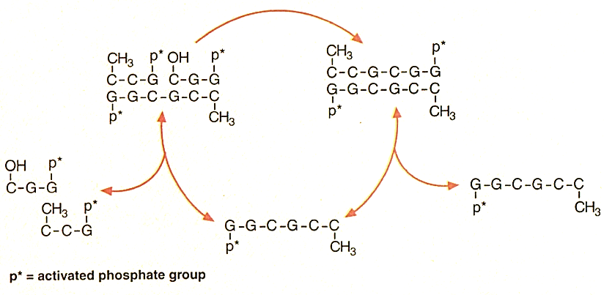
Complementary Base-Pairing
DNA template = palindromic (left-right self-complementary)
Nucleotide Building Blocks
Template Copy
Original Template
Recycling
Use 2 nucleotide trimers to align and pair with hexa-DNA template, bind the two trimers → bound hexamer on template → Recover original template plus one copy.

Slide 5
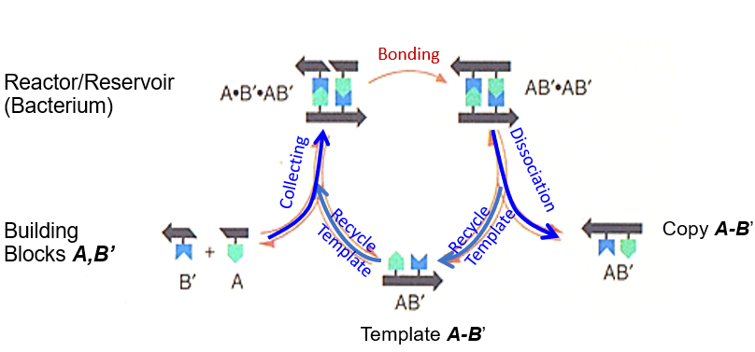
Autocatalytic Self-Replication
Autocatalytic self-replication with template: Cycle combines available separate building blocks A, B’ on template, dissociates template from copy,
Re-cycles template
Template Copy A-B’
Each cycle makes another template copy → exponential growth in numbers, inhibits other competing processes.

Slide 6
Mathematics of Self-Replication
Represent replication structure by set of rules:
Simples case rule → function G,
“Parent” = Object x = x₀ starting point of a series
Descendant (“child”) x₁ = G(x₀) = copy of x₀,
possible transformation (scaling, translation, …) → Self-Similar Structures
x_{n} = G(x_{n-1}) = G[G(x_{n-2})] = G{G[G(x_{n-3})]} = G ^{n}(x₀) → Map
Sierpinski Gasket
Fractal structures
See tutorial
Generation x₀ x₁ =G(x₀) G(x₁)

Slide 7
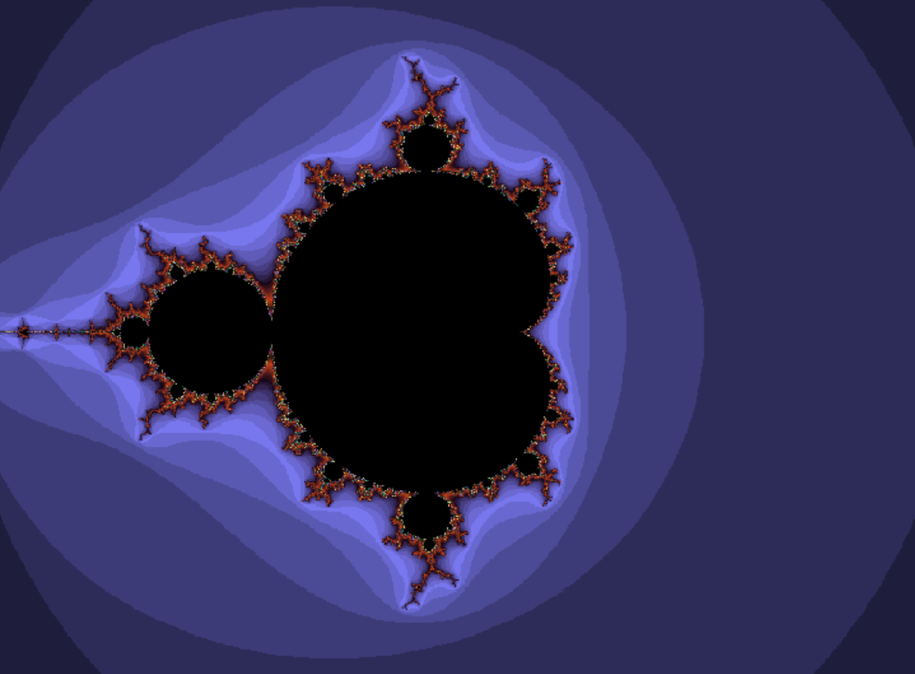
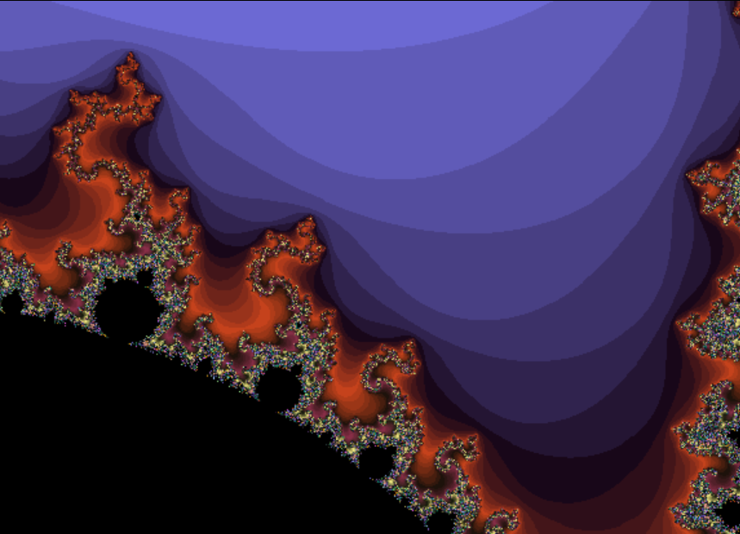
Fractal Mandelbrot Set

Slide 8
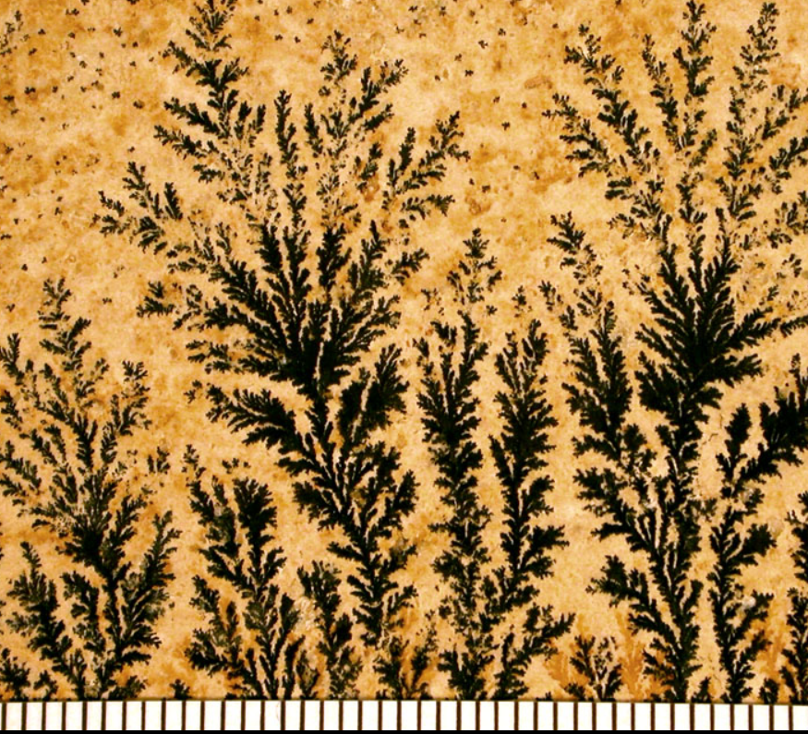
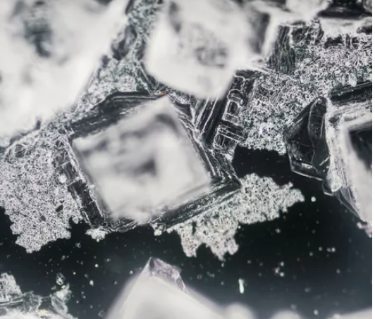
Simple Rules Govern Complexity
..in processes and structures to which they lead
self-organizing, orderly behavior,
co-operative phenomena
global fractal structures,
In the limit: complete disorder/chaos
Examples:
Behavior of gas and liquids, diffusion, convection
Crystallization
Turbulence in fluids
biological life (stem cells), ageing
Forest fire propagation
The flow of electricity in a power grid
Urban development.
.
.
Manganese dendrites on limestone
Precipitate from saturated solution

Slide 9
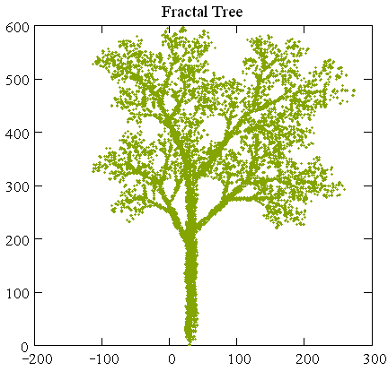
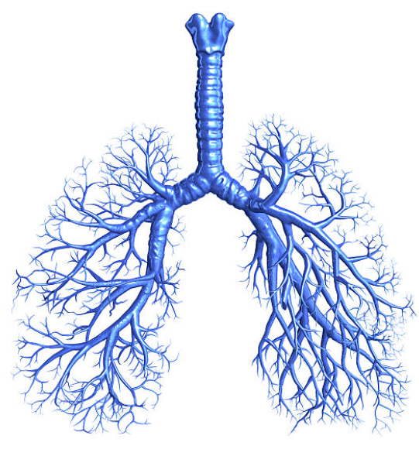
Bronchial Tree

Slide 10
Agenda: Complex Processes in Nature and Laboratory
Order and Chaos, determinism and unpredictability
Non-linear dynamics in nature and their modeling
Examples (climate, planetary motion),
mathematical model (logistic map)
Stability criteria, stationary states
Complex kinetics in coupled chemical reactions Self-organization in coupled chemical reactions Application: Self-replication in autocatalytic reactions
Cellular automata and fractal structures
Thermodynamic states and their transformations
Collective and chaotic multi-dimensional systems
Energy types equilibration,
flow of heat and radiation

Slide 11
Simple Rules Govern Network Complexity
Migration pattern in NE USA

Slide 12
CA Concept
The configuration (state) space of a system is approximated by an n-dimensional lattice of equal cells.
Each cell has a finite number of discrete properties.
Time evolution of CA system occurs (can be modeled) in discrete time steps → generations.
Evolution occurs to (a set of) strict deterministic rules.
Evolution rules reference exclusively states of neighboring cells,
reflect local environment.
Time
t_{i-1}
1D Cellular Automaton
….
….
p_{i-1}
p_{i-1}
q_{i-1}
r_{i-1}
p_{i-1}
….
….
t_{i}
p_{i-1}
p_{i-1}
q_{i}
r_{i-1}
p_{i-1}

Slide 13
Classification of Propagation Rules
p_{i-1}
Occupied, alive
p_{i-1}
Not occupied, dead
Byte
i-1
i-1
i-1
i-1
i
i
i
i
i-1
i-1
i-1
i-1
i
i
i
i
i-1
i-1
i-1
i-1
i
i
i
i
i-1
i-1
i-1
i-1
i
i
i
i

Slide 14
Classification of Propagation Rules
p_{i-1}
Occupied, alive
p_{i-1}
Not occupied, dead
Byte
Consolidate: Any of the patterns could result in the future middle cell to be alive or dead
i-1
i-1
i-1
i-1
i
?
i
?
i
?
i
?
i-1
i-1
i-1
i-1
i
?
i
?
i
?
i
?

Slide 15
Classification of Propagation Rules
p_{i-1}
Occupied, alive
p_{i-1}
Not occupied, dead
Byte
Rearrange byte pattern in ascending order: bytes ordered in binary sequence
Condition of survival of a cell depends on the states of its own past and that of its two neighbors’ past → depends on the past state of a triplet of 3 cells (=byte).
7
6
5
4
3
2
1
0
?
?
?
?
?
?
?
?
There are 8 possible occupation schemes (0, 1, 2, 3, 4, 5, 6, 7) for a byte.
Any one of them, and any logically valid combination, could produce an alive (= 1) cell or a dead (= 0) cell.
There are obviously 256 (0-255) possible constructions of combination rules (represented by the set of all numbers 0,….,255).

Slide 16
Classification of Propagation Rules
1
Occupied, alive
0
Not occupied, dead
Byte
Rearrange byte pattern in ascending order: bytes ordered in binary sequence
Condition of survival of a cell depends on the states of its own past and that of its two neighbors’ past → depends on the past state of a triplet of 3 cells (=byte).
7
6
5
4
3
2
1
0
p
q
r
i-1
Code
#₂
0
0
0
1
0
0
1
0
i
Implies live for the cell in the next time step, if it the cell was previously unoccupied and had only one alive neighbor on the left or on one on the right, but not on both sides.

Slide 17
Interpretation of Propagation Rules
CA code # = 10100₂ = (2⁴+2²) = 20₁₀
p_{i} q_{i} r_{i}
Decimal
2⁷ 2⁶ 2⁵ 2⁴ 2³ 2² 2¹ 2⁰
if (p_{i}) is occupied and (q_{i}) is not and (r_{i}) is not
if (q_{i}) is occupied and (p_{i}) is not and (r_{i}) is not
In the next time step, center cell (q_{i+1}) is populated
Formal logic

Slide 18
Constructing the Propagation: CA 20
CA code # = 10100₂ = (2⁴+2²) = 20₁₀
p_{i} q_{i} r_{i}
Procedure
Draw grid x (k) vs. time (i)
Load initial conditions, pattern x_{k}(i=0)
Derive pattern x_{k}(i=1) from population of triplet {x_{k-1}, x_{k}, x_{k+1},} at (i=0)
Next row i……
For self-replication, keep history
Just one initial cell
i=0
 |  |  |  | x_{k}
 |  |  |  |  | ? | ? | ?
 |  |  |  |  |  | q₃
i=1
time step
i=7
coordinate step

Slide 19
Constructing the Propagation: CA 20
CA code # = 10100₂ = (2⁴+2²) = 20₁₀
p_{i} q_{i} r_{i}
Procedure
Draw grid x (k) vs. time (i)
Load initial conditions, pattern x_{k}(i=0)
Derive pattern x_{k}(i=1) from population of triplet {x_{k-1}, x_{k}, x_{k+1},} at (i=0)
Next row i……
For self-replication, keep history
i=0
 |  |  |  | x_{k}
i=1
time step
i=7
coordinate step

Slide 20
Constructing the Propagation: CA 20
CA code # = 10100₂ = (2⁴+2²) = 20₁₀
p_{i} q_{i} r_{i}
Procedure
Draw grid x (k) vs. time (i)
Load initial conditions, pattern x_{k}(i=0)
Derive pattern x_{k}(i=1) from population of triplet {x_{k-1}, x_{k}, x_{k+1},} at (i=0)
Next row i……
For self-replication, keep history
i=0
 |  |  |  | x_{k}
i=1
time step
i=7
coordinate step

Slide 21
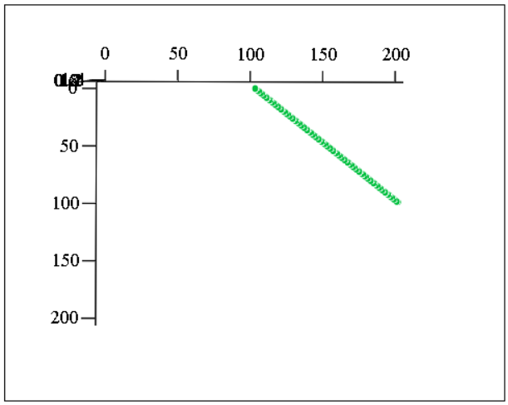
Coding CA#20

Slide 22
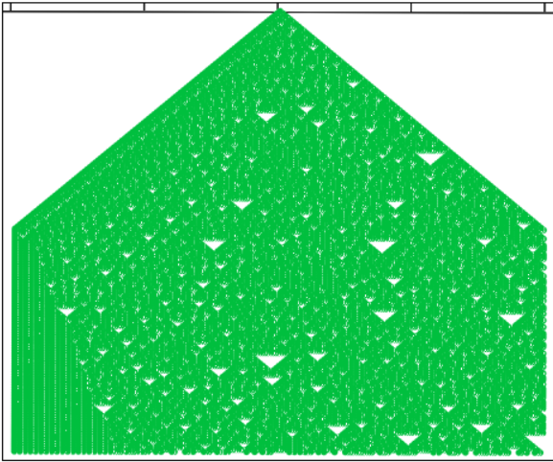
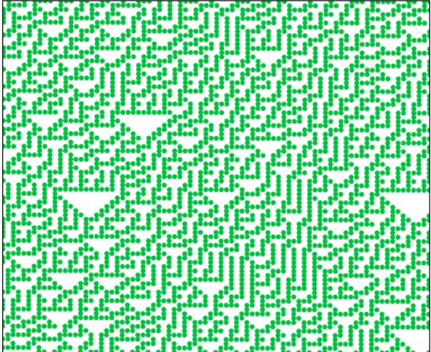
Coding CA#30
CA #30, with one more condition. More complex pattern. Repetitive fine structure is observed at the rim of the triangle and upon blowup.

Slide 23
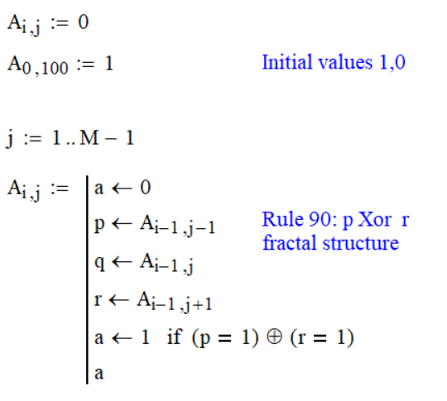
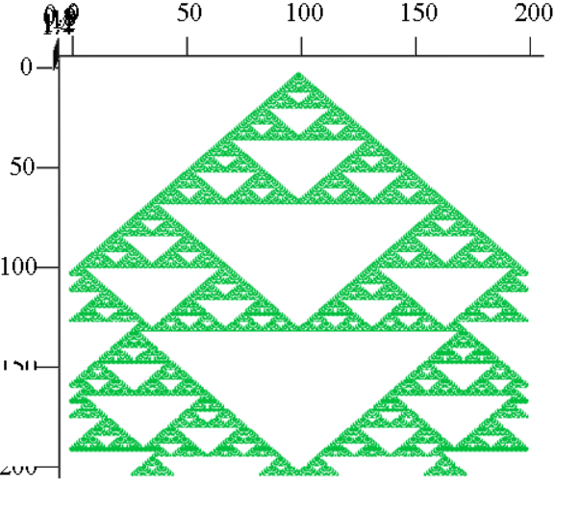
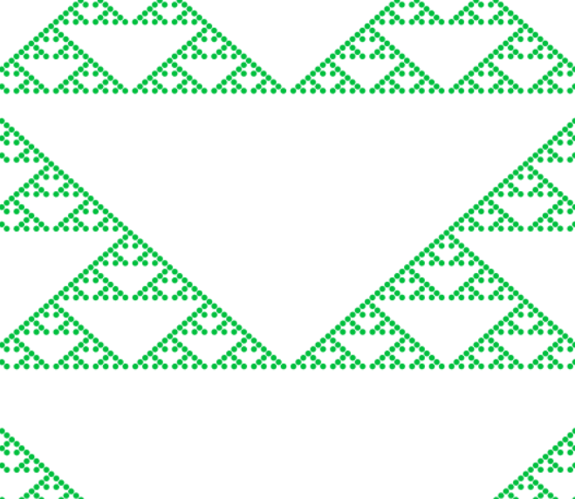
Coding CA#90 Specific IC
CA #90, expected to show similar randomness as automaton #30. However, there is a highly repetitive pattern of nested triangles. Blow-up: persists at several length scales (fractal).

Slide 24
Coding CA#90 Specific IC
CA #90, with 3 initial cells populated. Fractal structure is modified but persists.

Slide 25
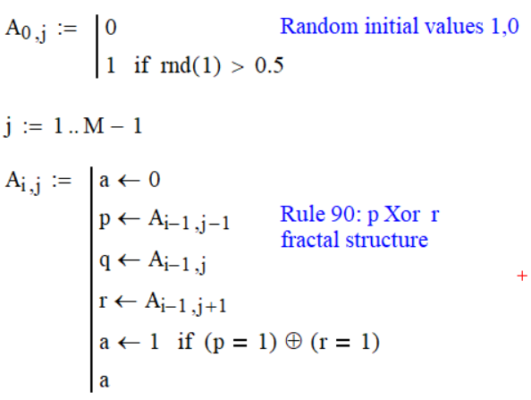
Coding CA#90 Random IC
CA #90, with random population of
50% of initial cells. Specific fractal structure is washed
out, additional pattern appears on
larger length scale.
Approximates Random chaos

Slide 26
Summary
CA research: 4 classes of automata,
Class 1 reaches a homogeneous state (all cells free) after a few initial steps.
Class 2 shows a periodic pattern after the first few steps, relatively independent of initial conditions.
Class 3 develops into a chaotic pattern, independent of initial conditions.
Class 4 produces a highly complex, nested fractal pattern.
Very specific, simple, localized microscopic interactions of coupled systems can lead to highly organized structure.
Pronounced fractal structure emerges from localized initial conditions (seeds).
Spread-out initial state conditions lead to washed out structures or chaos.
Because of their specific (unusual) geometrical shape (surface/volume), Class-4 CAs have functionality important for live, biomed and general technology.
Fractal dimensions

